Slide 1





GQuEST & Single Photon Detection
Alex Ramirez
Caltech Graduate Student in Physics
JPL SNSPD Meeting
March 27th, 2024
Notes:
I will briefly be reintroducing some of the previous points regarding our motivation for photon counting, but the bulk of this talk will be on the photon counting and detectors themselves.

Slide 2

Agenda
Brief introduction to GQuEST
Why SNSPD’s, and what are they?
SNSPD innovations and integrations in GQuEST
Status of SNSPDs for GQuEST at Caltech
Preliminary photon counting with avalanche photodiodes
3/27/2024
Notes:
rehash why GQuEST will be utilizing a photon counting
how it aims to speed up our detection progress
why SNSPD’s are the preferred method for photon counting,
what they are exactly
how the SNSPD’s have been improved
how they will be integrated into the GQuEST experiment.
Some testing has been done on the GQuEST SNSPD,
Finally, avalanche photodiodes will be used in place of SNSPD’s during the initial build phases

Slide 3

GQuEST: Gravity from the Quantum Entanglement of Space-Time
Goal: Measure geontropic quantum space-time fluctuations
  We assume gravity is both Geometry and Quantum Mechanical
  Therefore quantum fluctuations should occur that can be measured as length fluctuations
Distance measurements should exhibit length fluctuations
  𝛿L ≈ 10⁻²¹ m @ 10 MHz (for 5 meter interferometer)
Fluctuations are associated with quantum degrees of freedom counted by entanglement entropy
When a photon propagates in a metric that exhibits these fluctuations, it accumulates a change of phase compared to the case without fluctuations
Notes:
LIGO sensitive to 10⁻²⁰ m @ 100 Hz
Geontropic quantum space-time fluctuations
Rindler/Killing horizon

Slide 4
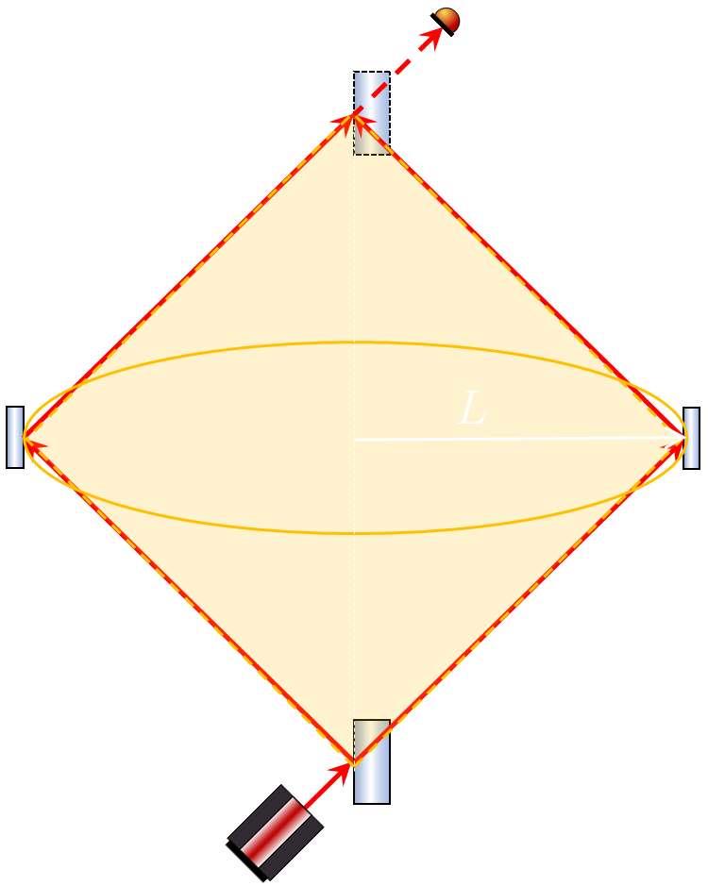

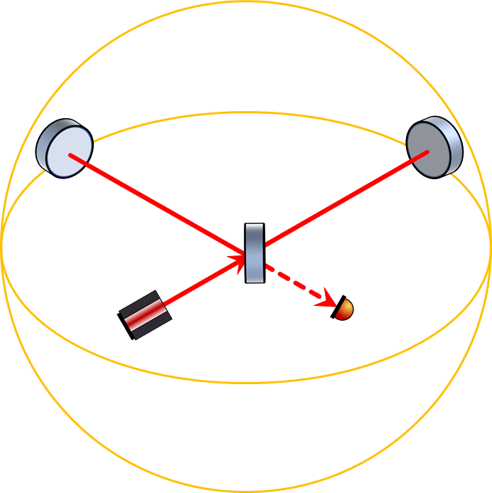
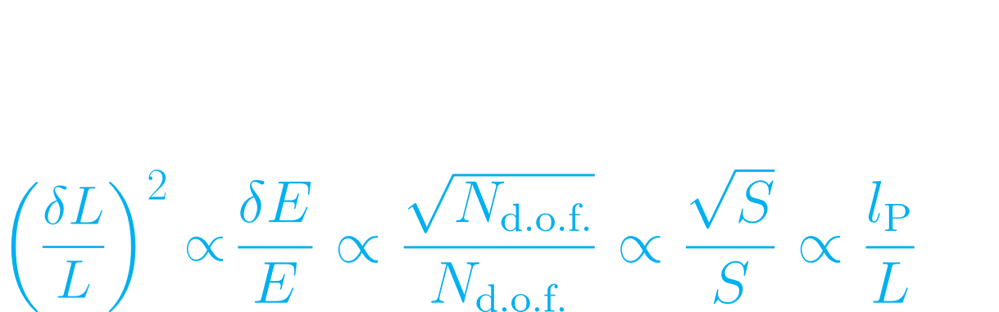




Heuristics of Holographic Quantum Gravity
Assume covariant entropy bound is saturated
Zurek-Verlinde Effect⁽¹⁾
δL
Erik P. Verlinde, Kathryn M. Zurek, Observational signatures of quantum gravity in interferometers, Physics Letters B, Volume 822, (2021)
Notes:
We see our relation of Entropy to the change of length over the plank length on right side
We then take that relation and can relate the length fluctuations and change in entropy with quantum microstates
As we know the number of microstates within a quantum mechanical system must scale with the degrees of freedom
This effect can then be loosely related with the way we measure gravitational waves such as in LIGO
We can say that the strain a gravitational wave produces is proportional to the energy it produces
Finally, we may then relate the way we measure these gravitational waves to the physical attributes of our interferometer
(In newtonian gravity - inverse square law, if you equate that get something like this proportionality)
We see that the length change squared in an arm of the interferometer is then proportional to the overall length of the detector
This is all described in detail within some of the papers by Kathryn Zurek and Eric Verlinde, as they coined this effect of being able
To measure length fluctuations with an interferometer as the Zurek-Verlinde Effect
Zurek -verlinde effect - holographic fluctuations that produce measurable length fluctuations that can be seen within an interferometer
Apply the covariant entropy bound to flat spacetime
Assume it is saturated for the rindler horizon (yellow surface traced by light in interferometer arms)
Right to left
Covariant entropy bound - white top equation scaling relation, entropy is proportional to length /plank
1/sqrt S for this proportionality
Number of degrees of freedom - microstates scale with degrees of freedom
Number of
Gravity part - strain a wave produces is proportional to the energy it produces
In newtonian gravity - inverse square law, if you equate that get something like this proportionality
S is entropy inside horizon
A_{H} is area of casual diamond
L_{p} is planck length
Covariant entropy bound: Saturated for black holes (Generalised 2nd law of T.D.)

Slide 5

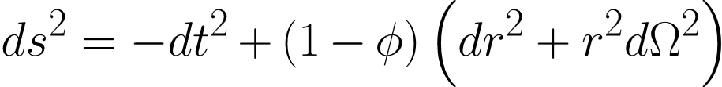
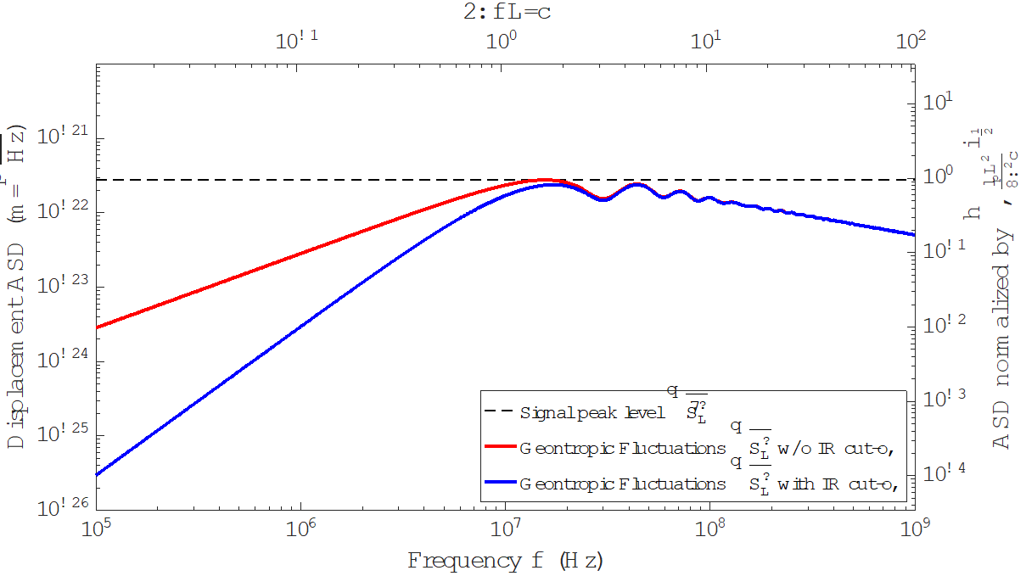
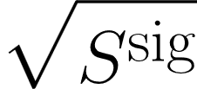
Space-time fluctuations: Pixellon Model
Associate a stochastic scalar field to holographic degrees of freedom
The field gravitates, perturbing the metric
IFO signal spectrum:
Notes:
Signal spectrum must be integrated the path of the light along the interferometer arms in this perturbed metric
Ds² is space time interval, if phi is 0 we get L, if phi is none sero we get del + delta L
Two slight variations of pixelon model, two ways to give the modes of phi
For one, kathryn has said some of these modes they should be cutoff at IR (long wavelengths)
Low freq behavior that the IR cutoff provides…
Both have a peak at the same area near our detection level

Slide 6
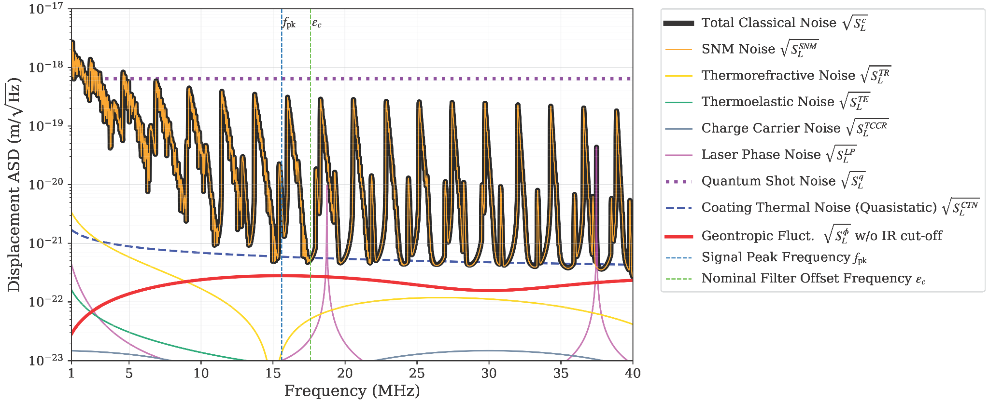
GQuEST Noise Budget

Slide 7
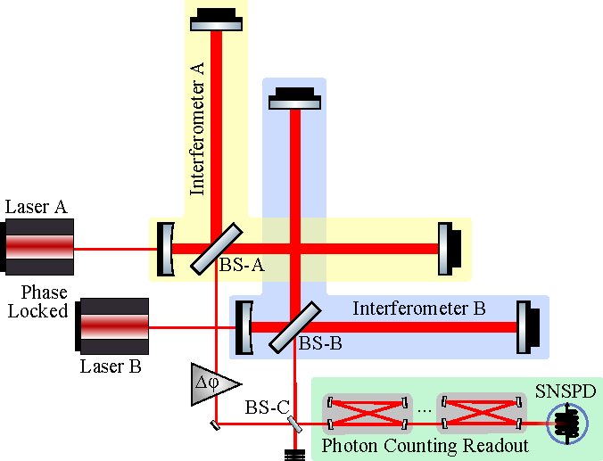
GQuEST Goals for Detecting Quantum Gravity
Searching for a signal on the order of (10⁻²² m/√Hz)²
Sensitive at ∼15 MHz
Surpass SQL with integrated single photon detection (6・10⁻¹⁹ m/√Hz)²
Cross correlate two interferometers
QuRIOS 3/22/2024
Notes:
GQuEST is a highly sensitive interferometer
capable of searching for signals at roughly 15 MHz on the order of 3 * 10 -22 m/sqrt hz
To achieve this we must “surpass” the SQL by using integration statistics from pc
GQuEST will cross correlate two interferometers to create a coherent signal
To discern from dominant incoherent classical noise
this can all be done using standard homodyne fringe readout,
But let’s take a closer look at why photon counting makes more sense
Dark counts thought to be: thermally activated single-vortex crossing events
Thus thermal radiation from external sources such as stray electrons or

Slide 8
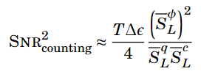


Benefits of Homodyne Fringe Readout vs Photon Counting
Homodyne Fringe Readout
Measure of time-dependence (phase/freq)
Quantum Shot noise (3・10⁻¹⁹ m/√Hz)²
SNR²=9 or σ = 3 significance for ɑ = 1
  2 months per single detection
Photon Counting Readout
Measure of the power in the optical sidebands
Classical Noise limited (3・10⁻²¹ m/√Hz)²
SNR²=9 or σ = 3 significance for ɑ = 1
  28 hours per single detection
QuRIOS 3/22/2024
Notes:
Alpha is overall scaling parameter - free parameter of strength of signal, occupation number of pixelon modes
Lets compare the two methods now
time dependent measure of the phase and frequency of our signal (Sanders talk)
limited by quantum shot noise, on the order of 10⁻¹⁹ and our signal 10⁻²²
SNR reading with at least 3 sigma significance for alpha =1, 2 months
SNR is a function of the square of our signal divided by the square of our quantum shot noise
measuring the power spectral density, removing arbitrary information from utilizing a homodyne readout (sander)
limited by classical noise, (spoken in detail by daniel) primarily fluctuations and perturbations of the arm lengths of the interferometer
Since we are now just counting photons
We win from the fast readout of an SNSPD
this method would allow for a 3 sigma detection to be made in nearly 1 day
Neglecting the dark count rate of the SNSPDs (will cover later) the SNR can then be calculated as shown
we see that we lose the squared terms of the quantum and classical noises, increasing our ability to recover the SNR faster.
Lets now briefly compare the two methodologies for reading out a signal from GQuEST.
First we have homodyne fringe readout, which would be a time dependent measure of the phase and frequency of our signal (as described earlier in Sanders talk)
This method would be limited by quantum shot noise, as seen on my previous slide, where the shot noise is on the order of 10⁻¹⁹ and our signal 10⁻²². Lastly, to achieve an intermediary SNR reading with at least 3 sigma significance for alpha =1, we would require continual detection for at least 2 months. As seen in our equation below, the SNR is a function of the square of our signal divided by the square of our quantum shot noise.
With photon counting on the other hand, we are measuring strictly the power spectral density, removing the arbitrary information received from utilizing a homodyne readout scheme (again further explained previously in Sanders talk). In this methodology, we are then limited by classical noise, aka fluctuations and perturbations of the arm lengths of the interferometer, which are on the order of 10⁻²¹. Given the fast readout of an SNSPD, this method would allow for a 3 sigma detection to be made in nearly 1 day. Neglecting the dark count rate of the SNSPDs (which we will cover later on) the SNR can then be calculated as shown where, again, we see that we lose the squared terms of the quantum and classical noises, increasing our ability to recover the SNR faster.
Notably, this classical noise level is expected to be above the signal level, which implies a nonzero background photon count rate. Therefore, the sensitivity of the experiment will be limited both by the low flux of signal photons and by the variance of the flux of photons from thermal noise. The statistical impact and experimental remedy are described below.
Geontropic fluct. scale parameter α

Slide 9

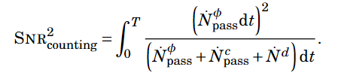
Motivation for Photon Counting with SNSPD’s
SNSPD’s offer a high speed and low noise approach to measuring photons
Photon counting “avoids” quantum shot noise (but not classical noise)
QuRIOS 3/22/2024
Notes:
As mentioned, SNSPD’s offer a very fast and low noise approach to reading out photons from GQuEST
Again this method inherently avoids quantum show noise of homodyne readout
Still at fault to classical noise and the dark counts we may expect to see on the snspd (we will cover this a bit later)
We may again model the SNR from the photon counting using this equation here, where we integrate over time (27 ish hours)
We then take into account the flux of the signal photons, which we expect to appear at a rate of
The filtered classical noise
And i will soon convince you that our setup for QQuEST will have a dark count rate lower than the signal and classical noise
Overall, SNSPD’s will offer the best speed and lowest noise readout for counting the photons from GQuEST and allows us to evade the SQL.
Seen here, we may also calculate the the SNR of the photon counting method as a function of the flux of photons from the signal, classical noise and the dark count rate. Thus our SNSPD’s will need to achieve a rate lower than that of the signal and noise, which i will show later to be 10⁻⁴
At the signal peak frequency, the classical noises will be lower than the quantum noise
Signal 10-3, we need 10-4 for detectors…
Some of the classical noise can be just dark counts (make this point)
Dark count rate from classical noise is 1e-2 hz so we need to be better than this with our detectors!
How rare signal or classical noise would be
Better background (count rate from signal)(signal is 1e-3) hz
(add from table)
For GQuEST want to exhibit at high SNR (9) which would correspond to a
Ask for alpha explanation

Slide 10
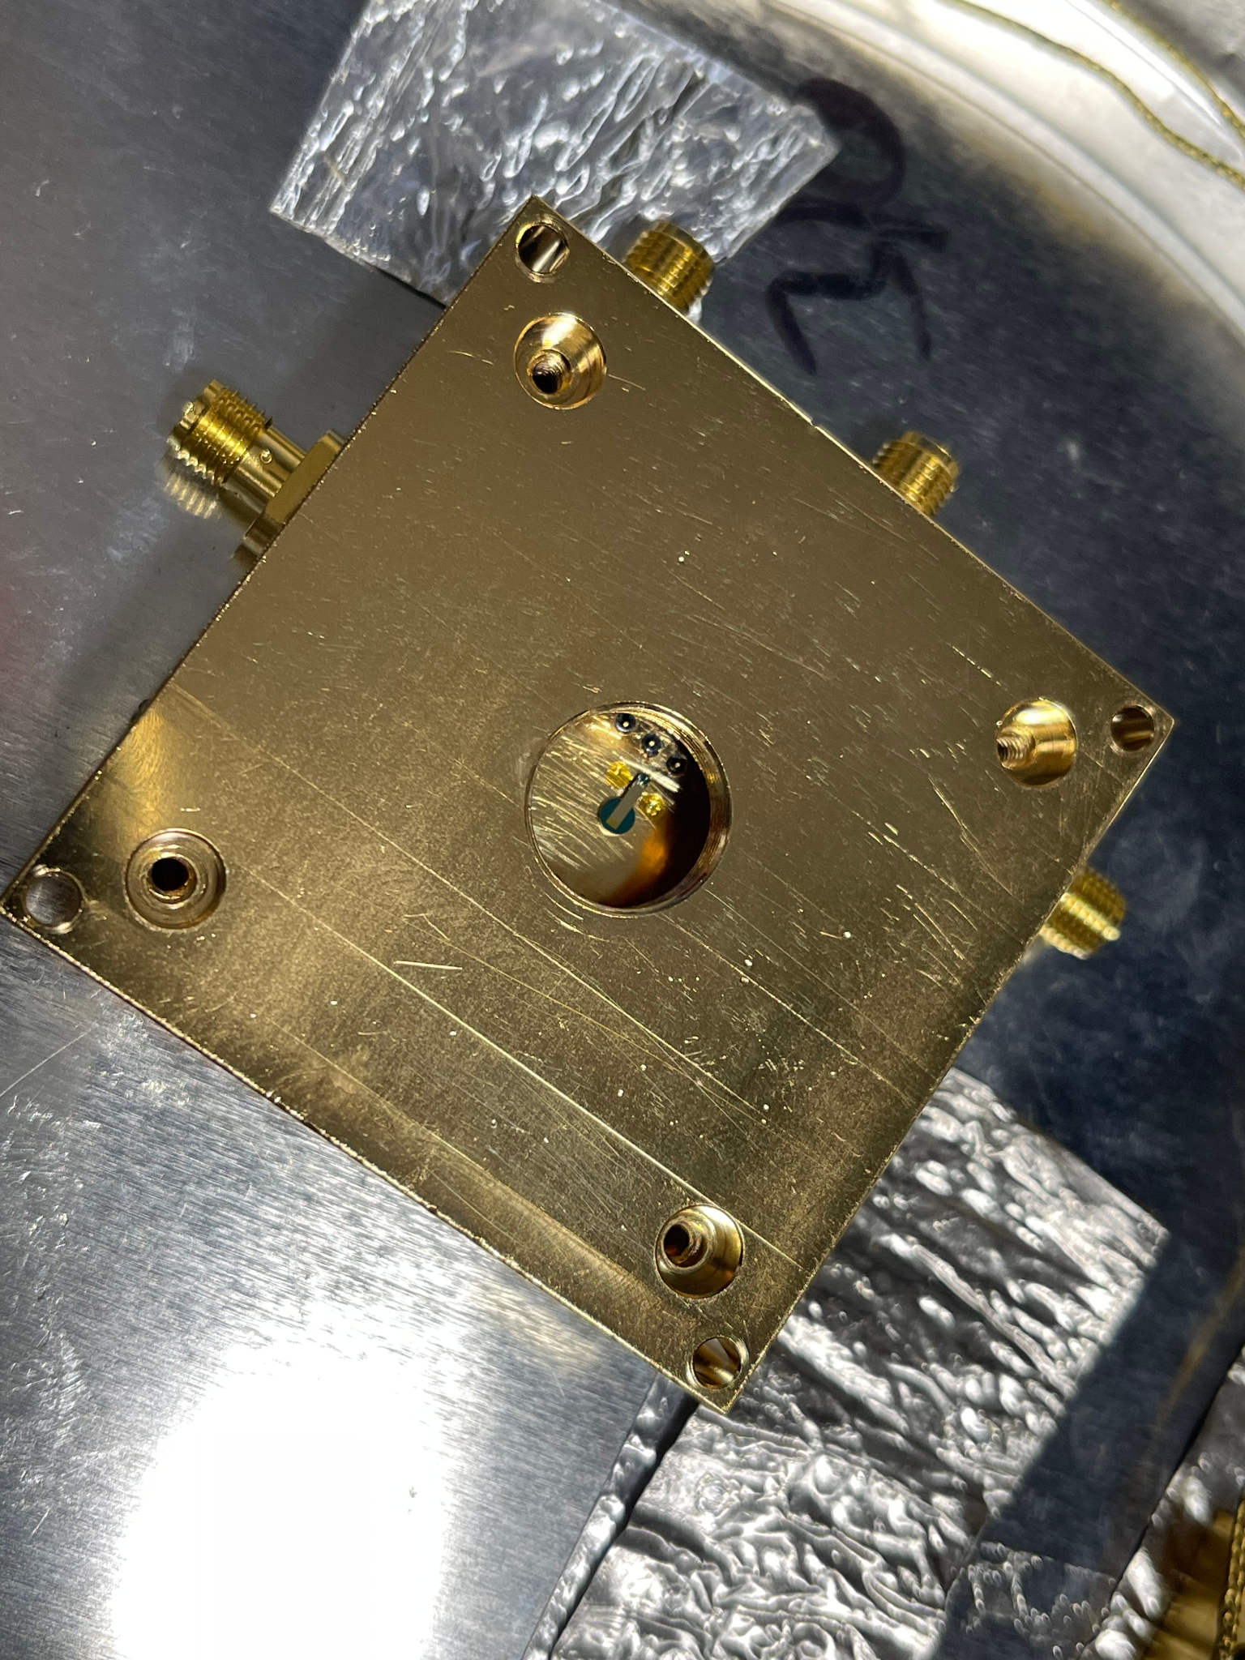
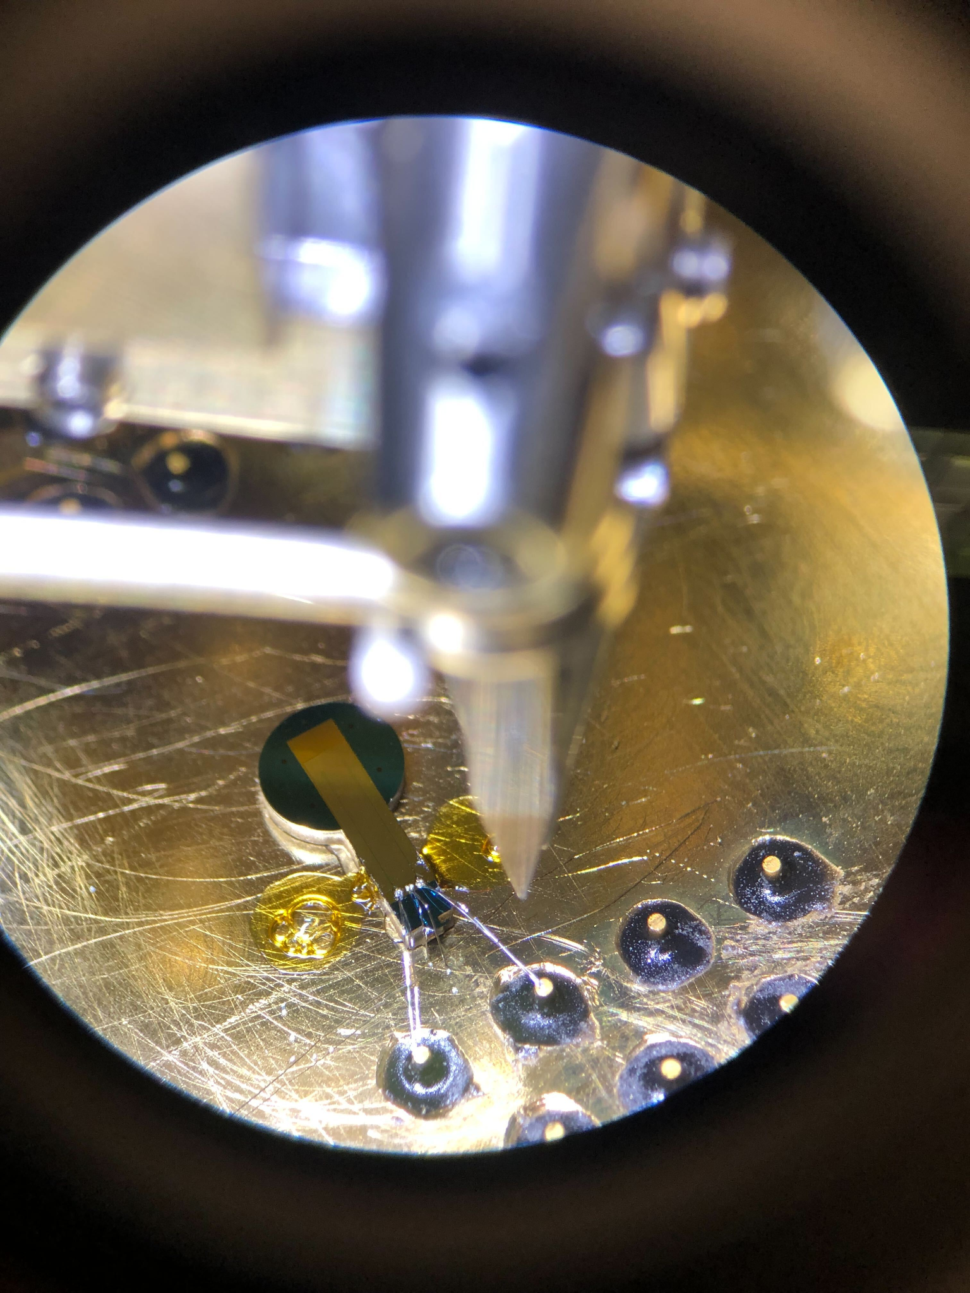
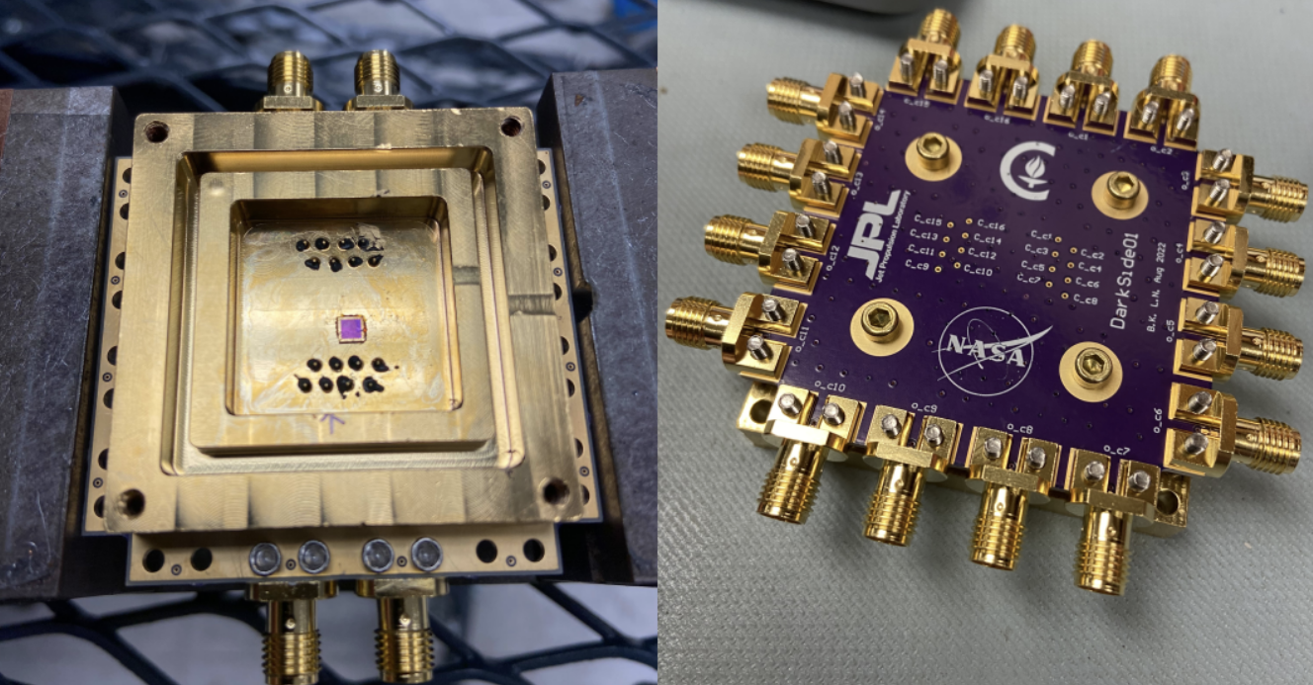
SNSPD Specs for GQuEST
Specialized for 1550 nm
Efficiency up to 83% ± 4.3% ⁽¹⁾
  Efficiency Record 98% ⁽²⁾
Temporal Resolution: 13 ± 1 ps ⁽¹⁾
Fast readout (10 ns / pulse)
  10⁷ photons / second / pixel
  Record 1.5 giga-counts/s ⁽³⁾
Marco Colangelo et al., “Impedance-Matched Differential Superconducting Nanowire Detectors”, Phys. Rev. Applied 19 (2023)
Dileep V. Reddy et. al, “Superconducting nanowire single-photon detectors with 98% system detection efficiency at 1550 nm”, Optica Vol. 7, Issue 12, pp. 1649-1653 (2020)
Ioana Craiciu et al. “High-speed detection of 1550 nm single photons with superconducting nanowire detectors”, Optica Vol. 10, Issue 2, pp. 183-190 (2023)
QuRIOS 3/22/2024
Notes:
Some specifications and records that have been achieved using SNSPDs at 1550 nm can be seen here.
It should be noted that the SNSPD we plan to use for GQuEST has been optimized for achieving high count rates with adequately high efficiencies. (most of these records are on highly specialized SNSPDs in which you have tradeoffs between the different characteristics).

Slide 11
GQuEST SNSPD Hardware Requirements
High efficiency at 1550 nm
Dark count rate of at least 10⁻⁴
Free space optics and bias electronics held at 4 K
Fully differential readout electronics
Long duty cycle for cryostat (order of 1 day)
Single mode fiber connection between cryogenic filter cavity and SNSPD
QuRIOS 3/22/2024
Notes:
Here we have listed a few of the hardware requirements for utilizng our SNSPD’s within GQuEST, most of which we will soon discuss in the next following slides.
Dark counts thought to be: thermally activated single-vortex crossing events
Thus thermal radiation from external sources such as stray electrons or

Slide 12
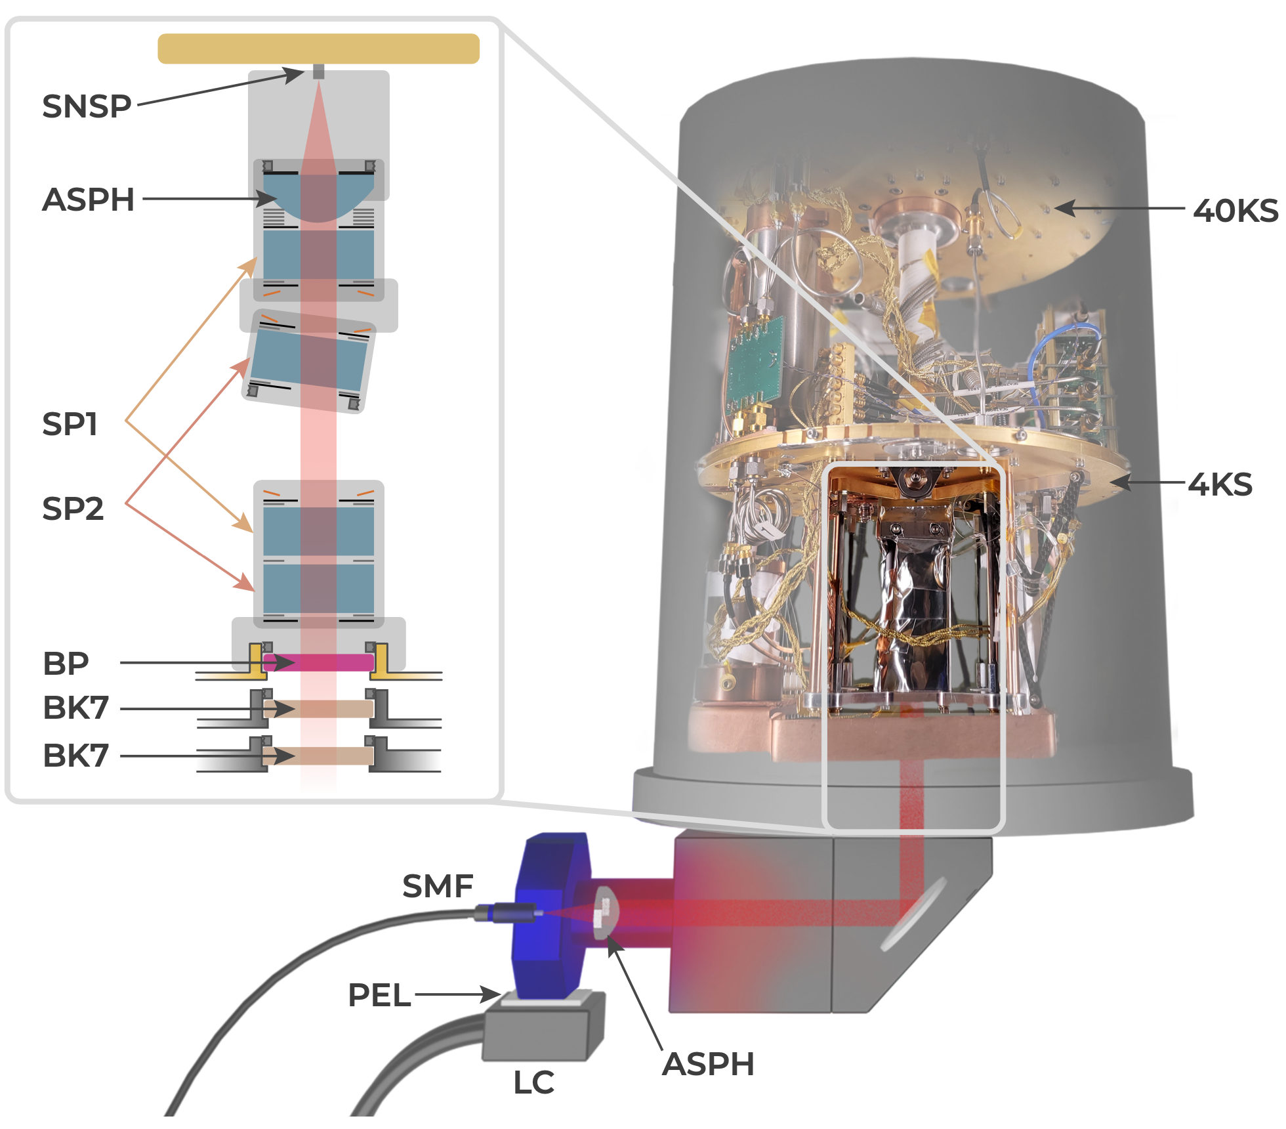
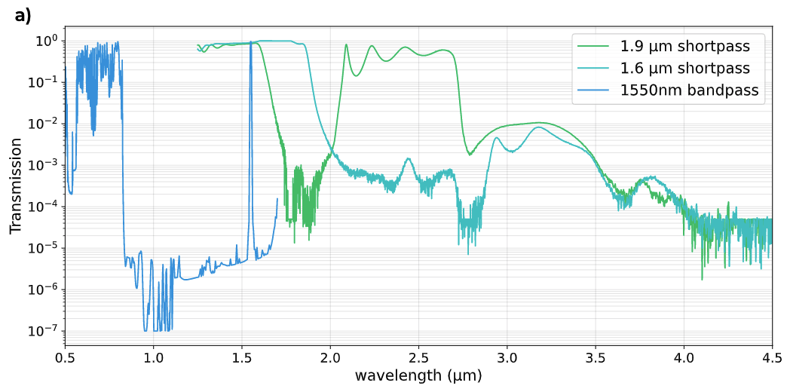
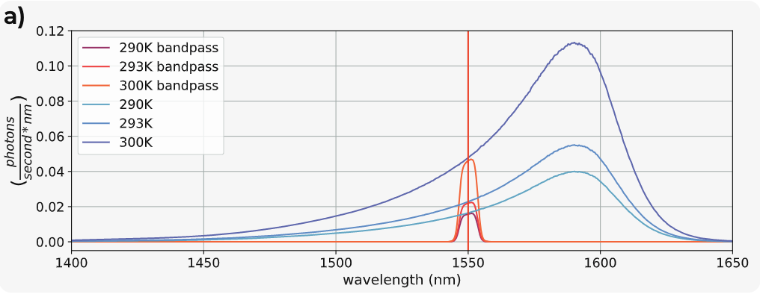
Free-space coupled SNSPD to room temperature
10⁻² DCR
Fiber and free space quantum comm
Remaining black body photons
Cooling external optics
QuRIOS 3/22/2024
Modified PhotonSpot Inc. Cryostat
Mueller, Korzh et al, Optica 8, 1586 (2021)
Notes:
SNSPD setup for the GQuEST predecessor.
created at Caltech by Andrew Muller and Boris Korzh.
Light is collimated from the incoming fiber before passing through the various filters and then being focused onto the SNSPD
We have 2 shortpass filters at 1.9 um and 1.6 um as well as a 1550 nm bandpass filter
These can be seen in our transmission plot on the right in which we get a very narrow transmission line of light reaching the SNSPD.
Now as we decrease the temperature that the filters are held at
see a sharp decrease in frequency range black body photons are passed at
an increase in the photons passed at 1550 nm
Achieved 10⁻² dcr with this! But that is slightly larger than the signal we expect to see at GQuEST… (next)
You may then see the reduction of high frequency noise when ensuring that these filters are cooled.
This model has been shown to be able to achieve a dark count rate of 10⁻²
Current record of whats been achieved in the Lab here at caltech, we are working to combine dark count rate and efficiency together (this case fiber is at room temp) best we can do in that scenario
Discuss what work that hadn’t been done yet… 10e-3, havent been done on these devices and dark tests.. Etc.
As dark as possible to connect to fibers etc. and thermal background, stays good enough, building out toward instrument..

Slide 13
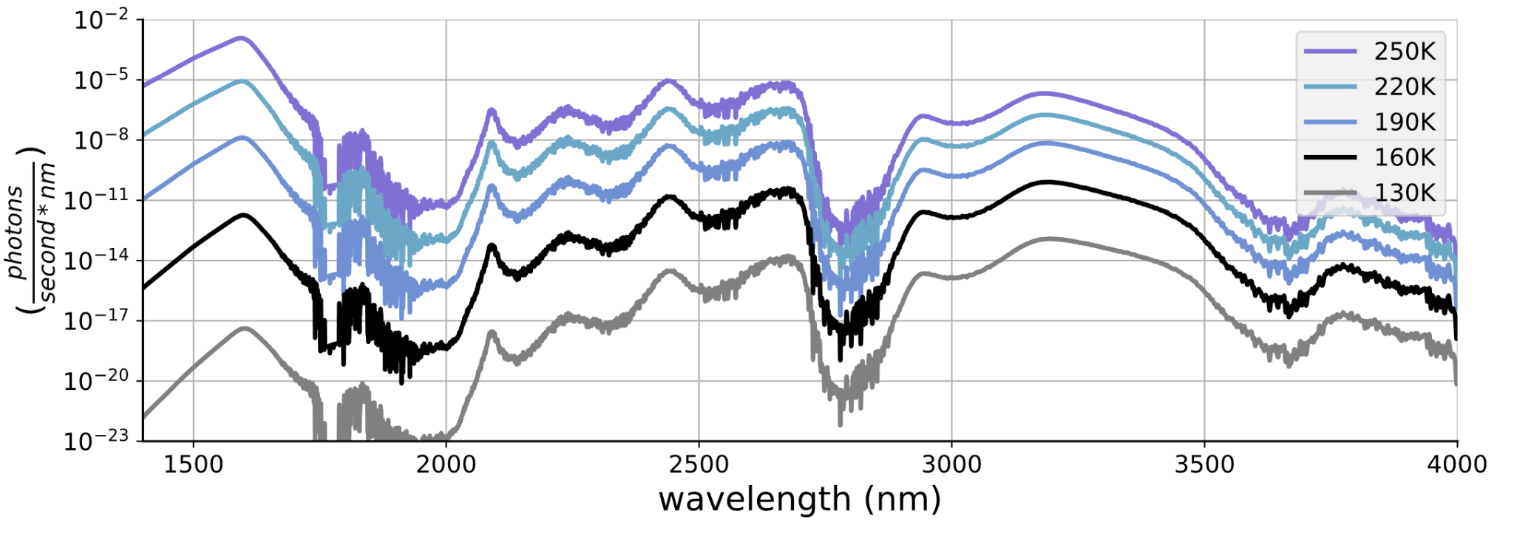
Free-space filtering of cryogenic environment
8x10⁻²
Total counts
One pair of short-pass filters
6x10⁻⁴
3x10⁻⁶
2x10⁻⁸
2x10⁻¹¹
Proposal for GQuEST
1 pair of short-pass filters
  2 x 0.5 inch of BK7 glass
Optional: 3 nm bandpass filter
QuRIOS 3/22/2024
Notes:
An advancement we are going to be applying to GQuEST
we will also be cooling our incoming fiber carrying the signal light from our cavities.
This plot was created by Boris and simulates the resulting photon rate when cooling the fibers
We still take into account the pair of short pass filters
As you can see the count rate decreases immensely as we begin cooling the fiber (function of wavelength)
If we start cooling the fiber we can get these results…
Furthermore, we have a plot that represents the motivation for the new SNSPD architecture for GQuEST. In the plot made above by Boris, simulations for the resultant photon rate vs wavelength at different fiber temperatures is shown.
Simulation by Boris of the expected photons per second when as a function of the temperature of the fiber
-Motivation for cryo cooling the fiber and the new updated SNSPD design

Slide 14
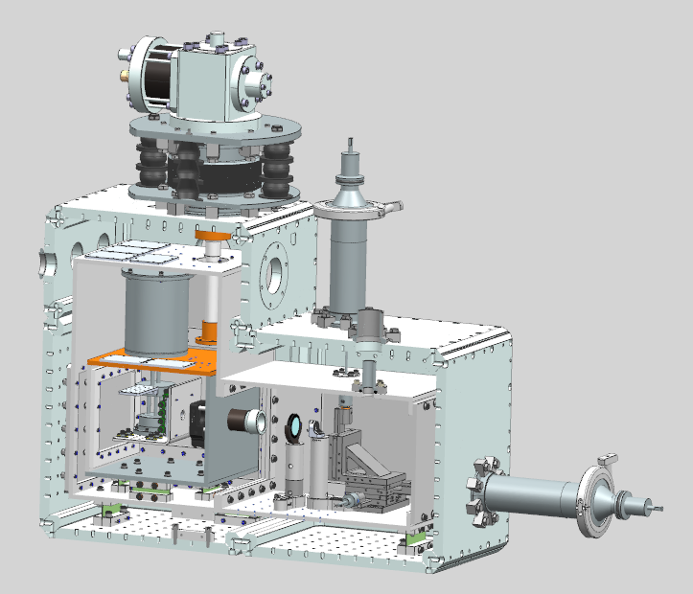
Cryogenic Cooling For Single Photon Detection
GM Cooler
3 Stage Cryostat
  Fiber held at 40-60 K
  Free Space Optics @ 4 K
  SNSPD @ 1 K
10⁻² DC rate w/o cooled fiber
10⁻⁵ DC rate w/ cooled fiber
4 K stage
40-60 K stage with fiber
1 K stage with SNSPD
QuRIOS 3/22/2024
Filter stack @ 4 K
Notes:
Now combining what i have described for you, Fermilab has designed and will be partially assembling our cryostat which will feature 3 stages of cooling.
We expect to achieve up to 10⁻⁵ dcr when utlizing the cooled fiber.
Here is our design on how to implement this!
GM: a pneumatically driven Gifford-McMahon refrigeration cycle,
Add motivation for the 1k stage etc. (phycics for design requirements )
Previous results have shown that we can achieve 10⁻² dark count rate when using the cooled freespace optics, our new approach will cool the fiber as well

Slide 15
Testing our SNSPD for GQuEST
Demonstrate 10⁻⁴ Dark Count Rate
Characterize Bare SNSPD sensitivity to thermal Radiation
Couple SNSPD with Optical Cavities
Characterize freespace filtered SNSPD to Thermal Radiation
Characterize SNSPD Efficiency
QuRIOS 3/22/2024
Notes:
So how will we be testing these SNSPDs? First, we will be demonstrating that we can achieve at least a dark count rate of 10⁻⁴. This will be our baseline. Thus placing it in a dark box and measuring counts. Next we will place a fiber in front of the SNSPD to characterize how the SNSPD responds to external black body radiation by using a thermal source and shining it on one end of a fiber

Slide 16
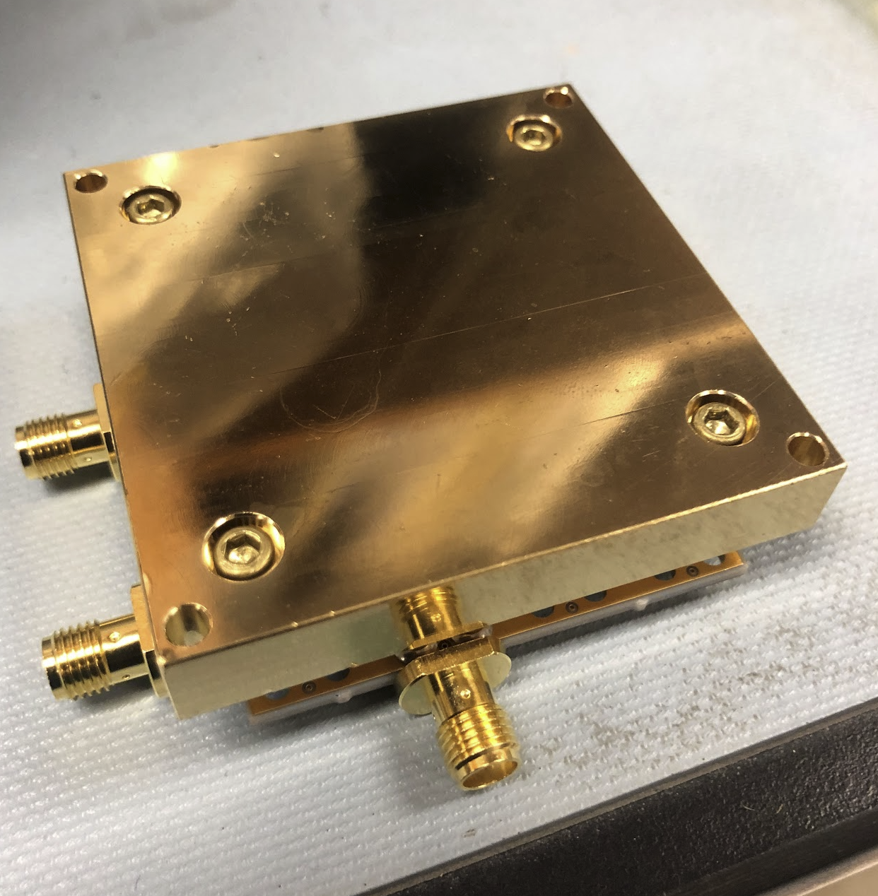
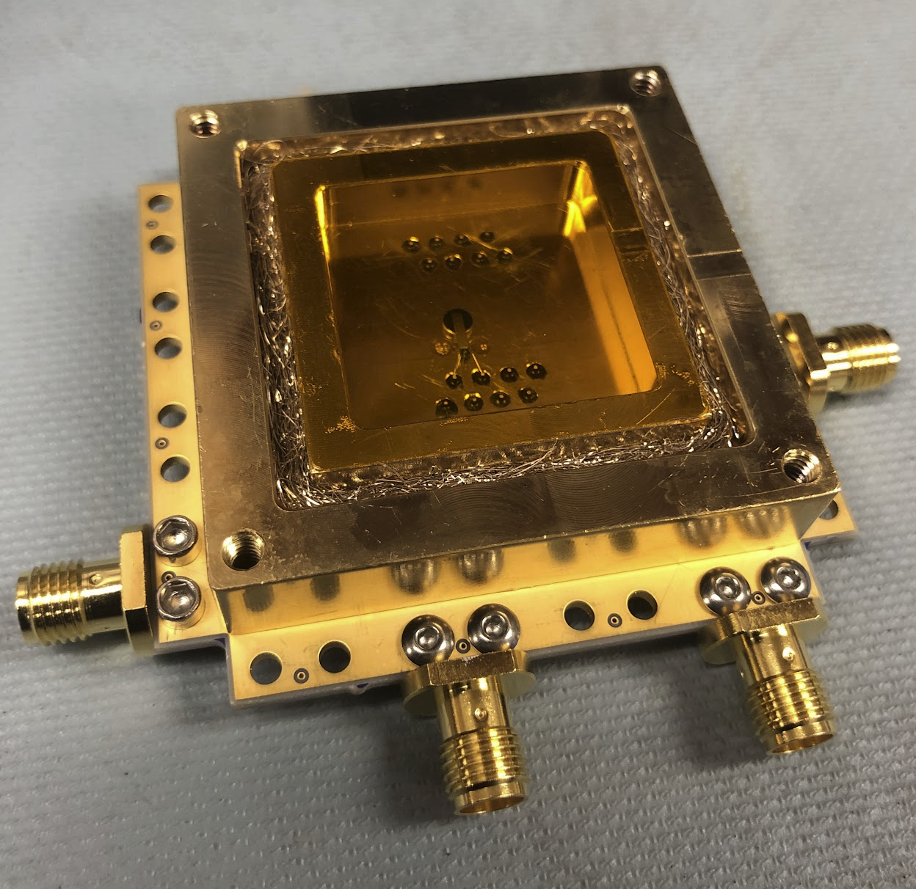
SNSPD Housings
Dark Box Enclosure
SNSPD Casing + PCB
Open Fiber Lid
QuRIOS 3/22/2024
Notes:
Before we get into some results we have seen from testing, i want to show the differences between the housings we place the SNSPDs into.
Here i have some images of the different housings we are utilizing in our testing. The left features the dark box the right our open lid which will allow our fiber to shine light on the SNSPD.
Brass wool is for reducing any stray light from entering the chamber (an optical oring of sorts)

Slide 17
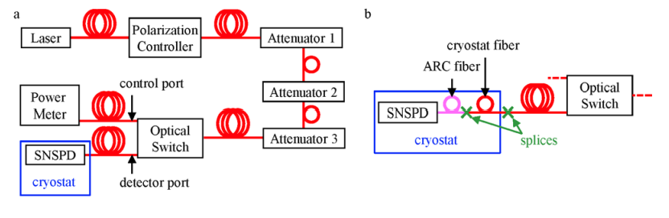
SNSPD Efficiency Experimental Setup
QuRIOS 3/22/2024
F. Marsili, Et al., 2013, Detecting Single Infrared Photons with 93 % System Efficiency: Supplementary Information
Notes:
block diagram of the two primary experimental systems for measuring our efficiencies.
(a) we have a 1550 laser, note that each of these components will be linked using shielded fibers single mode fibers.
laser and the fibers will have intrinsic polarizations,
use a polarization controller to tweak the polarization in the fiber such that we get achieve the highest amplitude at the output.
Next we have 3 sets of adjustable attenuators to reduce the overall output power of the laser
can calibrate this output with a power meter to achieve a desired output photon count rate.
Thus our optical switch then allows us to swap our output to the SNSPD in which
we can use the number of counts we receive per second to calibrate the efficiency of the SNSPD.
In b we show that in our actual GQuEST setup we will also be cooling the fiber in the cryostat,
something we will be testing efficiencies for in the future.

Slide 18
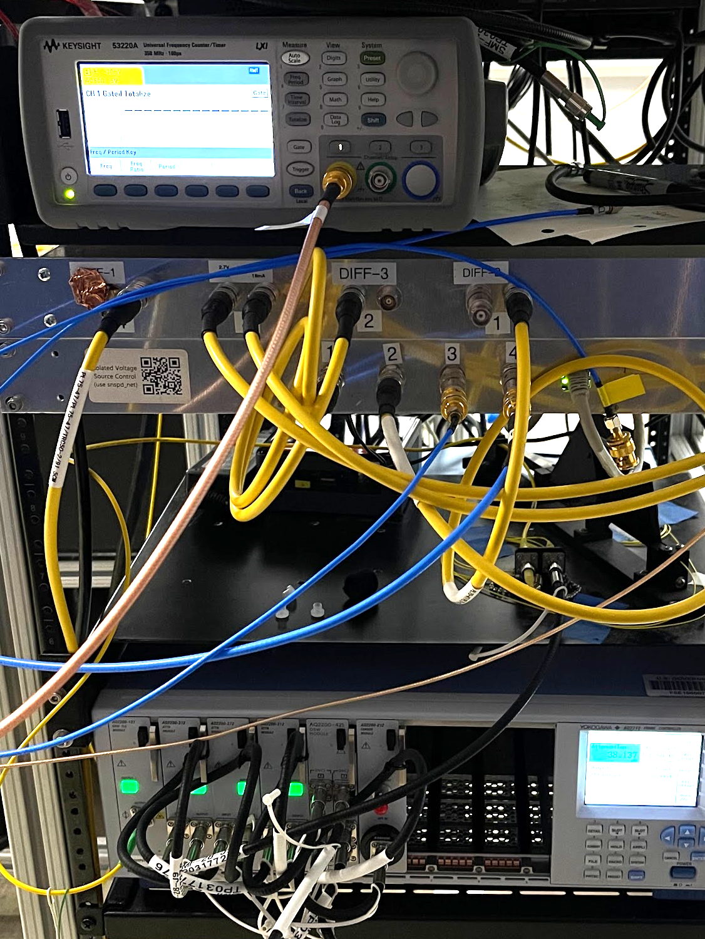
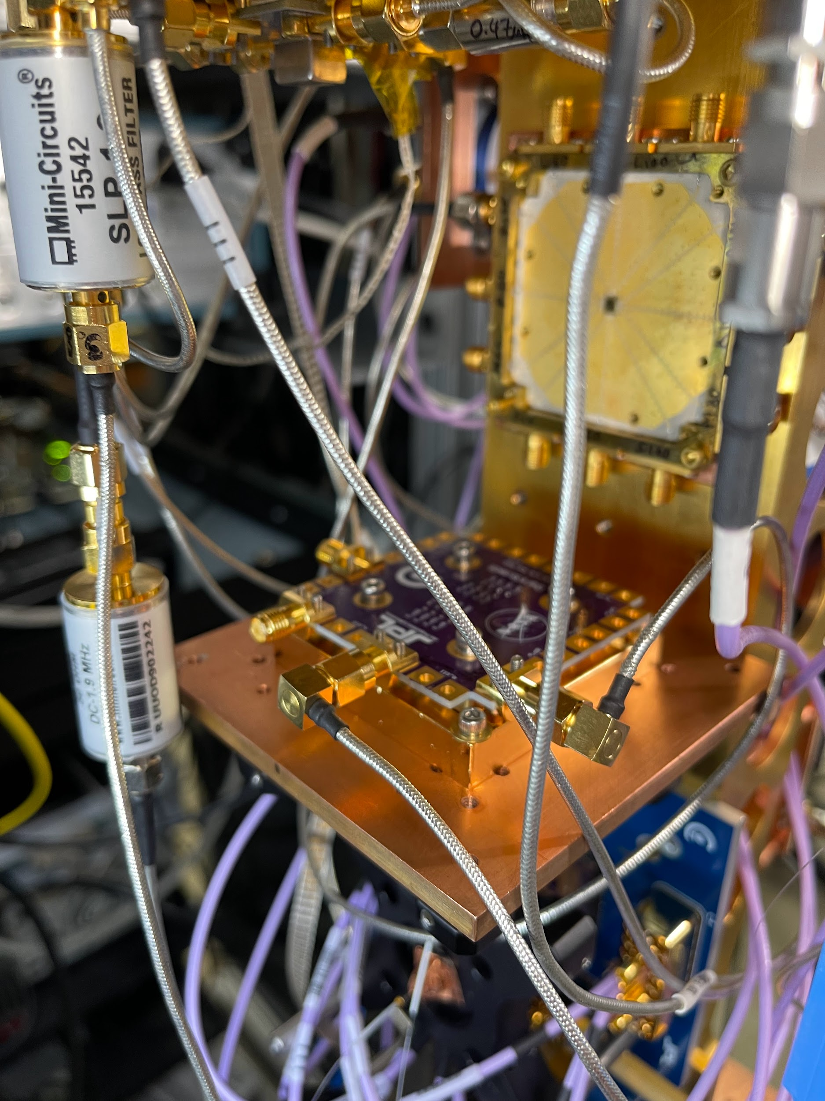
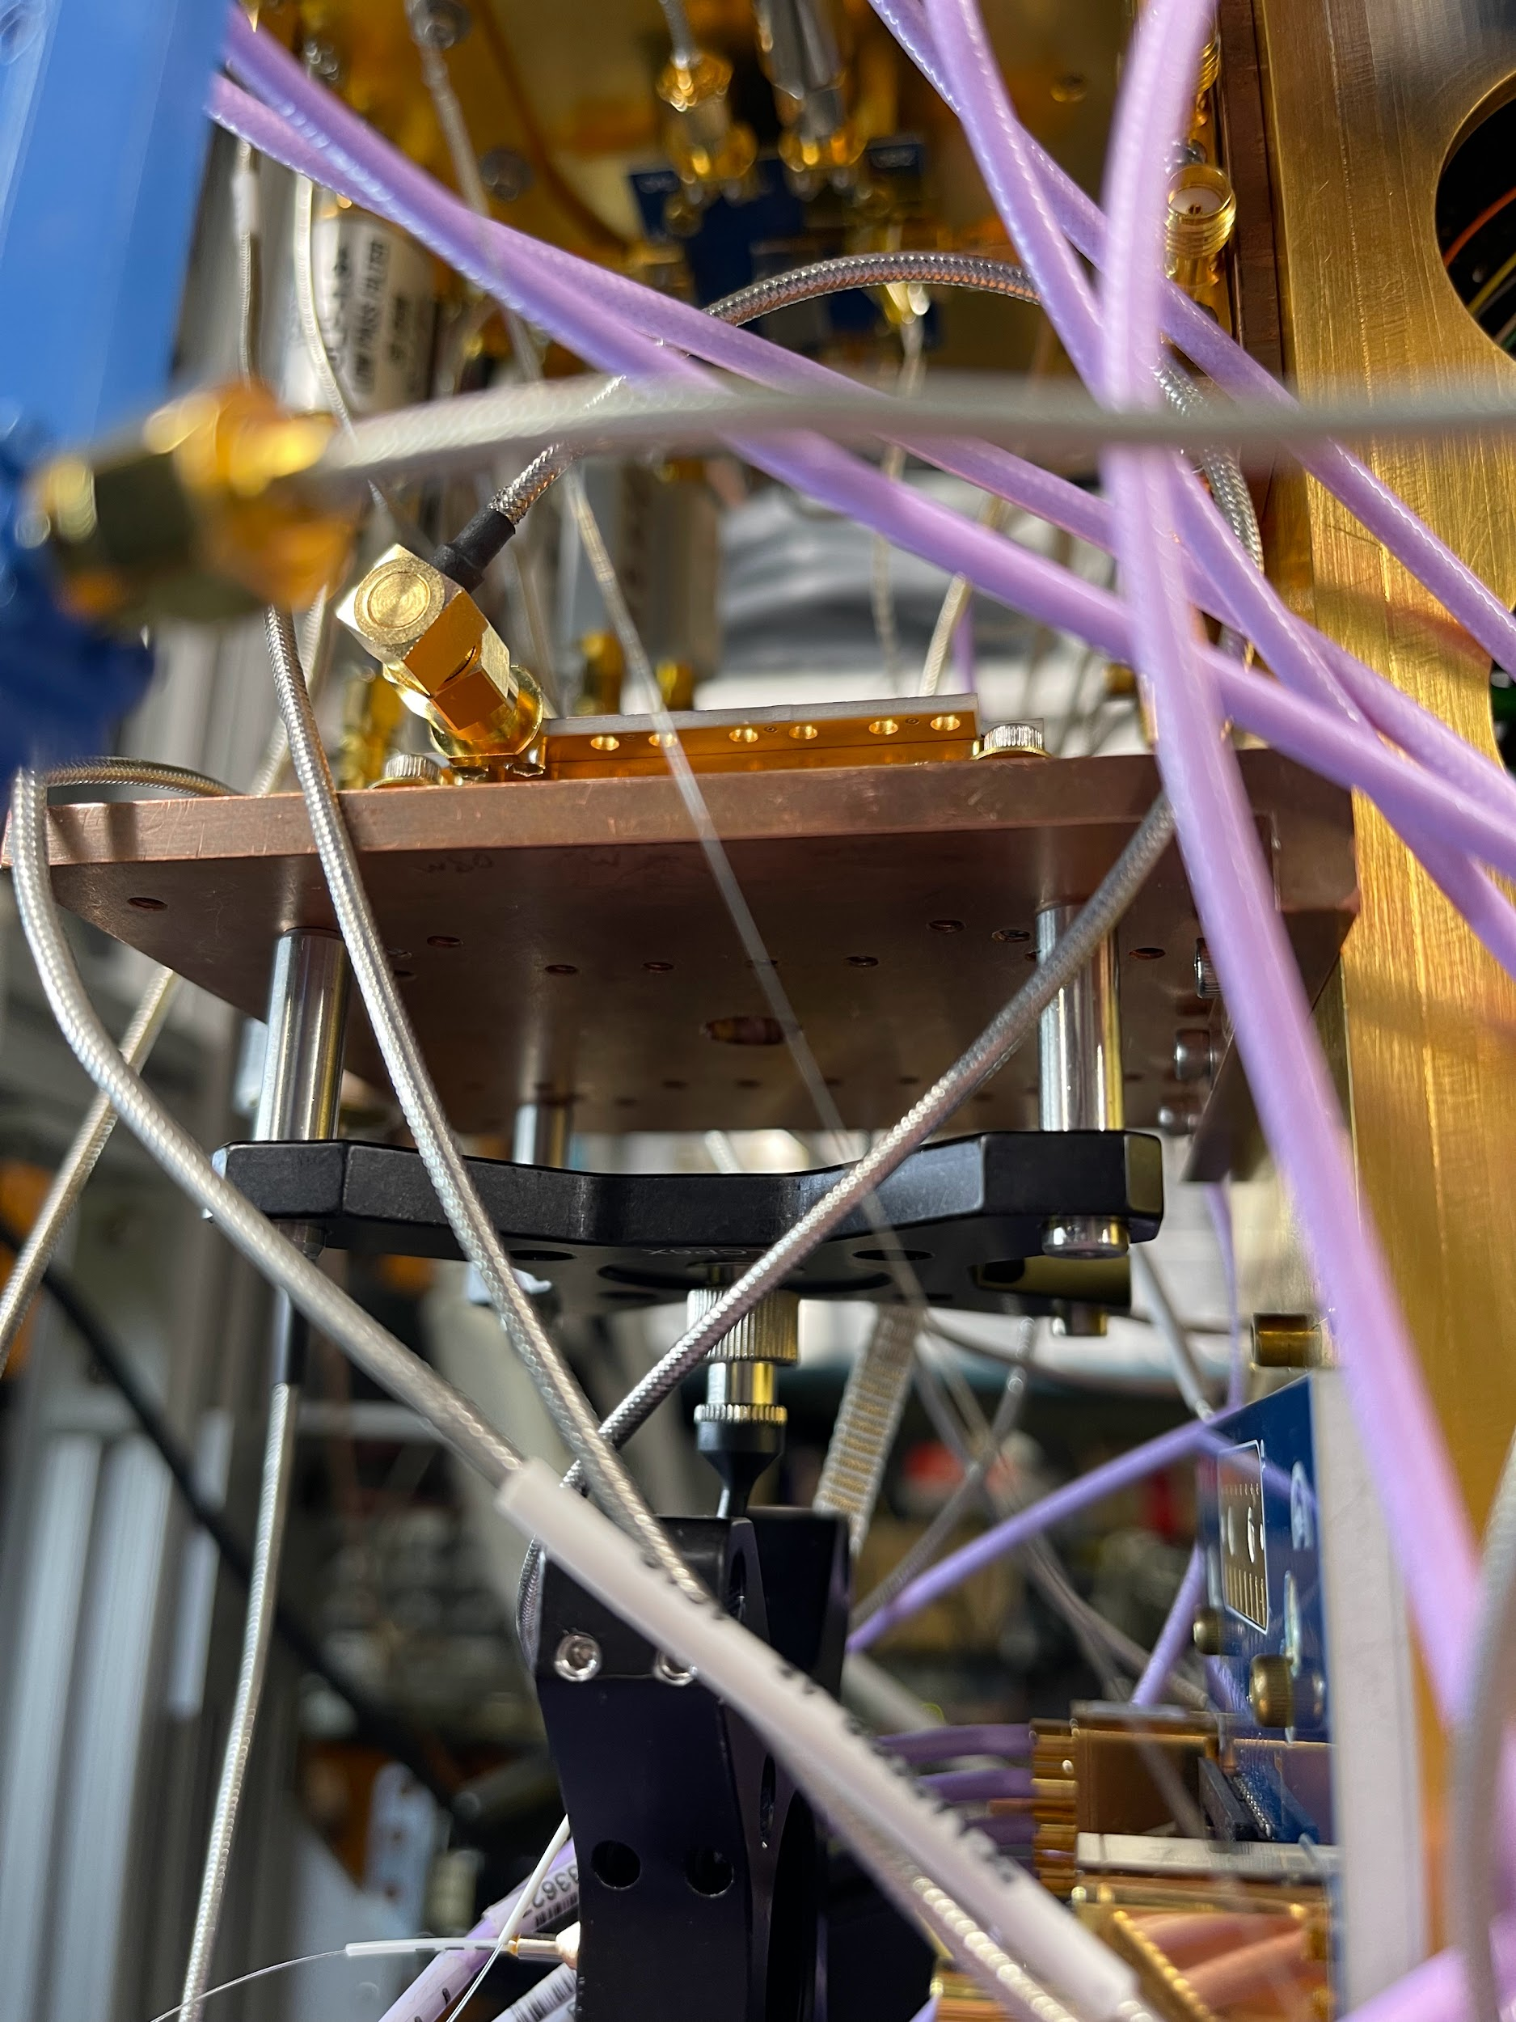
Laboratory Setup
QuRIOS 3/22/2024

Slide 19
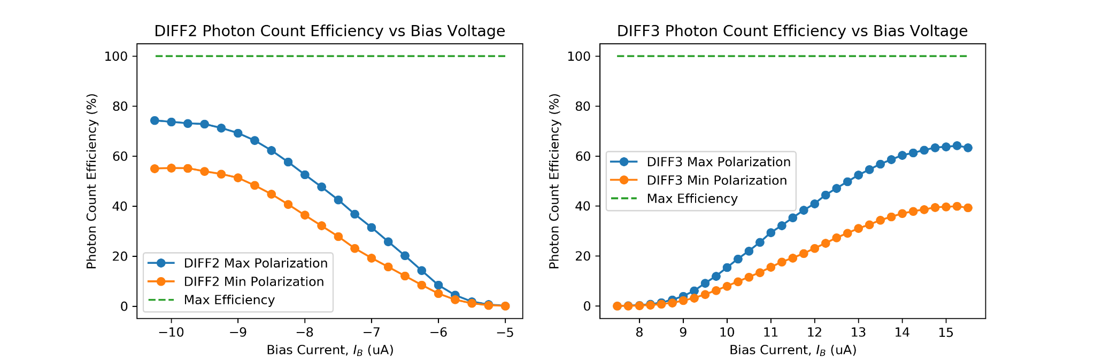
Initial SNSPD Measurements
Current Efficiency measurements taken with GQuEST SNSPD
QuRIOS 3/22/2024
Notes:
Here are some plots showing our initial efficiency measurements of the SNSPD, where we are so far able to achieve a 78% efficiency. The two plots show the difference in efficiency when we tweak our polarization controller to the max and min laser output powers and we measure between two differential readout electronics within the lab.

Slide 20
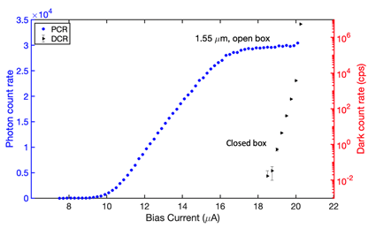
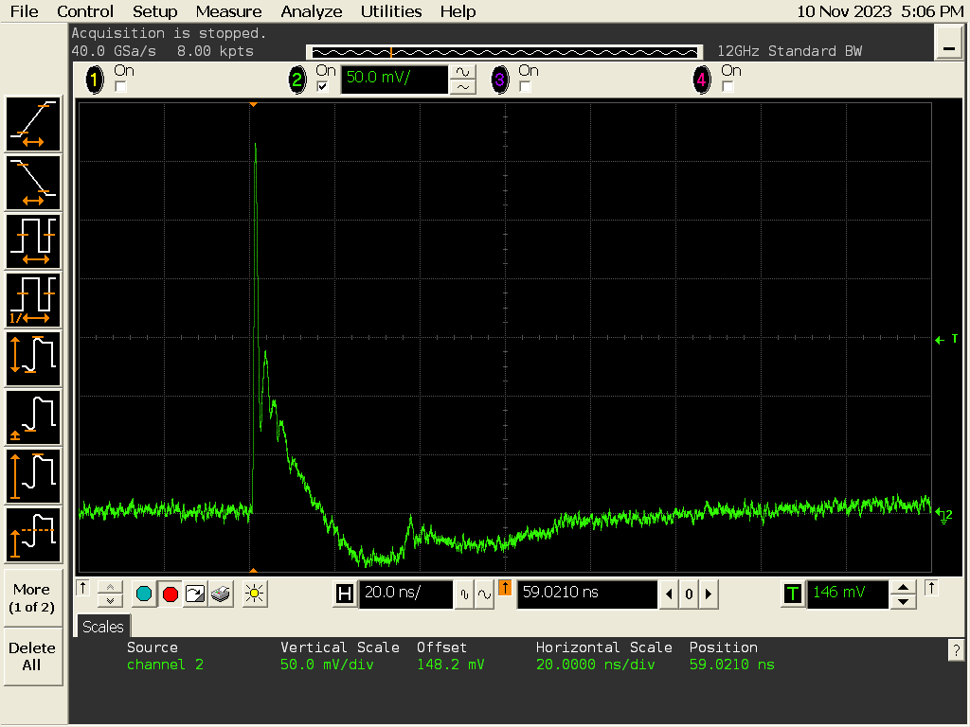
PCR Curve of GQuEST SNSPD
Photon Count Rate with respect to input Bias Current
QuRIOS 3/22/2024
Notes:
The snspd pulse has a very specific, say that for each detection we will see a very unique pulse shape and will differentiate these from other occurrences that may be caused by noise and radiation

Slide 21
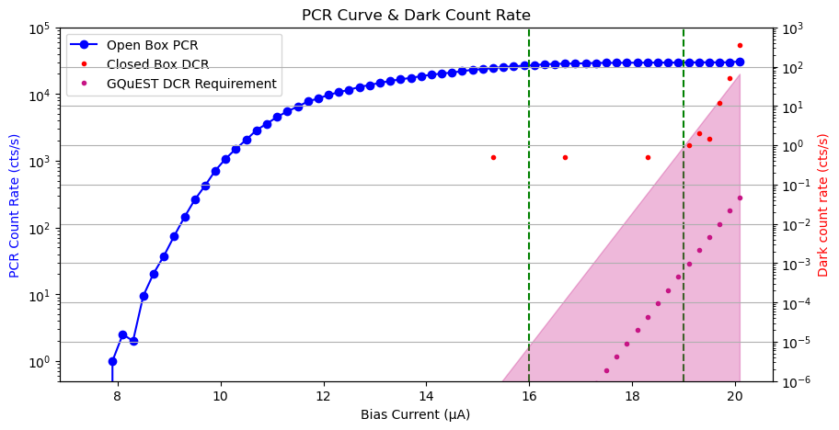
10⁻⁴ Measurements with Dark Box
Highest Efficiency
QuRIOS 3/22/2024
Notes:
Add further description on what dark counts are!
Can also say that without the filters, the extra blips seen in our data could just be extra dark counts

Slide 22
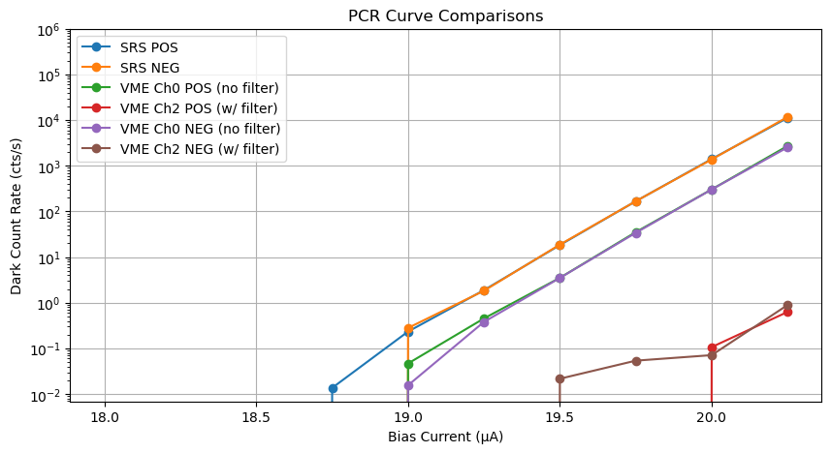
Voltage Supply Noise Comparison (Dark Box)
Comparison of SRS Voltage supply and the new DAC VME (built by Lautaro)
QuRIOS 3/22/2024
Notes:
We are also doing a bit more to improve our detection count rate by designing new voltage controlling sources.

Slide 23
Next Steps
Test and verify SNSPD Dark Count Rate with the new voltage source
Characterize the SNSPD response with the radiative thermal source
Utilize Avalanche Photodiodes to calibrate and measure the outputs of the filter cavities
Assemble and install cryostat from Fermilab in Bridge
Begin SNSPD testing with filter cavities
QuRIOS 3/22/2024

Slide 24
Conclusion
Our SNSPD can achieve low dark count rates of at least 10⁻⁴ (a precedent for the 1550 nm detector)
  An order of magnitude smaller than our signal
Reach efficiencies of 80+ %
Improving upon previous designs by cooling the incoming fiber from filter cavities
QuRIOS 3/22/2024

Slide 25
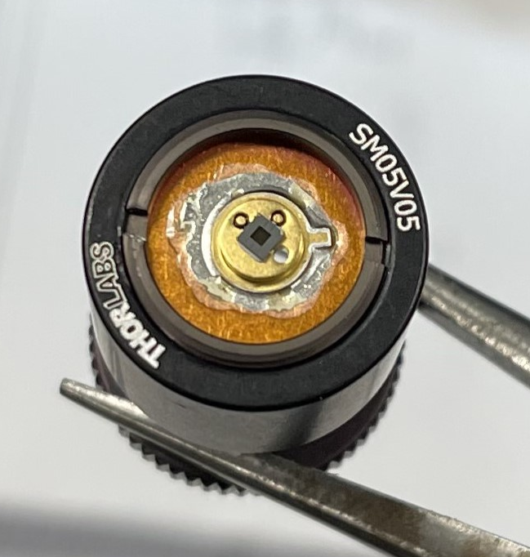
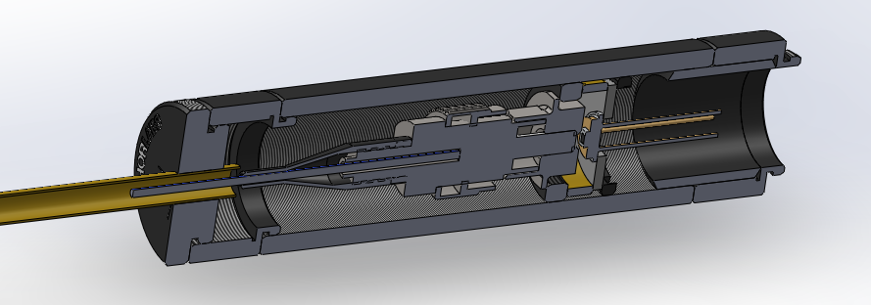
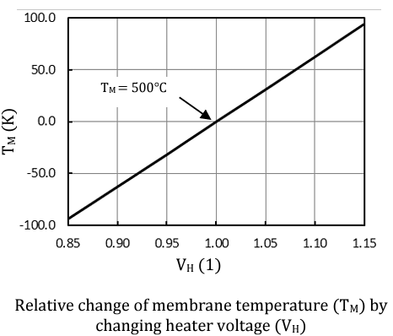
Thermal Source Measurements with SNSPD
Measuring SNSPD response to thermal excitation via radiating thermal source
Brass Spacer (gap 1-1.5mm)
Fiber to SNSPD
Thermal MEMS based infrared source (EMIRS50 AT06V BR25M)
Brass tube fiber enclosure
PC Fiber Coupler
QuRIOS 3/22/2024
Notes:
Thermal source to apply black body radiation to the tip of the fiber in a controlled environment

Slide 26
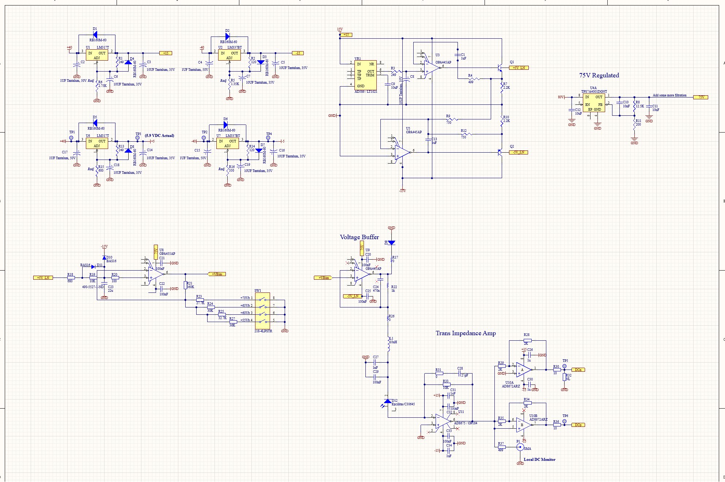
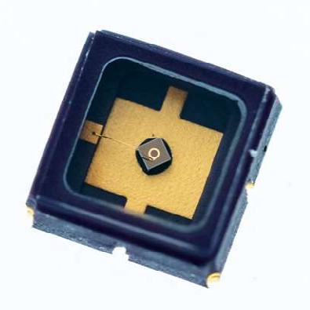
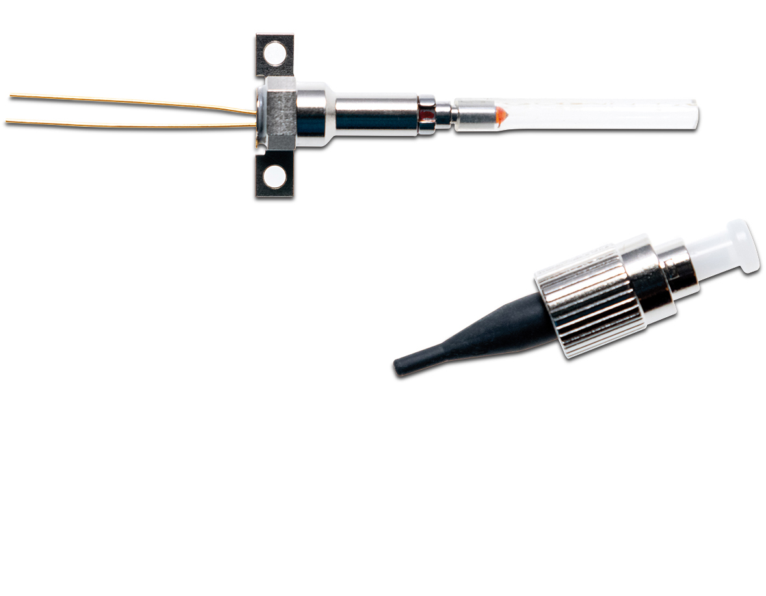
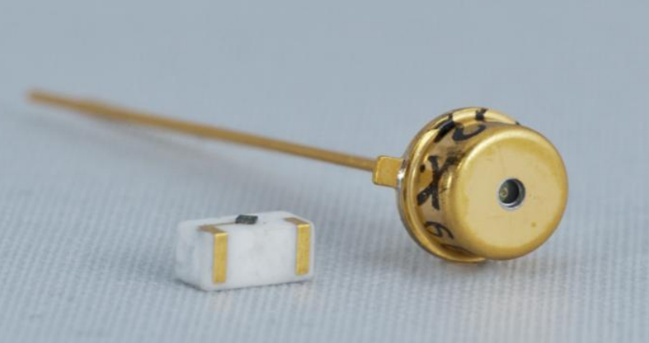
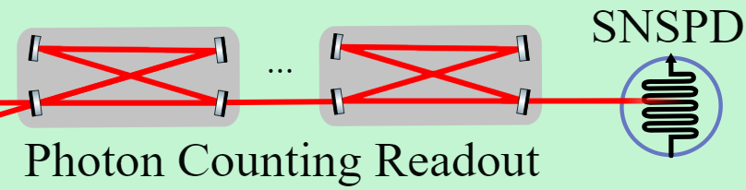
Low-noise Avalanche Photodiodes
Sub-pico-watt noise floor @ 293 K
Preliminary testing with 1-2 cavities
60-120 db of attenuation
10¹² p/s - 10⁶ p/s or 100 nW - 100fW
Exponential gain in avalanching mode
Previously: 1 count/sec achieved with 10% efficiency ⁽¹⁾
Boris Korzh et al., “Free-running InGaAs single photon detector with 1 dark count per second at 10% efficiency”, Appl. Phys. Lett. 104, 081108 (2014)
QuRIOS 3/22/2024
Notes:
Cite boris paper on 1 cps low dcr

