Slide 1
GQuEST: Gravity from the Quantum Entanglement of Space Time
Chris Stoughton
Fermilab Cosmic Day
30 October 2023

Slide 2
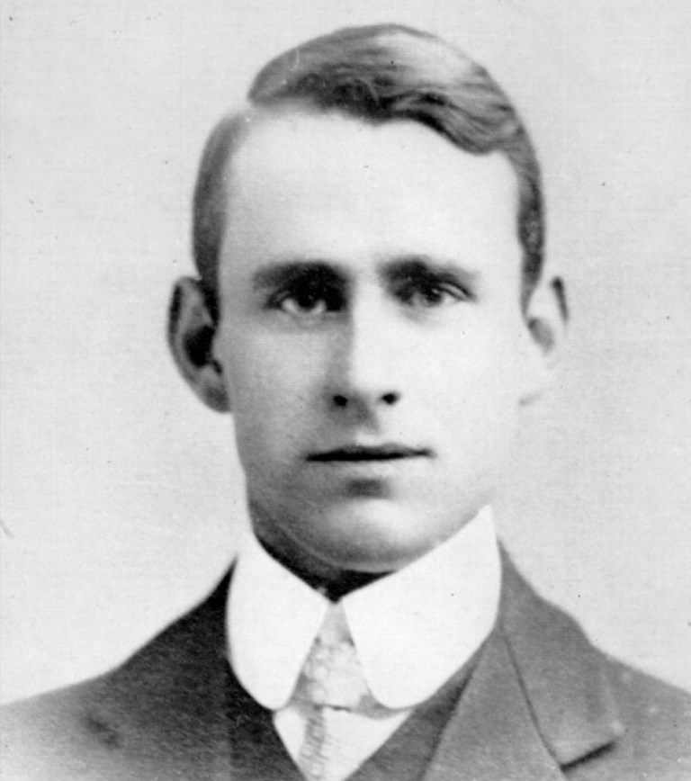
Quantum Mechanics and General Relativity
It seems to be inevitable that this length must play some role in any complete interpretation of gravitation…
In recent years great progress has been made in knowledge of the excessively minute;
but until we can appreciate details of structure down to the quadrillionth or quintillionth of a centimetre,
the most sublime of all the forces of Nature remains outside the purview of the theories of physics.
A.S. Eddington, discourse delivered to the Royal Institution, published in Nature 1917 no. 2542 vol 101

Slide 3
Kathryn Zurek’s View of the Theoretical Landscape

Slide 4
GQuEST in One Slide
The metric of spacetime modifies the metric with a scalar field
This introduces a signal in the sidebands of an interferometer of length L as a PSD with peak level, peak frequency, width:
We will filter the IFO output, count photons, with S/N=1 in 2.4 hours for each offset frequency. Measure (or exclude) this signal with repeated operations.

Slide 5
Full GQuEST Configuration

Slide 6
Experimental Risks and Opportunities

Slide 7
This year: build a Technology Demonstrator
For the demonstrator, focus on the red risks
Currently, squeezing speeds up direct readout by 16x
Our goal is to accelerate > 100x speedup using photon counting
1 Watt on beam splitter, locked to 1 mW output fringe
Couple output to bowtie cavities with 57 db each
Read with SNSPDs with 1e-2 Hz (or better) dark count rates.

Slide 8
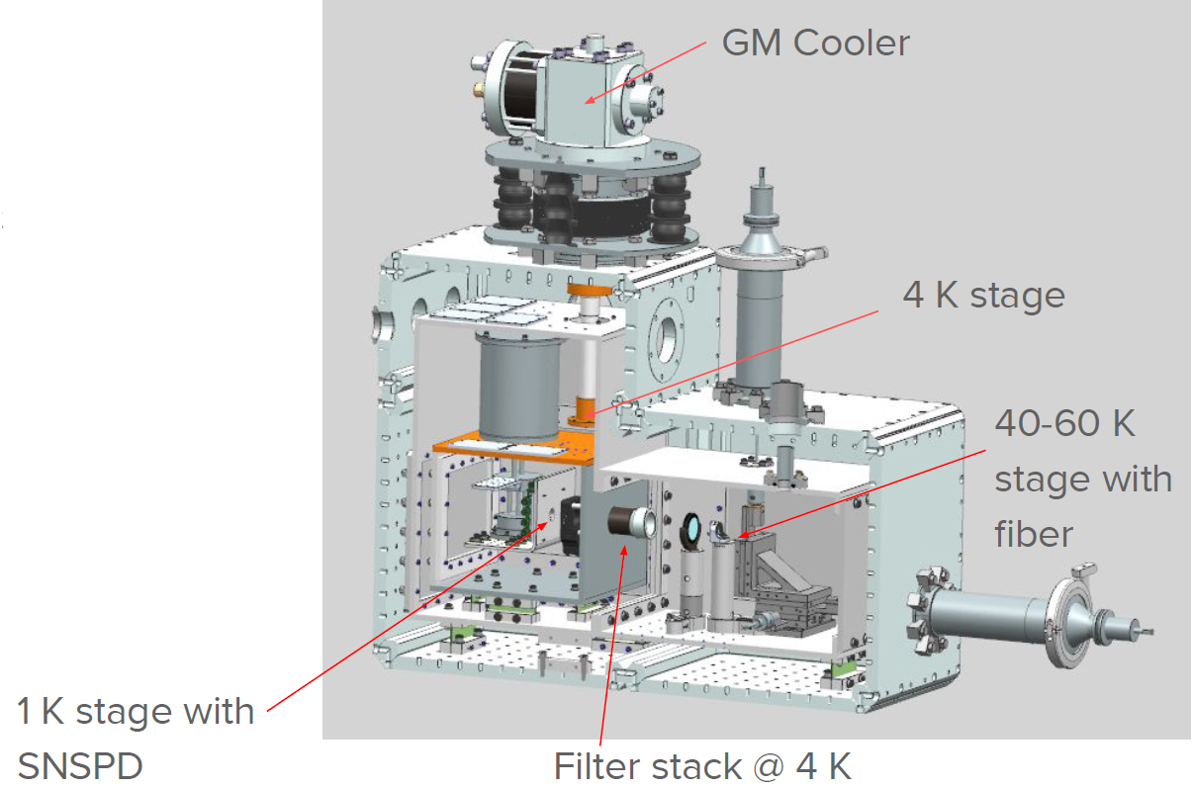
SNSPD Dewar Design and Fabrication @ FNAL

Slide 9
