Slide 1
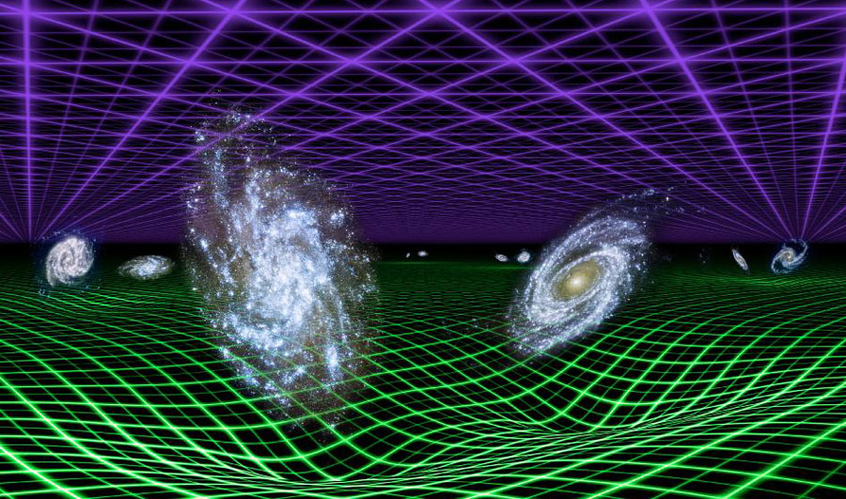
Searching for Quantum Gravity and Dark Matter with Laser Interferometers
Sander Vermeulen
Gravity Exploration Institute, Cardiff
Adapted from NASA/JPL-Caltech

Slide 2
Part I: Searching for Quantum Gravity Phenomena with Interferometers
Sander M. Vermeulen

Slide 3

Measuring a distance
Wigner & Salecker (1958)
→ Record the time it takes for a photon to go back and forth
‘Yonder’
L = ?
t = 0
t = L / c
‘Here’

Slide 4
Measuring a distance: space-time picture
L
space
time
How precise can we measure a distance L ?
Sander M. Vermeulen

Slide 5
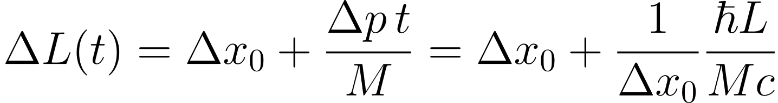
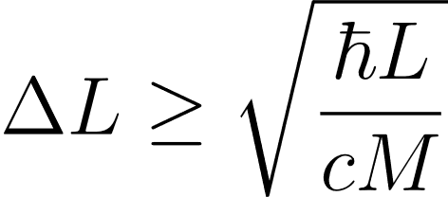
Standard Quantum Limit
∆x₀
∆p
∆L
∆t
space
time
Sander M. Vermeulen

Slide 6
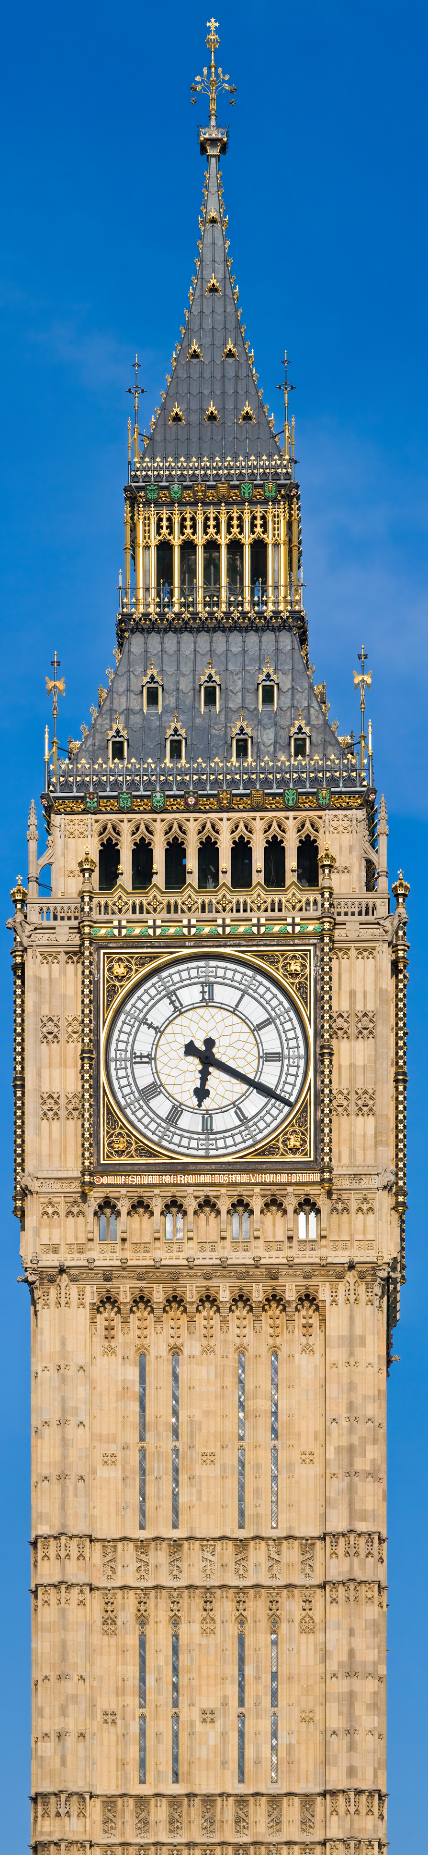
A measurement limit from General Relativity?
Increase mass to decrease uncertainty
space
∆p
time
Sander M. Vermeulen

Slide 7
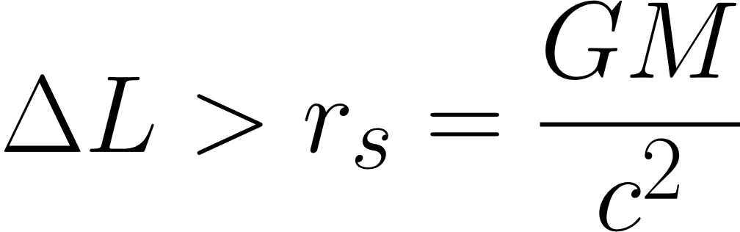
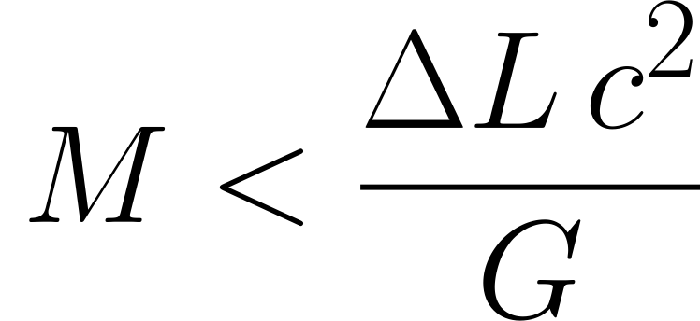

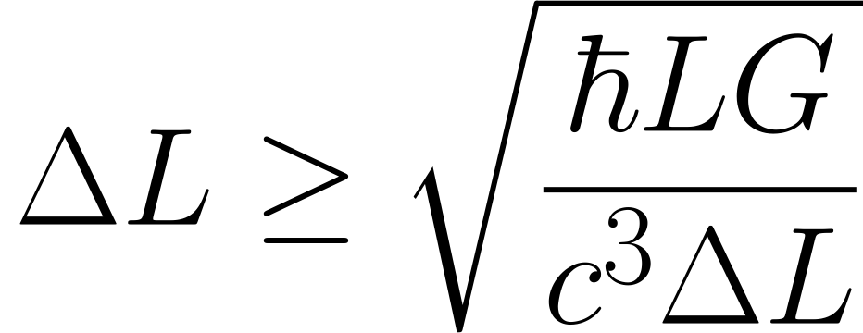
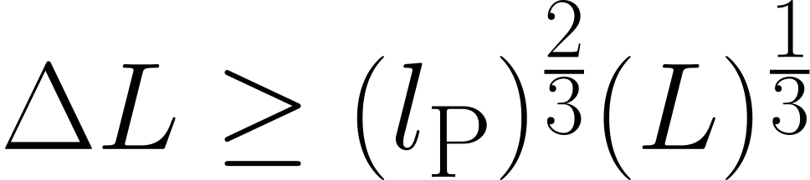
“Quantum Gravity” measurement limit
(‘Schwarzschild limit’)
(Standard Quantum Limit)
Jack Ng & Van Dam (1994)
Sander M. Vermeulen

Slide 8
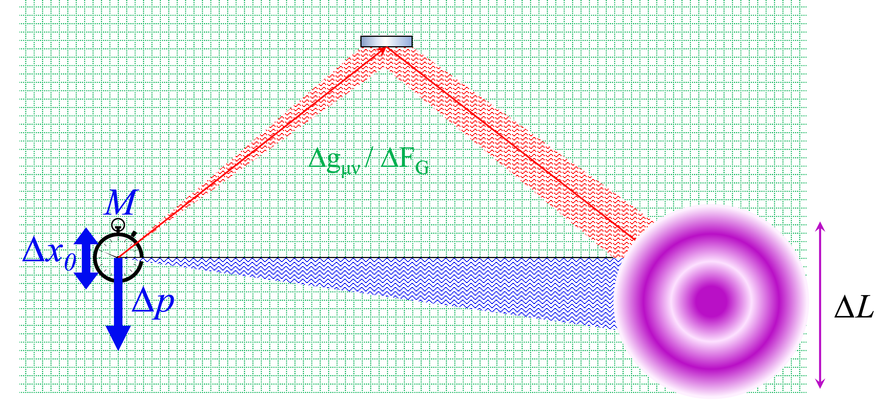
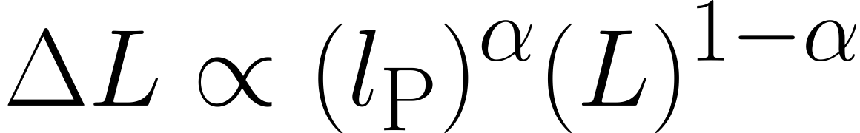

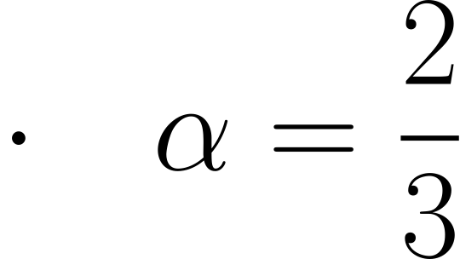
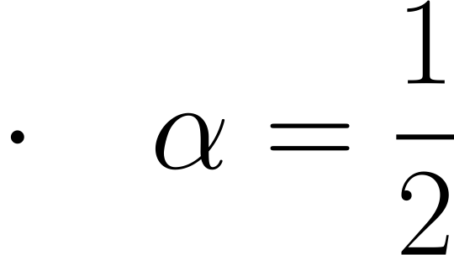
Limits on distance measurements from Quantum Gravity
EFT/String Theory/ LQG
Hoop Conjecture/ ‘Old’ holography (Y. Jack Ng & Van Dam)
Random walk, ‘New’ holography (Zurek & Verlinde, Hogan & Kwon)
Sander M. Vermeulen

Slide 9

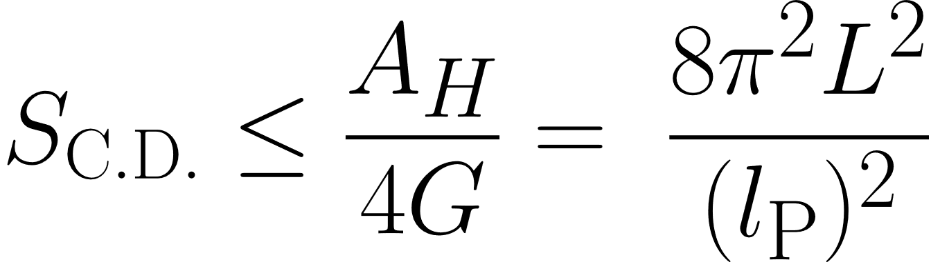

Interferometric measurement in holography
An interferometric measurement defines a causal diamond
Boundary of a causal diamond is a Rindler horizon
Causal Diamond
Covariant entropy bound:
Boundary/Horizon
time
→ Number of d.o.f. is much smaller than in QFT
space
space
Sander M. Vermeulen

Slide 10
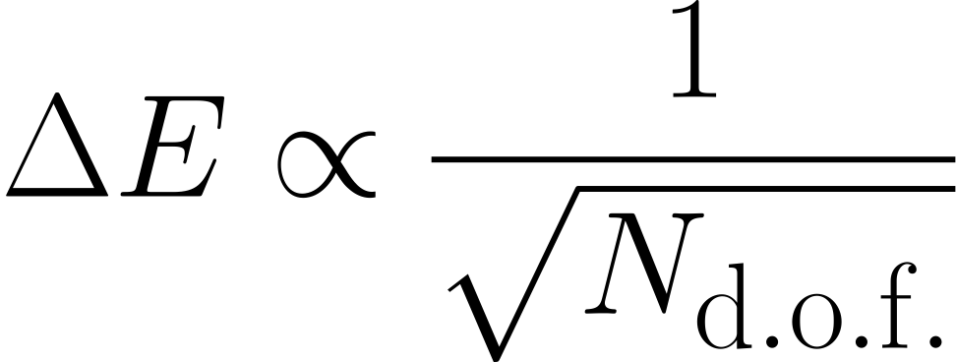
Interferometric measurement in holography
Verlinde & Zurek (2019)
Degrees of freedom can undergo quantum fluctuations
Energy fluctuations gravitate, perturbing geodesics
→ Light cone/horizon fluctuates
space
time
space
space
space
space
Sander M. Vermeulen

Slide 11

Radial horizon fluctuations
time
space
space
space
space
Sander M. Vermeulen

Slide 12
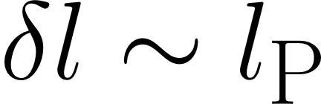
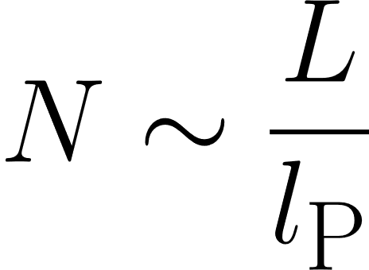
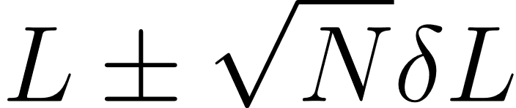
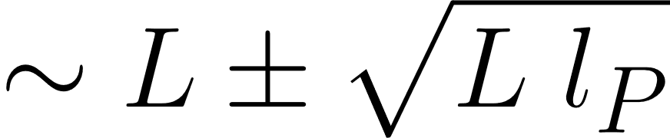
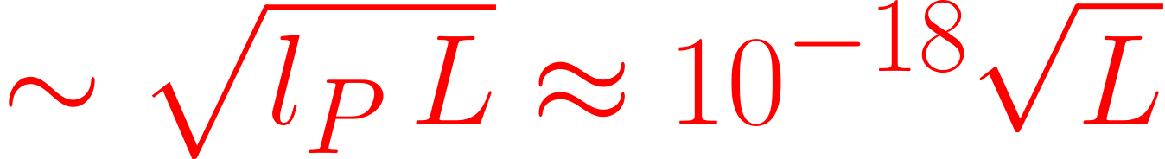
Light cone fluctuations accumulate like a random walk
time
Step size:
Number of steps
space
Total length:
Can we detect displacements m ?
Verlinde & Zurek (2019)
Hogan (2012)
Sander M. Vermeulen

Slide 13
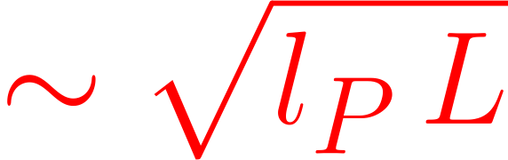
Cross-correlation of two co-located interferometers
Can we detect displacements with an interferometer?
LIGO/Virgo have Fabry-Pérot cavities and ‘slow’ output sampling, which averages down the signal..
→ Use a simple Michelson interferometer
→ Use 2 co-located interferometers
Space-time fluctuations are correlated
Dominant noise is uncorrelated
→ Integrate cross-spectrum over time
Sander M. Vermeulen

Slide 14
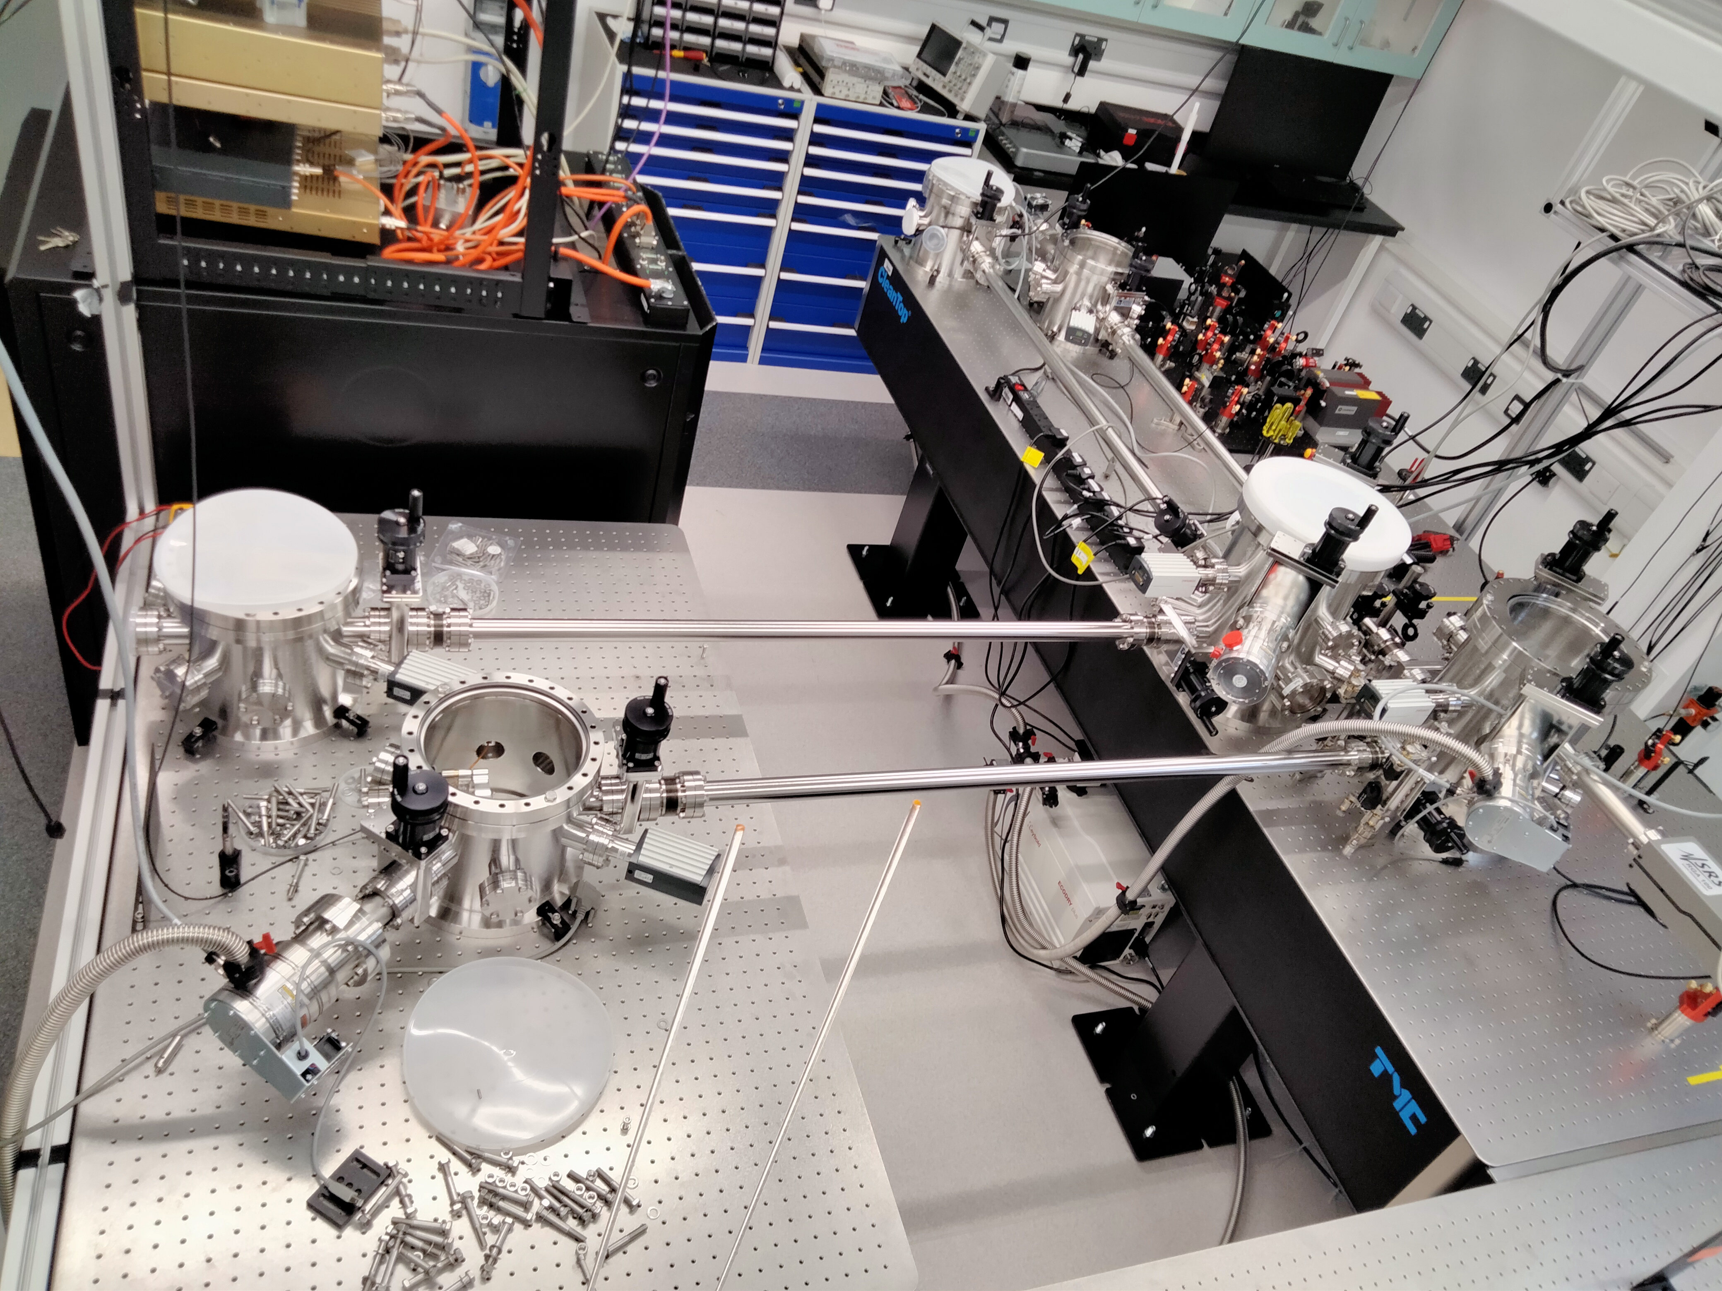
Sander M. Vermeulen

Slide 15
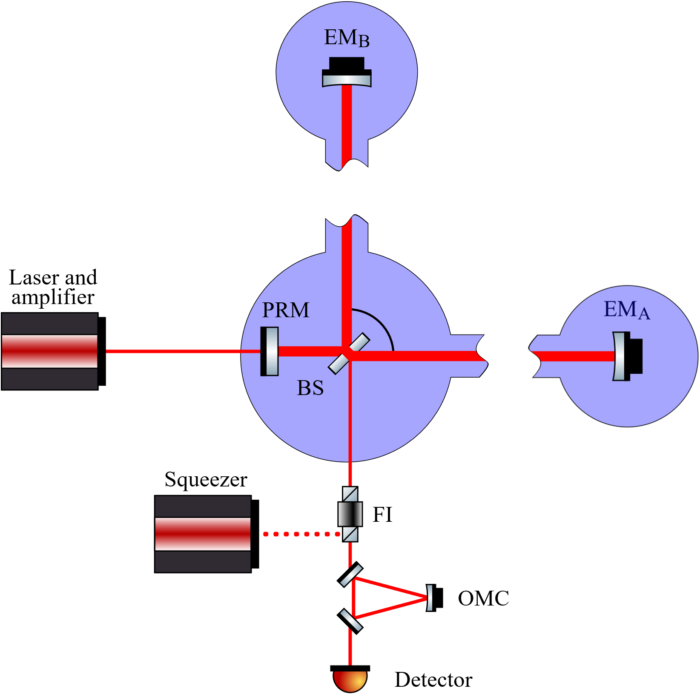
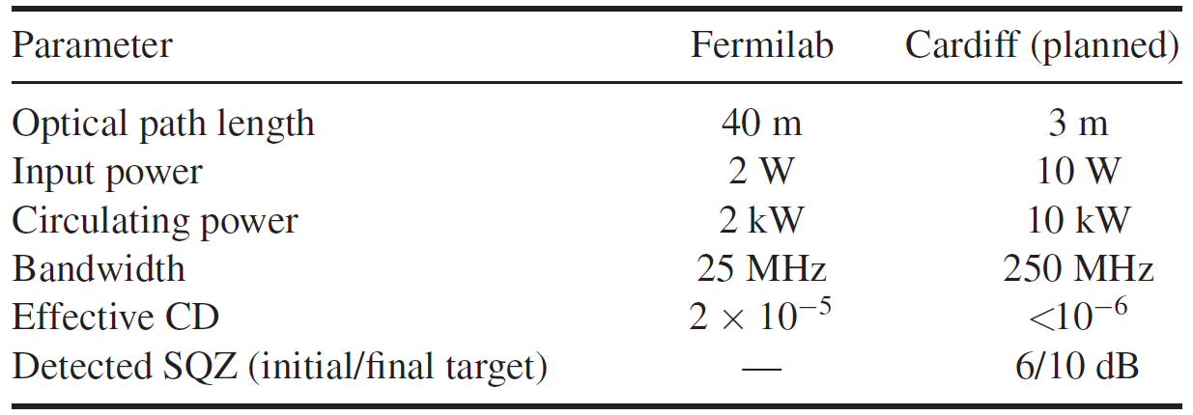
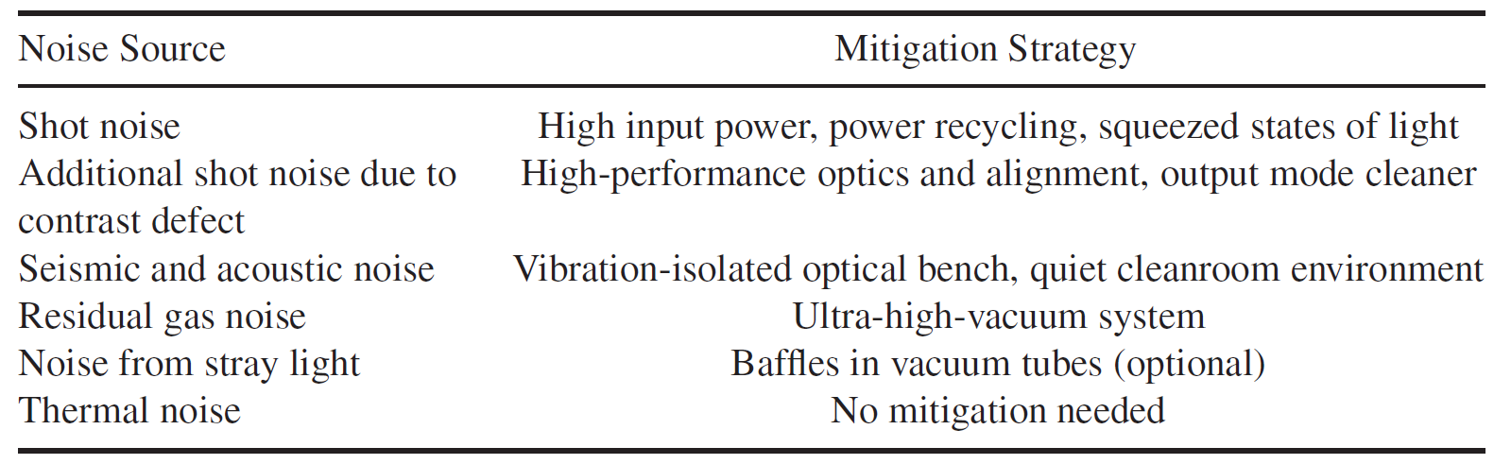
Cardiff IFOs Experimental Design
Sander M. Vermeulen

Slide 16
Rotational/transverse fluctuations
time
time
space
space
space
Hogan & Kwon
Sander M. Vermeulen

Slide 17
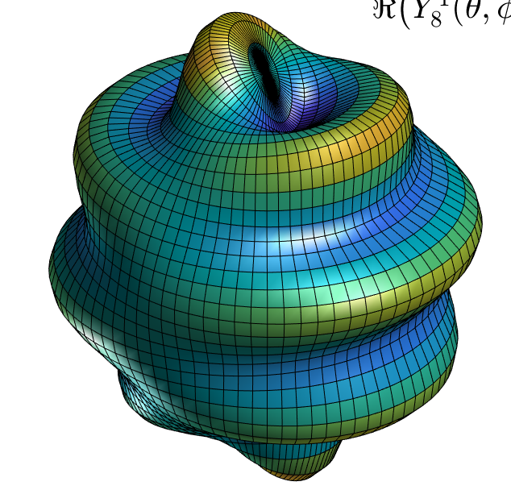
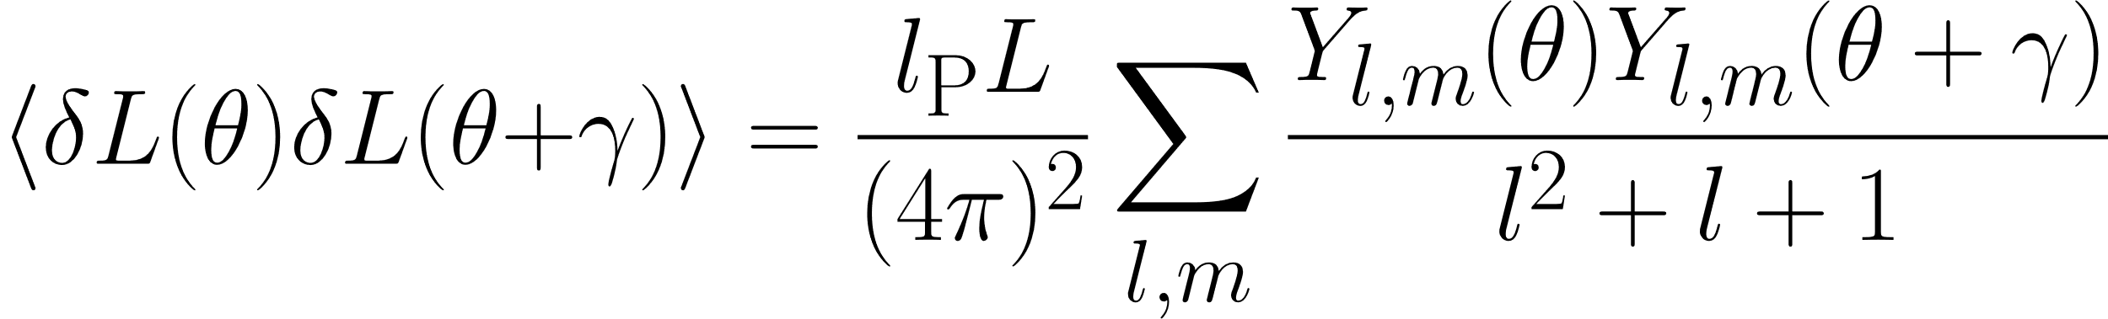
Angular correlations of fluctuations
‘t Hooft: BH horizon fluctuations (Hawking radiation) have angular correlations
Verlinde & Zurek: horizon responds according to Green’s function for a Laplacian
𝛾
Sander M. Vermeulen

Slide 18
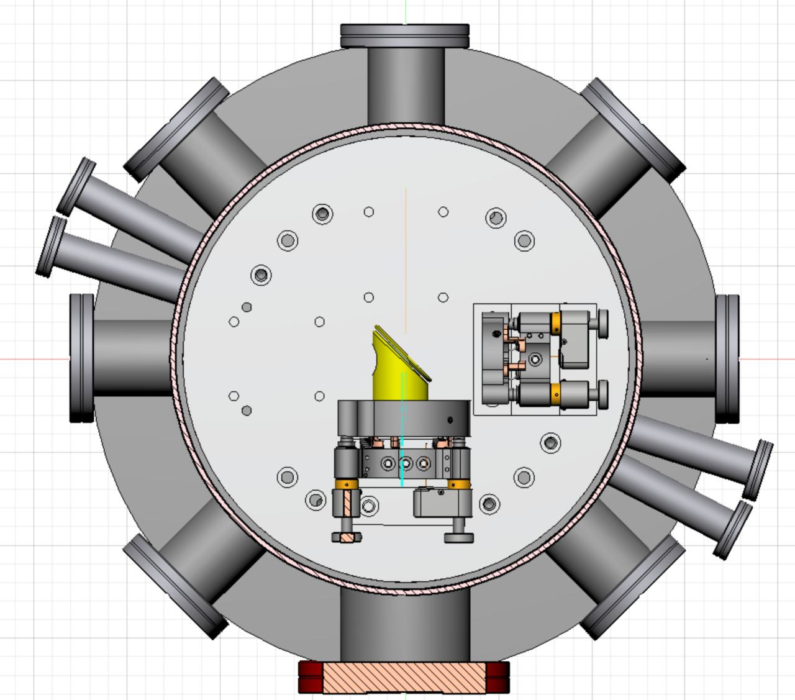
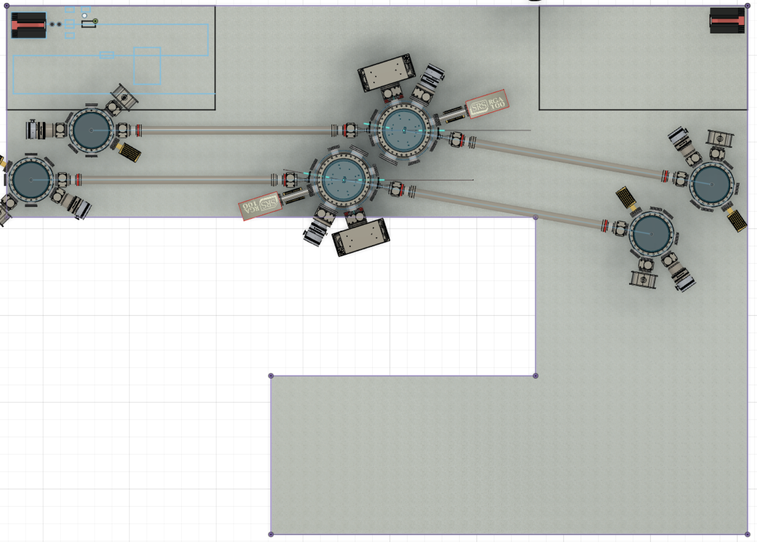
Interferometer geometry can be reconfigured ‘quickly’
Sander M. Vermeulen

Slide 19
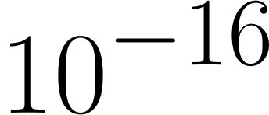
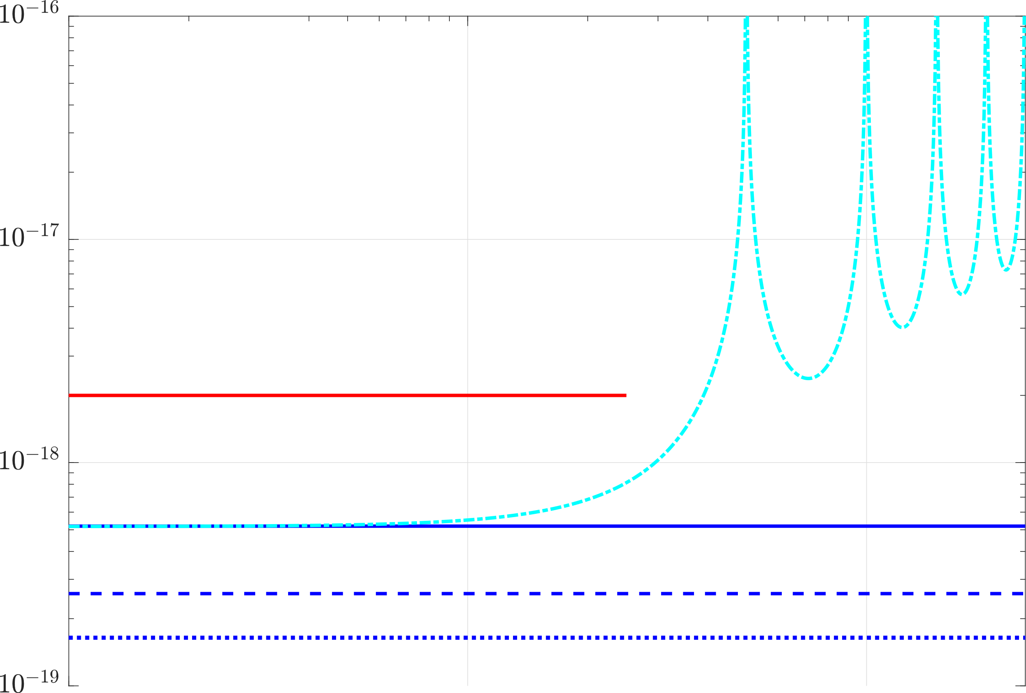
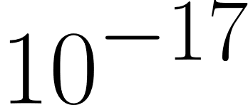
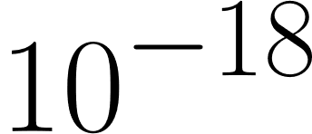
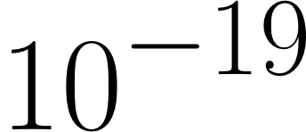
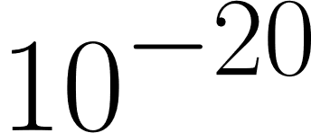
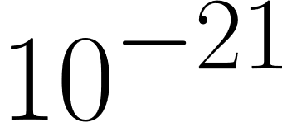
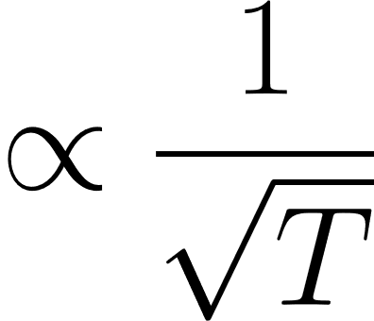
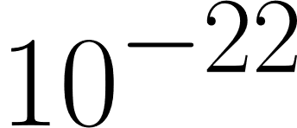
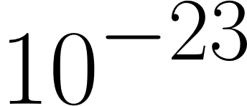
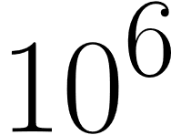
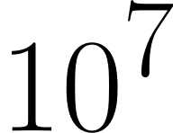
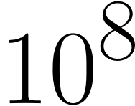
Projected sensitivities and signal strength
(?) GQuEST Caltech (ESTIMATE)
Fermilab Holometer
(?) Zurek et al. signal level (ESTIMATE 3 m arm)
Cardiff
Displacement ASD (m / (Hz)^{1/2})
Noise
Kwon & Hogan signal level (transverse fluctuations, 3 m arm)
Zurek (2022)
Kwon (2022)
Frequency (Hz)
Sander M. Vermeulen

Slide 20
Part II: Searching for Scalar Field Dark Matter with Interferometers
Sander M. Vermeulen

Slide 21
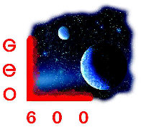


Direct Searches for Scalar Field Dark Matter with Laser Interferometers
Phys. Rev. Lett. 128, 121101 (2022)
Nature 600, 424–428 (2021)
Sander M. Vermeulen¹, Lorenzo Aiello¹, H. Grote¹, P. Relton¹, V. Raymond¹ et al.^{1,2,3,4}
¹Gravity Exploration Institute, Cardiff University
²Max-Planck-Institute for Gravitational Physics and Leibniz University Hannover
³School of Physics and Astronomy, University of Glasgow
⁴ Fermi National Accelerator Laboratory, Batavia, Illinois 60510, USA
Sander M. Vermeulen

Slide 22

Dark Matter, broadly speaking
(Mostly) issues with gravitation:
Solution 1: add terms here (dark matter)
Solution 2: add terms here (modified gravity)
Solution 3?: replace the theory (quantum gravity?)
Sander M. Vermeulen

Slide 23
Recent Developments:
WIMPs were not detected (miracle)
Particle DM is now in trouble, it does not explain:
  Mass distribution in galaxies (central overdensity not observed)
  Satellite galaxies (too few observed, too aligned)
  Baryonic Tully-Fischer relation (rotation velocity strongly correlated with luminous matter)
  Renzo’s Rule (features in rotation curve strongly correlated with luminous matter)
  The Bullet Cluster (high velocities very improbable with particle DM due to friction)
Sander M. Vermeulen

Slide 24
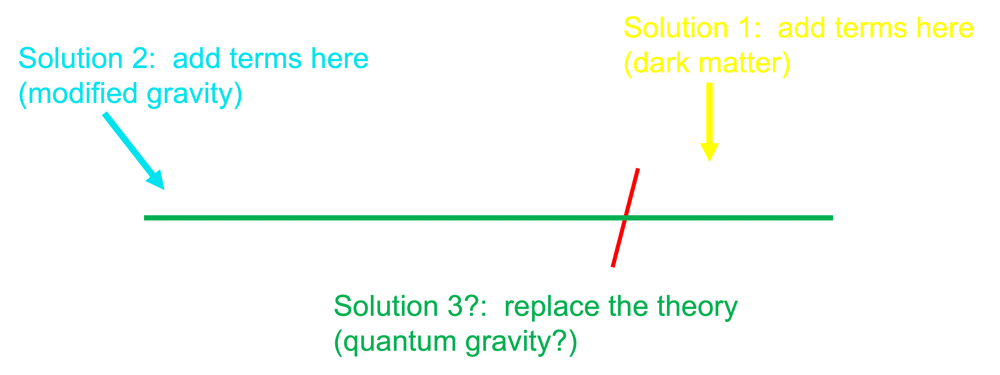
Why do we still study (particle) DM?
Dark matter is simpler than other solutions to the problem
The SM has explained all normal matter, and does not preclude the existence of extra matter
QFT provides machinery to quickly make testable predictions
Sander M. Vermeulen

Slide 25
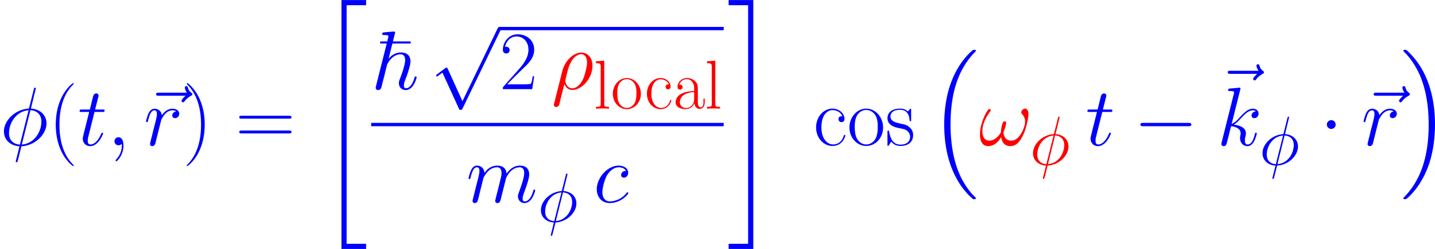
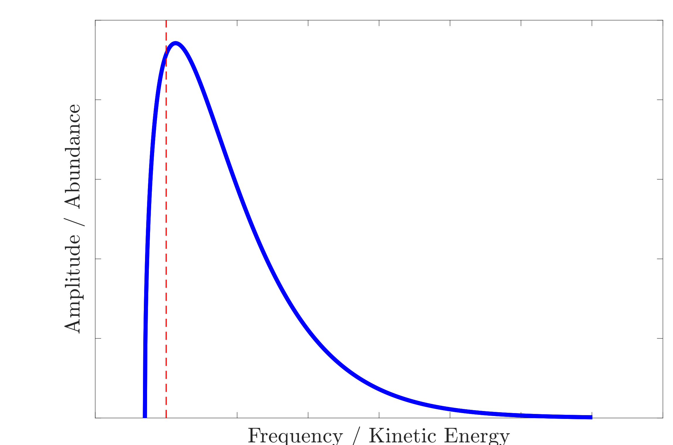
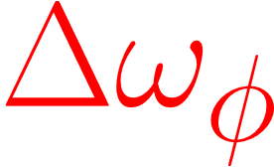
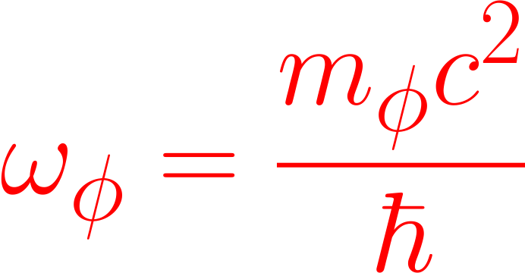
Sub-eV scalar field Dark Matter
(includes WISP/VULF, Dilaton, Modulus, Relaxion, …)
Produced in early Universe by e.g. ‘misalignment mechanism’, manifests as oscillating field with local density ρ_{local}
Viralised DM frequency distribution
Trapped and virialised in gravitational potential wells of e.g. galaxies

Slide 26
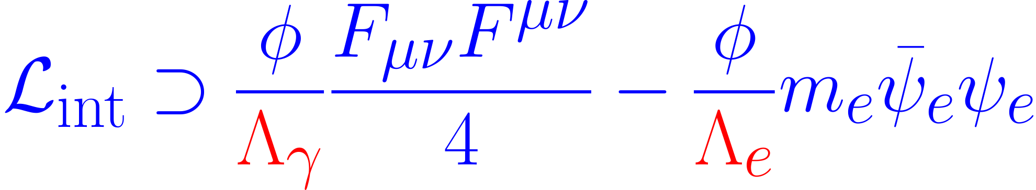
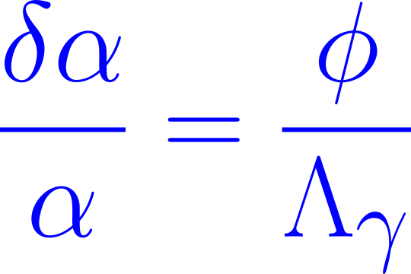
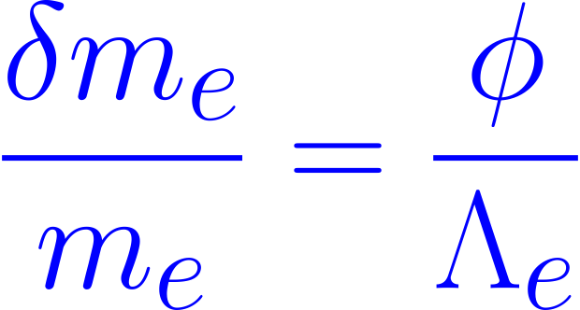




Scalar DM changes size and refractive index of solids
Couples to SM photon and electron fields with coupling strength Λ_{𝛾, e}
Scalar DM changes electron mass 𝑚_{e} and fine structure constant 𝛼
Causes oscillatory changes of size l and refractive index n of solids
Grote & Stadnik (2019)

Slide 27







Scalar DM Couples to an Interferometer
DM field TROUGH
DM field CREST
R = 50%
R ≈ 0%
Grote & Stadnik (2019)

Slide 28
Scalar DM Couples to an Interferometer
LIGO/Virgo/KAGRA have high arm strain sensitivity, relatively lower phase sensitivity
DM field TROUGH
DM field CREST
→ GEO600 most sensitive interferometer for this signal
only in Fabry-Pérot interf.
Grote & Stadnik (2019)

Slide 29
DM search w/ co-located interferometers
Signal is correlated, noise is not
Scalar DM wave
Sander M. Vermeulen

Slide 30



Expected signal from scalar DM in an interferometer
DM abundance
Frequency set by DM mass
DM coupling parameter
Beamsplitter properties
Spectral linewidth

Slide 31

Dark matter signal is pseudo-coherent
Quasi-monochromatic signals → Problems with spectral analysis
Signal becomes incoherent with itself for T_{DFT} > τ_{coh}
Large spectral measurement uncertainty for T_{DFT} < τ_{coh}
Centers+ (2021)

Slide 32
Custom spectral analysis for max. SNR
Δf_{bin} = Δf_{DM} ⟺ T_{DFT} = 𝜏_{coh}
→ Gives max. SNR

Slide 33


Spectral analysis
GEO 600
Fermilab Holometer
Check persistence and frequency stability of candidate signals

Slide 34

Follow-up analysis of candidate signals
14 candidate signals are persistent in time
Follow-up analysis showed these 14 peaks are inconsistent with dark matter
No DM found → scalar field DM models are constrained

Slide 35

Constraints on Scalar Field Dark Matter

Slide 36

Thank you for your attention.
Cardiff experimental gravity group:
Aldo Ejlli
Will Griffiths
Kate Dooley
Sander Vermeulen
Lorenzo Aiello
Hartmut Grote
Ali James
Terri Pearce
Keiko Kokeyama
Abhinav Patra
Eyal Schwartz
Sander M. Vermeulen

Slide 37


Constraints on Scalar Field DM
Basic Scalar
Dilaton/Modulus
Relaxion Halo
Nature 600, 424–428 (2021)

Slide 38


New Constraints on Scalar Field DM
Relaxion Halo
Relaxion Halo Overdensities
Banerjee et al. (2020)

Slide 39
Custom spectral analysis for max. SNR

Slide 40
224 Hz Peak

Slide 41



Frequency response of a beamsplitter
Size changes
log( Response )
Refractive index changes
GW detectors
log( DM Frequency )

