Slide 1
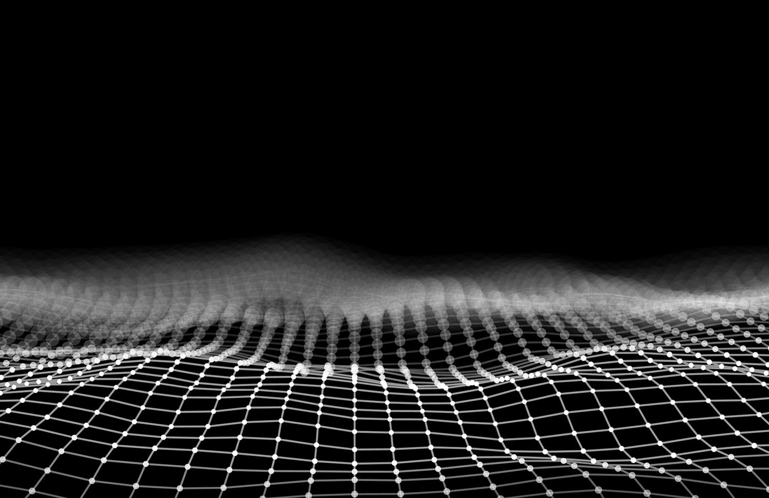
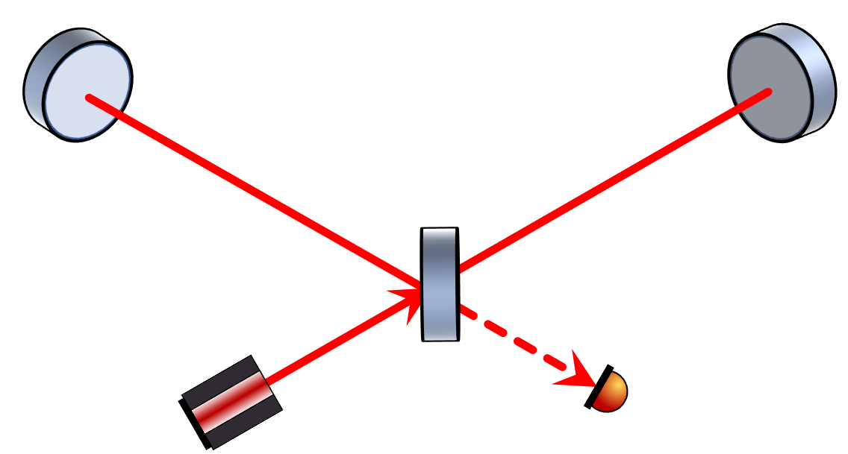

Photon counting interferometry to detect geontropic space-time fluctuations with GQuEST
Sander M. Vermeulen
McCuller Lab
California Institute of Technology

Slide 2
Outline
Introduction to GQuEST
Holographic Quantum Gravity Fluctuations
Basics of Laser Interferometry
Homodyne Readout
Photon Counting Readout
Classical Noises

Slide 3
GQuEST in short
Twin lab-scale (5 m) Michelson laser interferometers
Search for holographic quantum space-time fluctuations
i.e. Gravity from the Quantum Entanglement of Space-Time
Novel ‘photon counting readout’ evades quantum noise
Subsystems are under construction, awaiting new lab completion

Slide 4
Why use an interferometer to detect quantum gravity?
Gravity is Geometry
→ Geometry is Quantum-Mechanical
Gravity is Quantum-Mechanical
→ Distance measurements exhibit quantum fluctuations

Slide 5
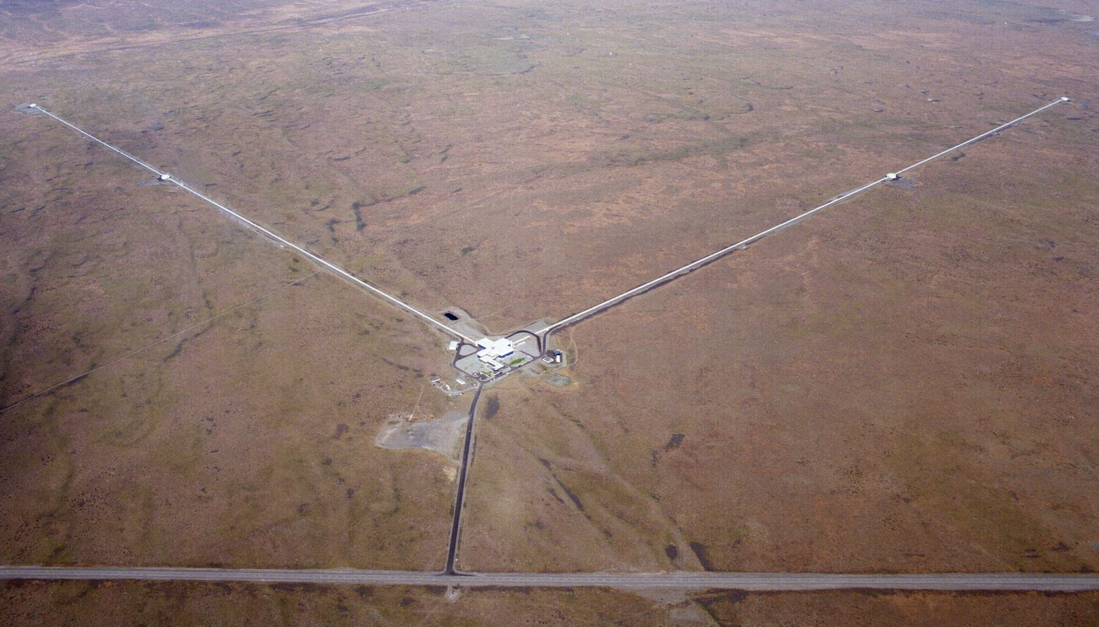
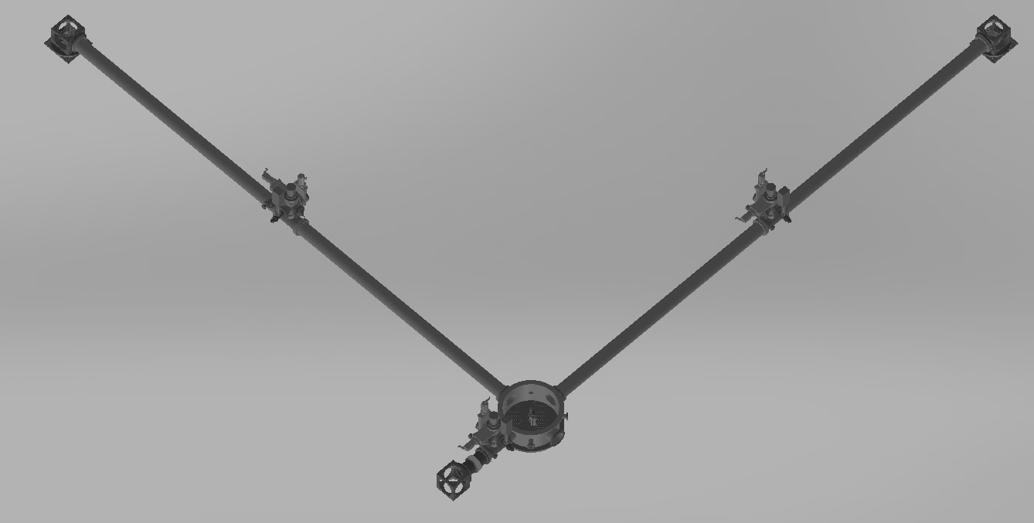


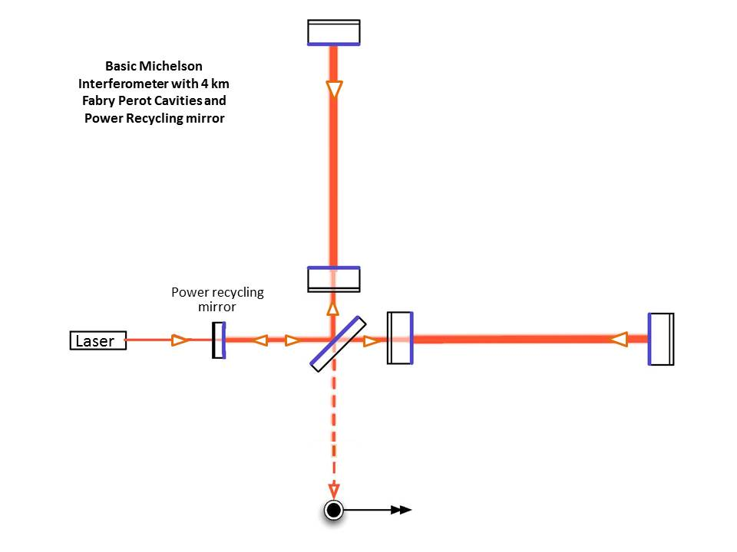
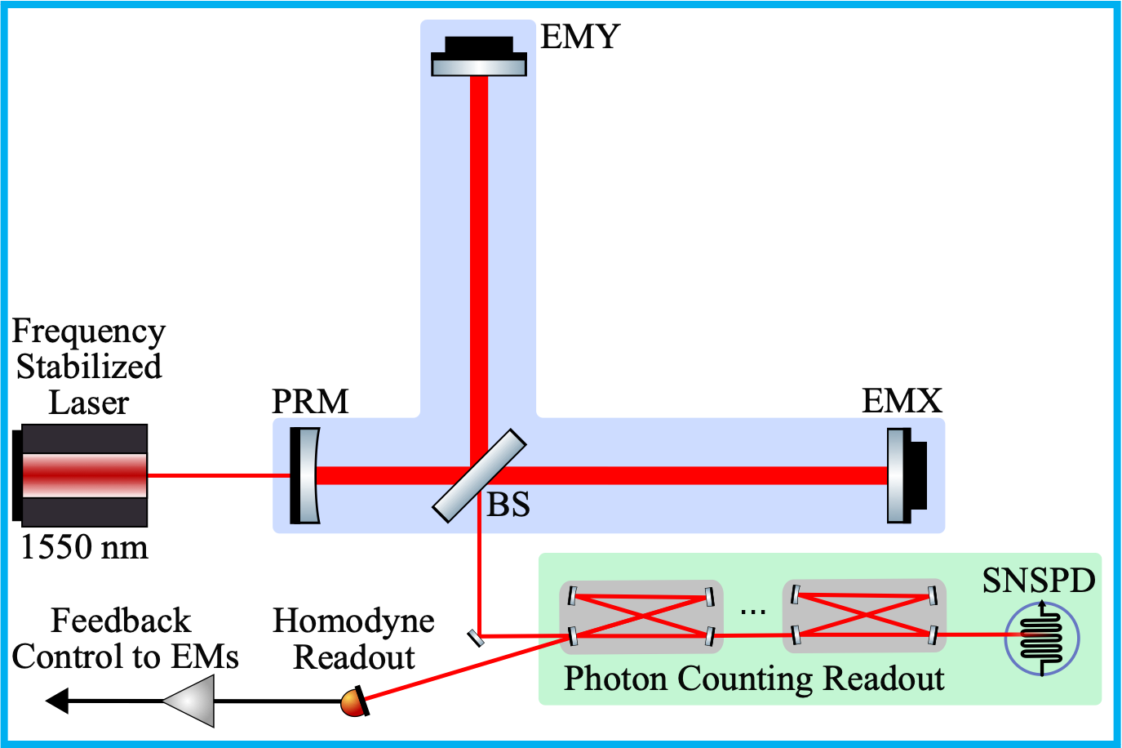
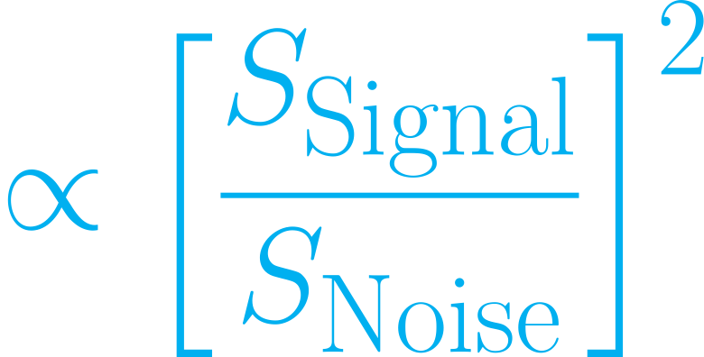
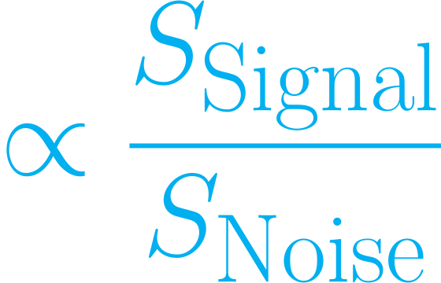

LIGO vs. GQuEST
Sensitivity to length changes:
4 km
5 m
@ 100 Hz
@ 10 MHz
Detection statistic:

Slide 6
Heuristic Holographic Quantum Gravity

Slide 7
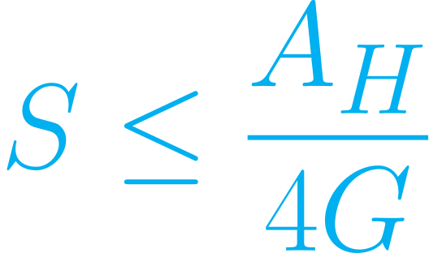
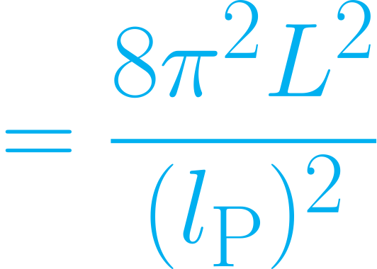
Heuristics of Holographic Quantum Gravity
Covariant Entropy Bound:
Area of causal horizon
Radius of spherical horizon
Entropy ‘inside’ horizon
→ Saturated for black holes (Generalised 2nd law of T.D.)

Slide 8

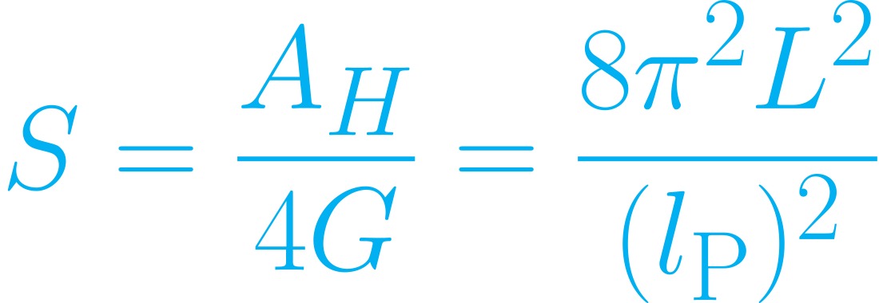

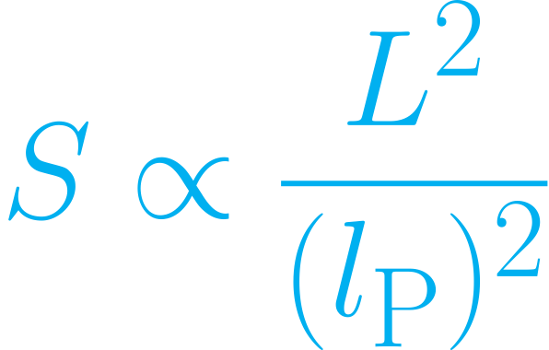

Heuristics of Holographic Quantum Gravity
Assume Covariant Entropy Bound is saturated:
time
space
Rindler/Killing horizon
space
space
space
space

Slide 9
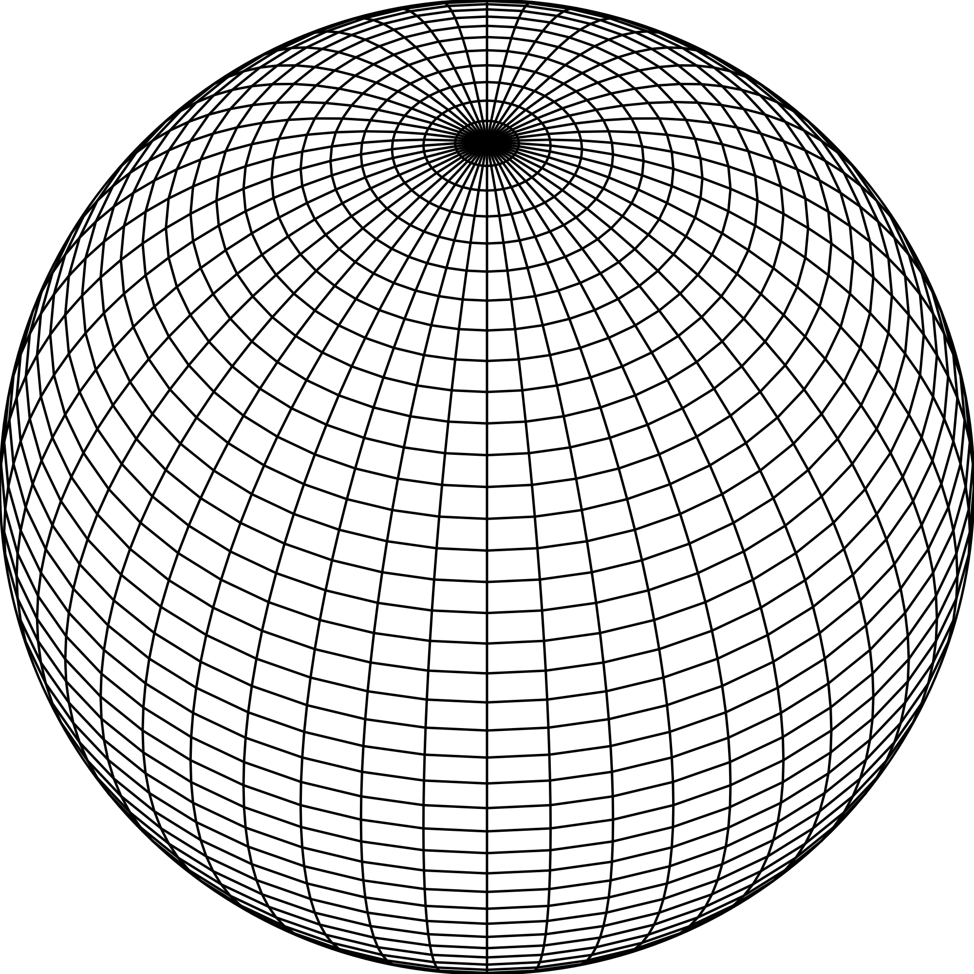

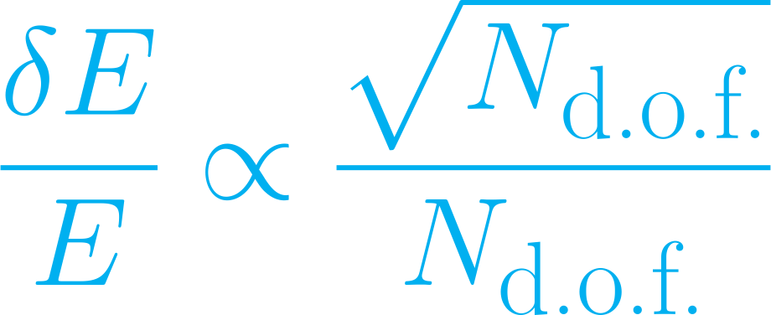
Heuristics of Holographic Quantum Gravity
Associate degrees of freedom to the entropy:
Assume degrees of freedom undergo quantum fluctuations:

Slide 10
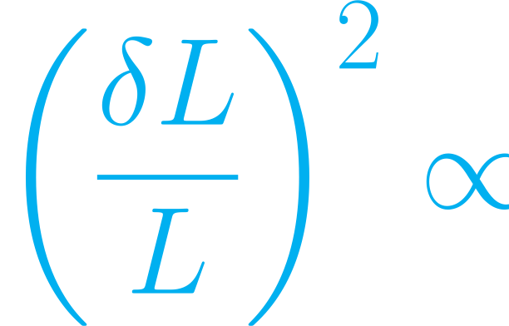
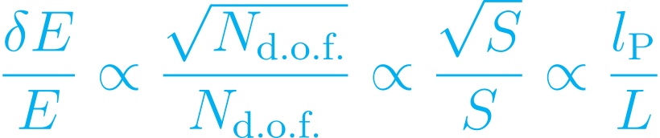


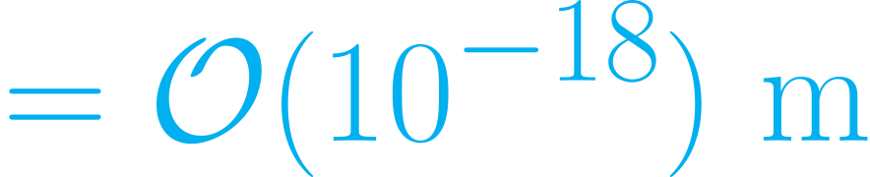
Heuristics of Holographic Quantum Gravity
Gravity
QM
Stat. Mech.
Holography

Slide 11
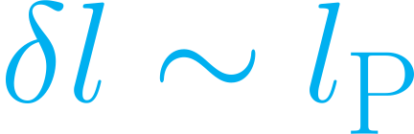
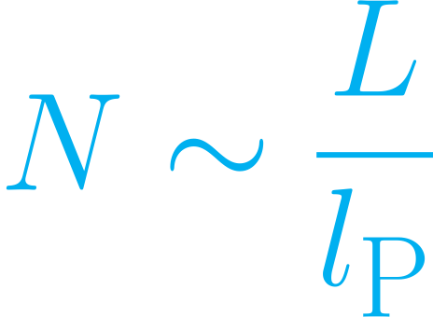
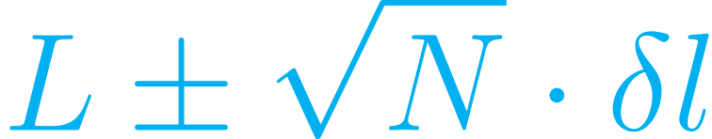

Planck-scale random walk noise
Light cone fluctuations accumulate like a random walk
time
Step size:
Number of steps
space
Total length:

Slide 12
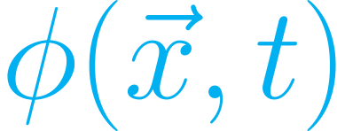
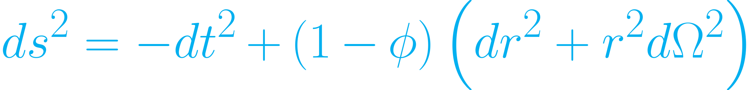
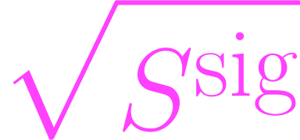
Space-time fluctuations: Pixellon Model
Associate a stochastic scalar field to holographic degrees of freedom:
The field gravitates, perturbing the metric:
→IFO signal spectrum:

Slide 13
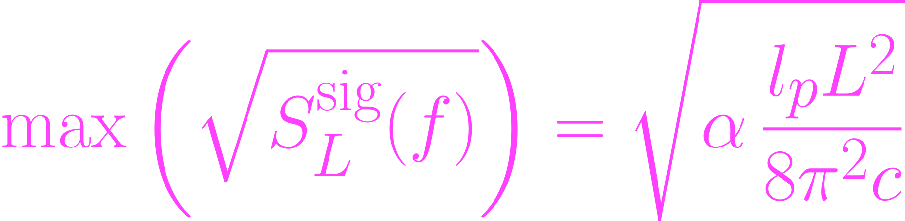
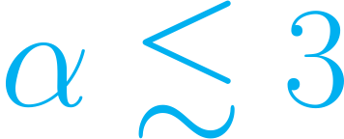

Pixellon Model: LIGO constraints
‘Low’-frequency LIGO constraints:
(with IR cut-off)
(without IR cut-off)

Slide 14
Laser Interferometry & Photon Counting

Slide 15
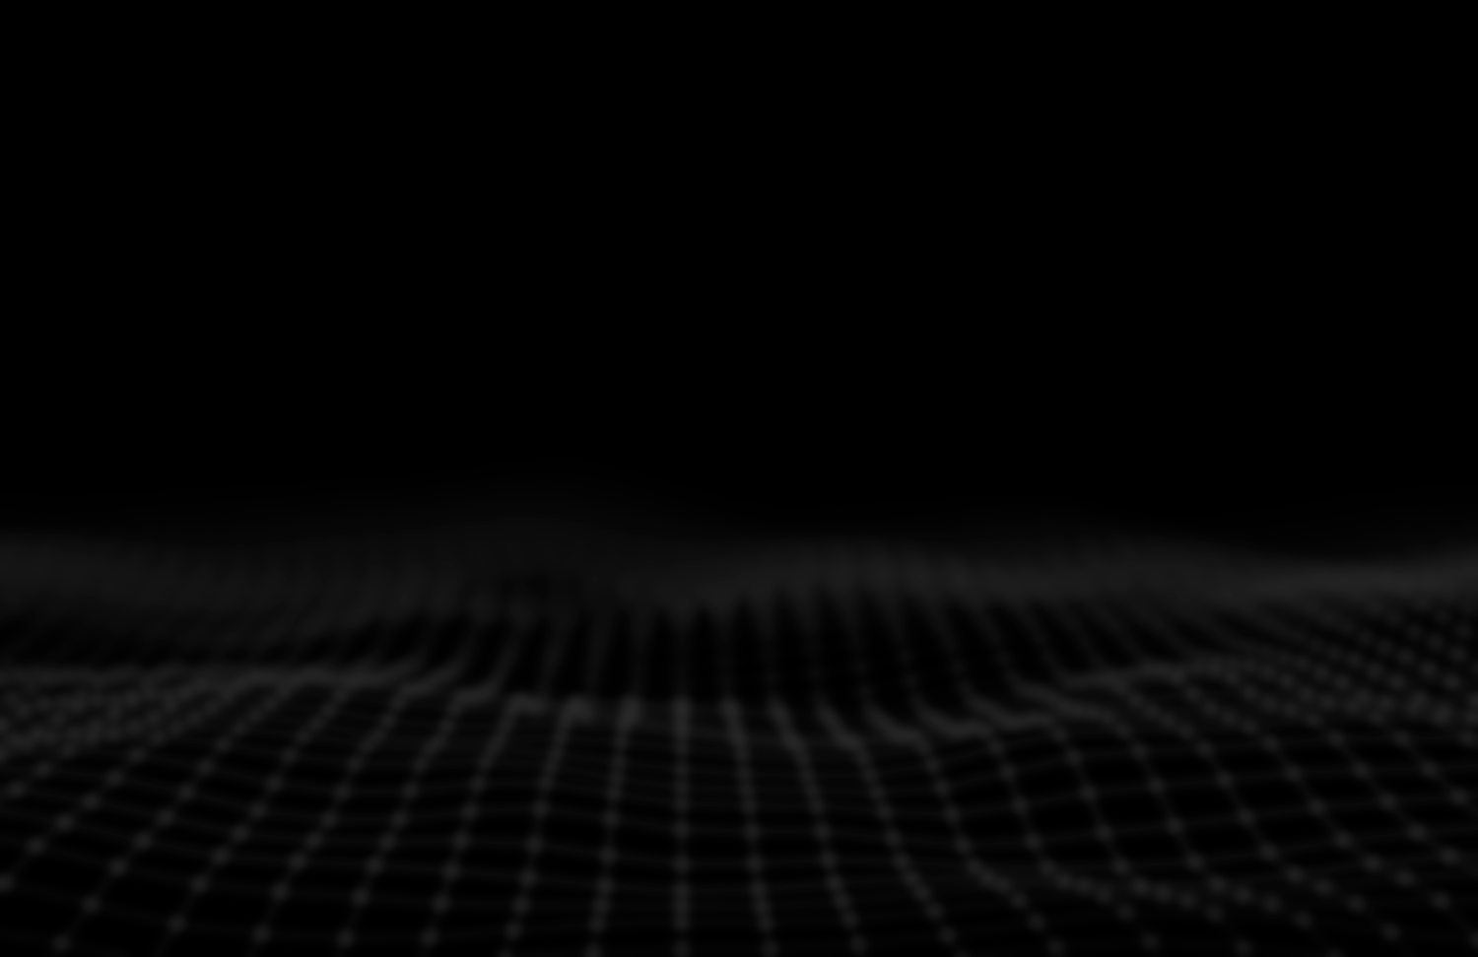



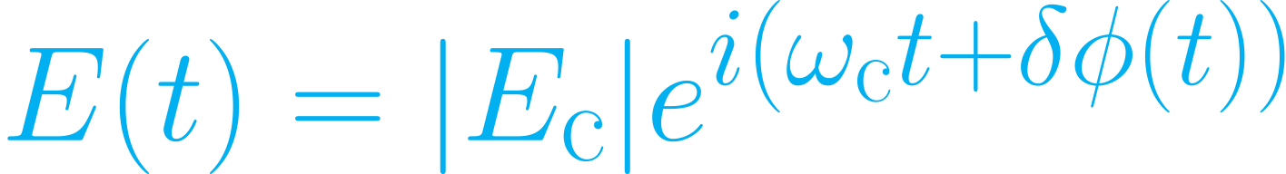
Laser interferometry: measuring phase modulations
Perturbations
or
Signal arm
Reference arm
Modulates the power at the output
Phase modulation of the carrier field:
Field in signal arm

Slide 16
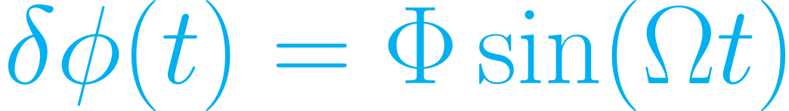



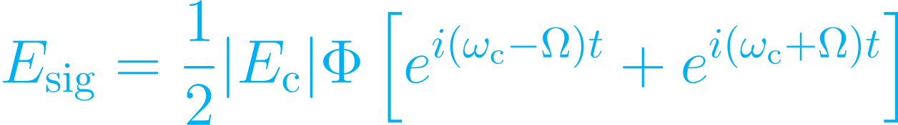



Sideband fields
Expansion for
Carrier
Amplitude
→
Carrier field:
Signal sideband
+ Signal sideband fields
Frequency

Slide 17
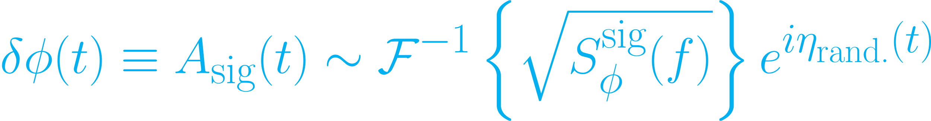

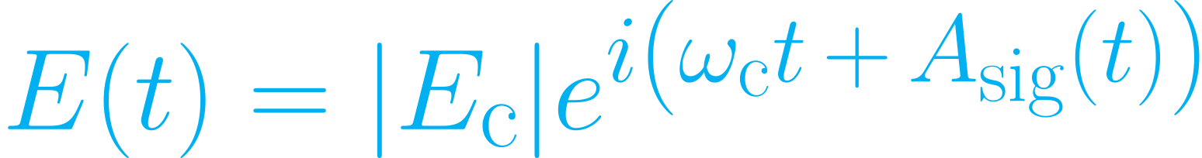



Sideband fields
Expand for
Amplitude
Carrier
→
Signal sideband
Carrier field:
+ Signal sideband fields
Frequency

Slide 18



Homodyne Readout
Introduce a small static arm-length difference
→ Allows carrier field to leak into the output:
Amplitude (P)
Frequency
Sidebands beat with ‘local oscillator’

Slide 19

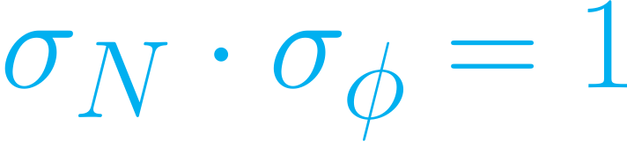
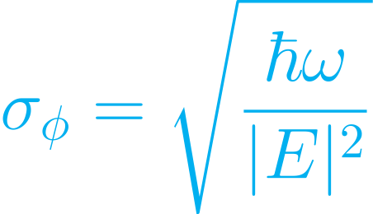
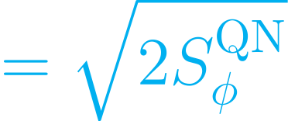
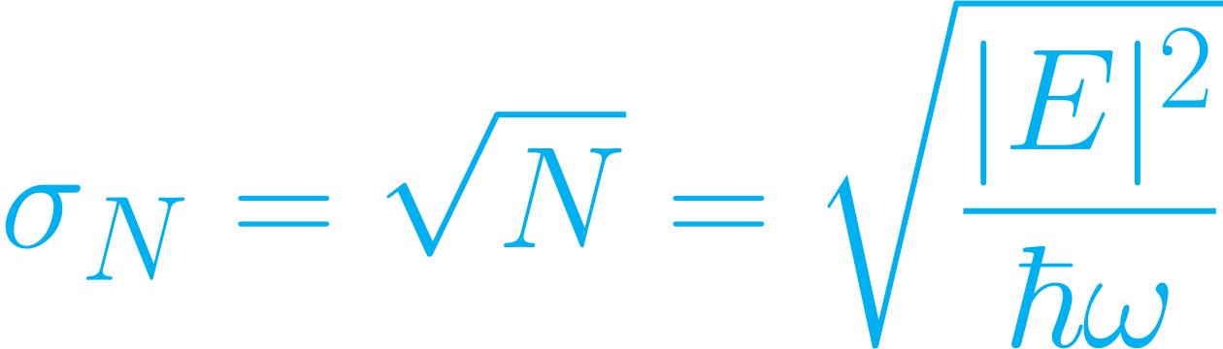


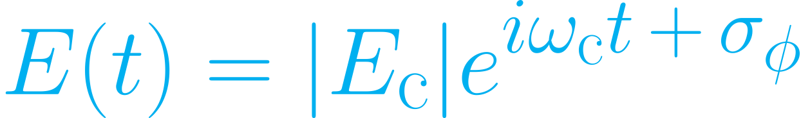
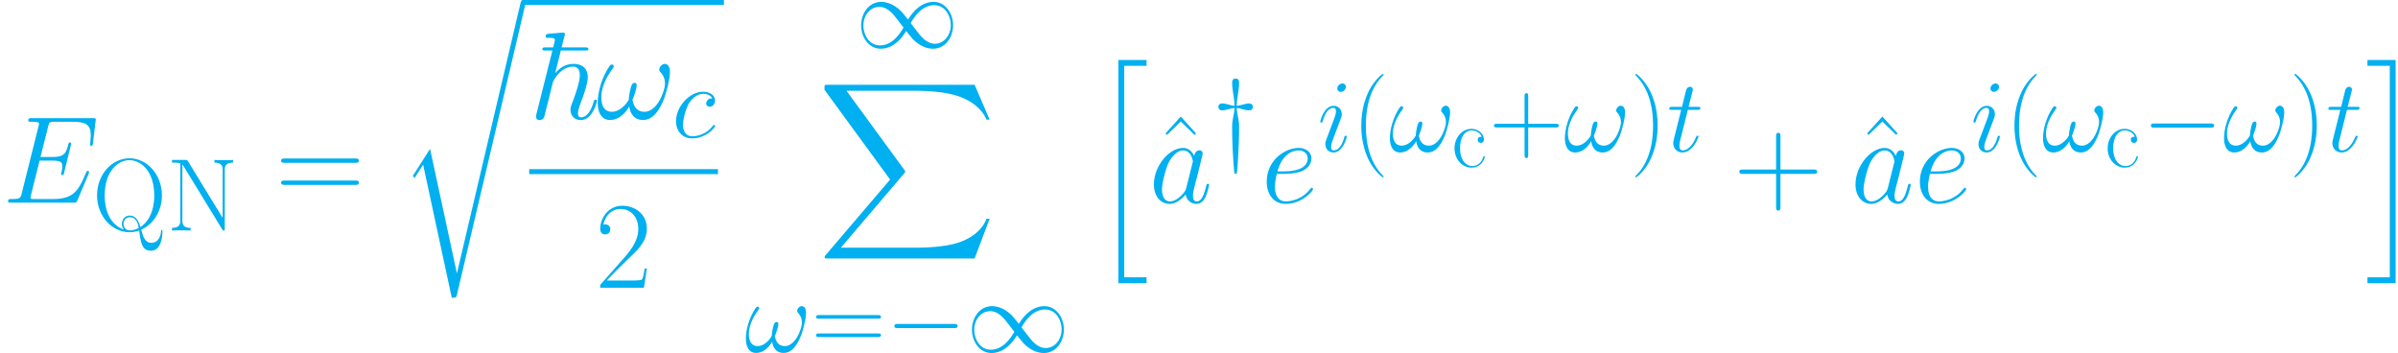

Quantum Shot Noise
Heisenberg uncertainty for coherent optical state:
Amplitude
Quantum noise ‘sidebands’:
Frequency

Slide 20


Homodyne Readout: Shot Noise
Quantum uncertainty produces measured shot noise
Amplitude (P)
Frequency

Slide 21

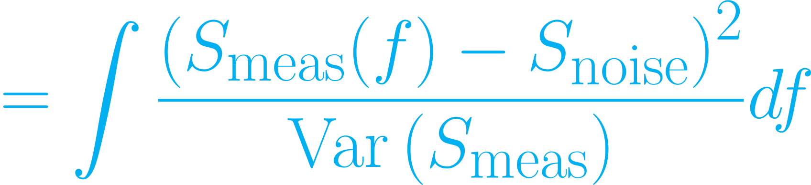
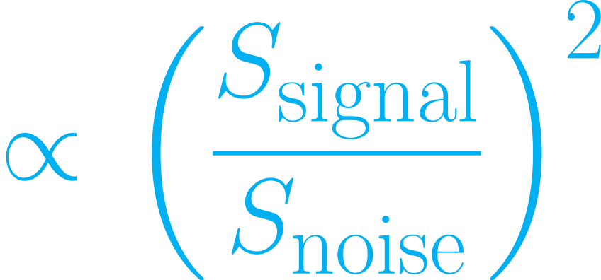
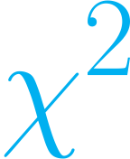
Homodyne Readout: Statistics
Amplitude (P)
Detection statistic:
4 orders of magnitude
Frequency
Can we do better?
→Yes, with photon counting!

Slide 22
Photon Counting: Intuition
Homodyne readout measures time-dependence, i.e. phase/frequency of the signal
The signal model does not specify these properties…
→ time-dependence/phase/frequency info is useless for finding a signal that is stationary/stochastic/broadband
→ Devise a quantum measurement that does not provide useless info, in exchange for useful info

Slide 23
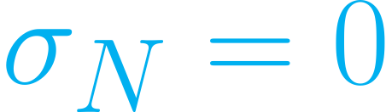


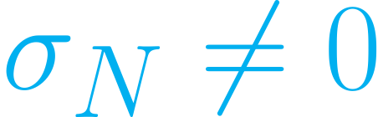
Photon Counting
Measure the number of photons exactly:
→No phase info measured
→Maximum info on signal power
Practical challenges with this approach:
Too much light to discern single signal photons
Too many non-signal photons
→ Can’t count photons precisely

Slide 24
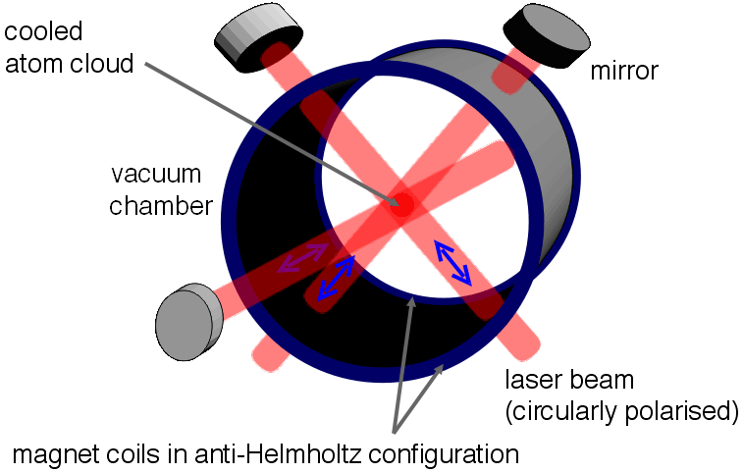
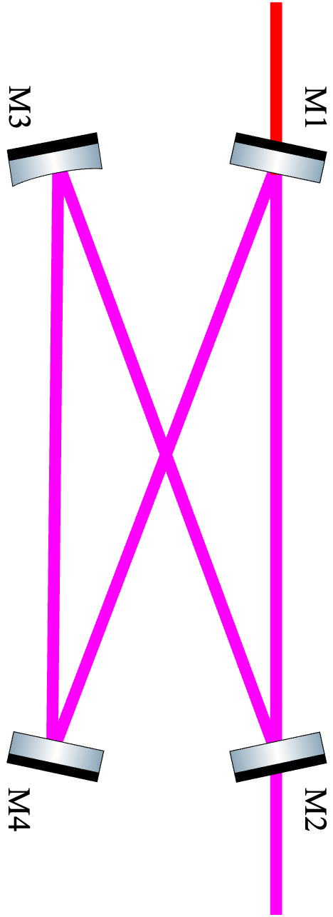


Photon Counting: Filtering
Narrowband optical filter
?
or
or

Slide 25
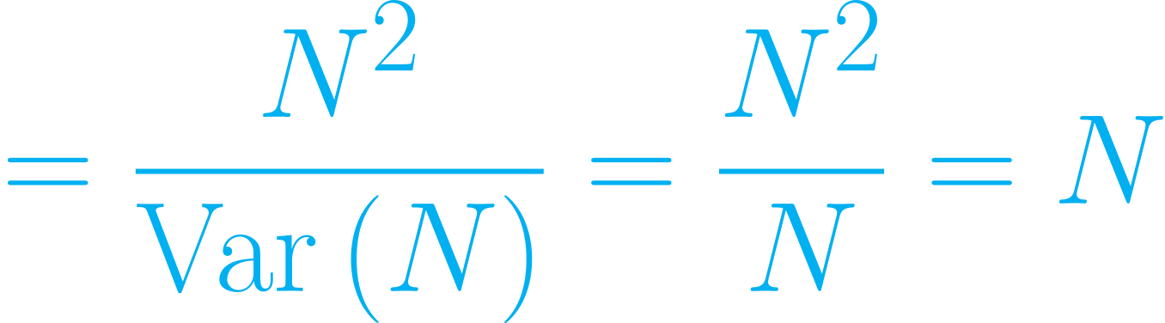
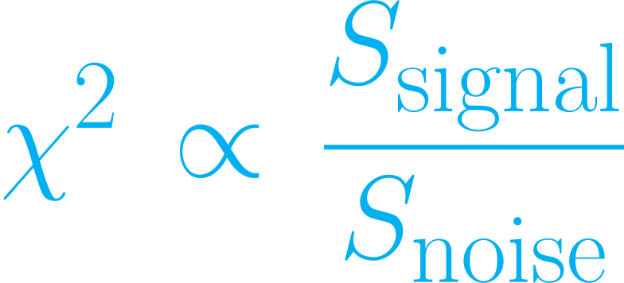
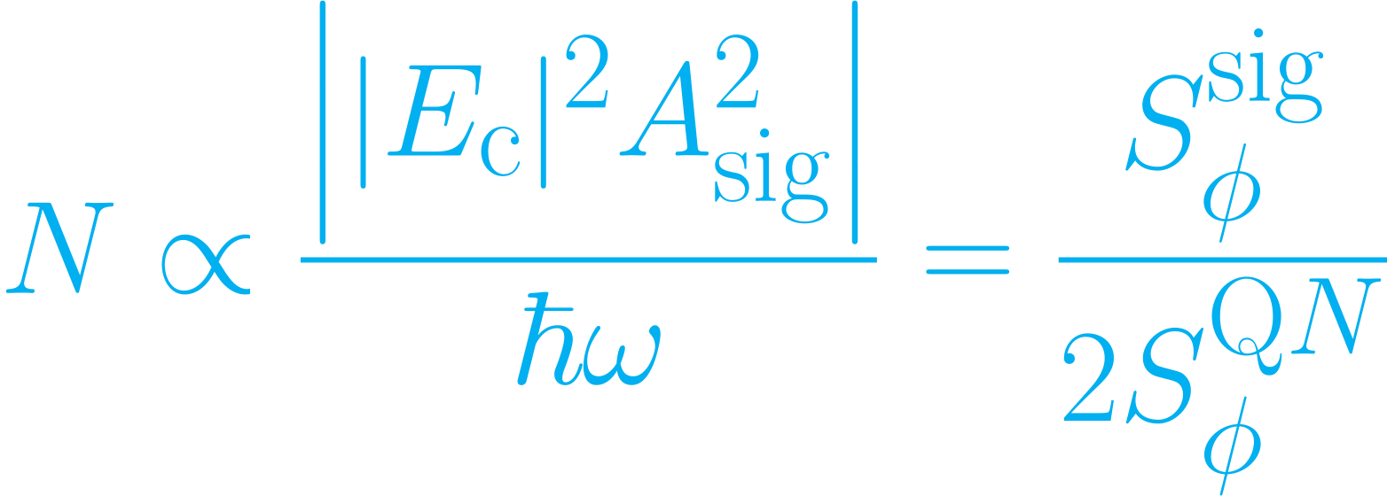
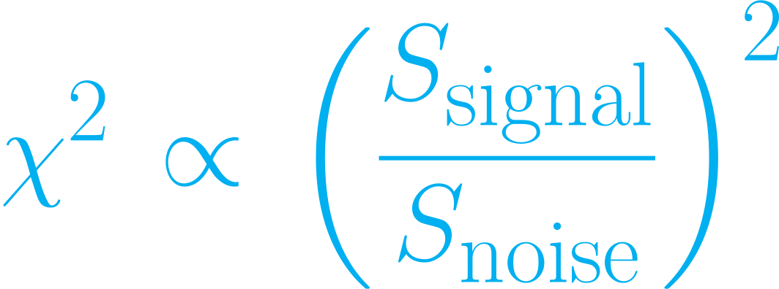
Photon Counting: Statistics
Detection statistic:
Recall for Homodyne readout:

Slide 26
Classical Noise & Outlook

Slide 27
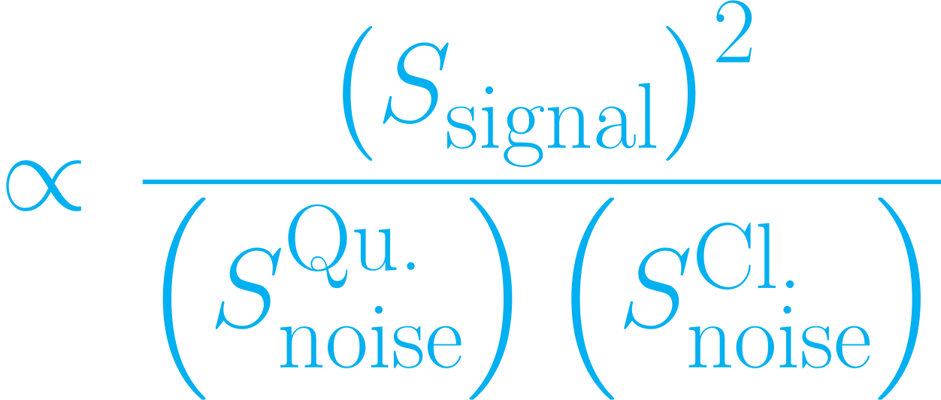
Classical Noise
Classical noise in the filter passband is indistinguishable from signal…

Slide 28
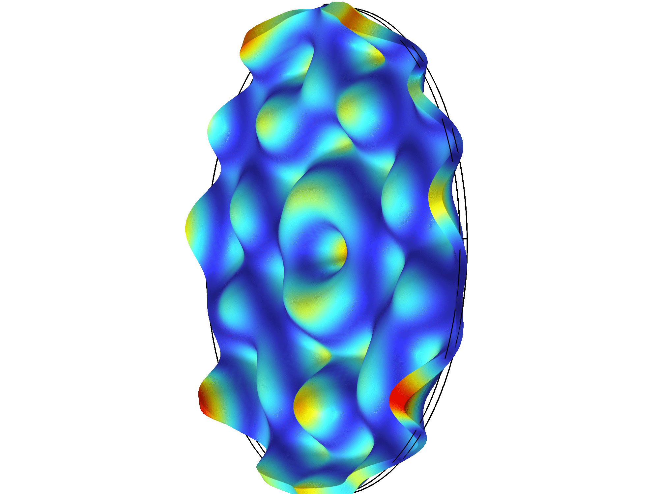

Classical Noise: Mirror Thermal Noise
=

Slide 29


Solid Normal Modes
Longitudinal
Transverse
Slide by Daniel Grass

Slide 30




GQuEST: Outlook
test of quantum gravity within day
+ time it takes to build the experiment…

Slide 31
Conclusions
Holographic Quantum Gravity implies broadband stochastic distance fluctuations
Conventional homodyne readout of interferometers is sub-optimal to detect this signal
Photon counting readout ignores phase information, which yields a quantum advantage
If classical noise is mitigated to below the quantum noise, GQuEST can provide a test of quantum gravity within days

Slide 32
FIN

