Slide 1
GQuEST: Filter Cavities and Technology Demonstrator
Torrey Cullen

Slide 2
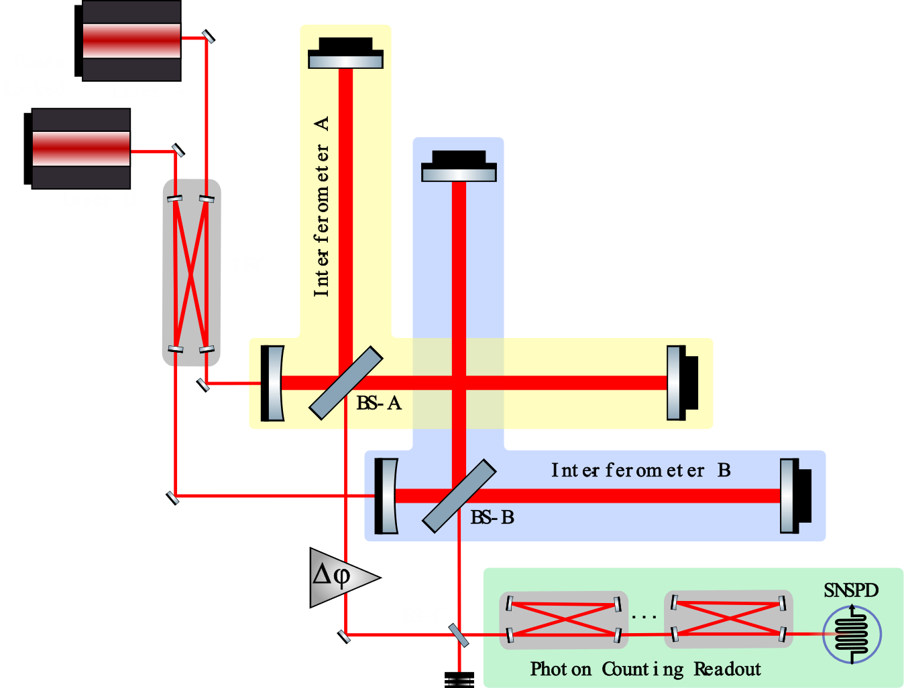
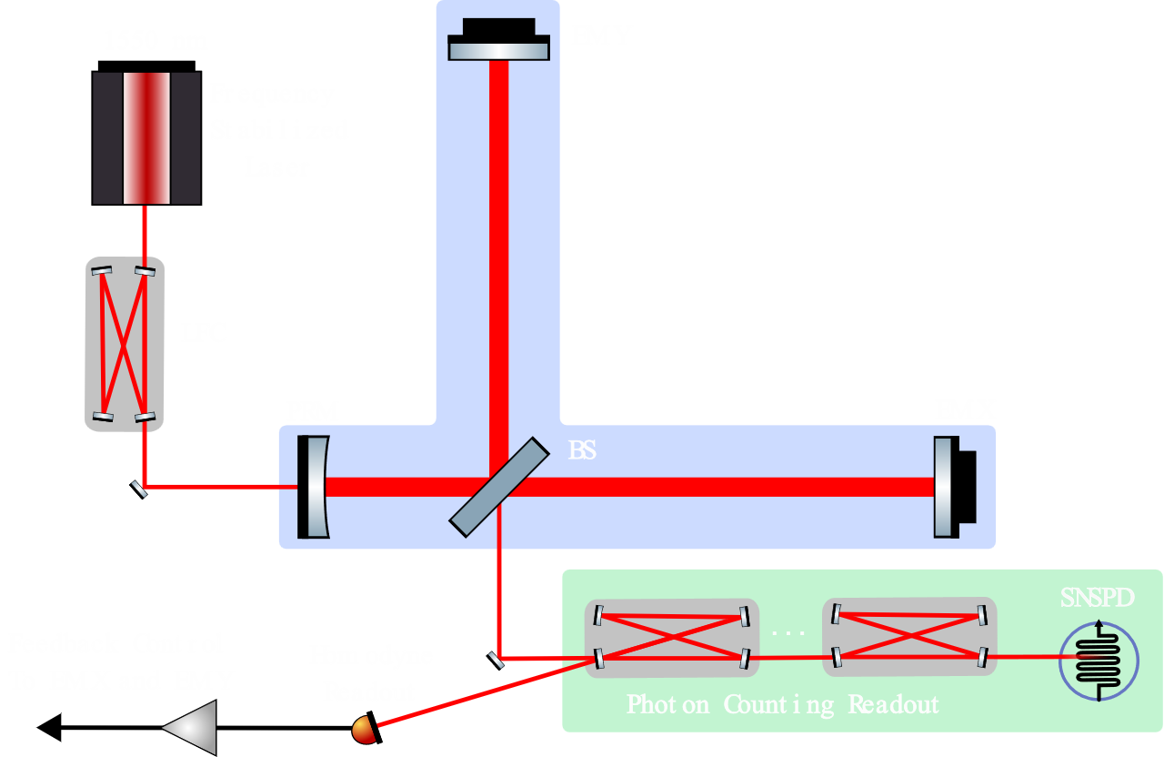
Planned Phases of GQuEST
Demonstrator
Dual longer, nested IFO
Longer IFO
Notes:
-demonstrator: all the components of gquest, L = .5, test classical noise floor.
-single 5m IFO: increase the magnitude of expected signal to detectable level
-Dual nested, long IFO: cross correlate the two outputs to see the correlated signal and remove uncorrelated noises.

Slide 3
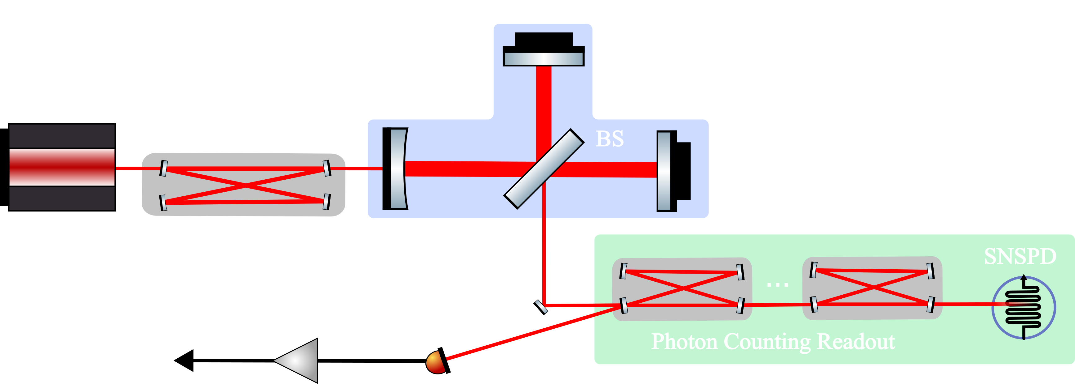
Features of Demonstrator
This interferometer does not have the sensitivity to detect a quantum gravity signal due to its short arm length, but will allow us to tackle experimental challenges outlined in previous talks.
GOAL: to characterize the classical noise floor and achieve low photon count rates with an SNSPD in the absence of a detectable quantum gravity signal. Additional goals of demonstrating new photon counting technology:
1. Carrier-power Isolation – $10^{−24}$ suppression of the carrier!
2. Laser noise
3. Black-body Radiation on SNSPDs
4. Isolate SNSPDs from noise
Notes:
-In this configuration and the longer IFO configuration thermal noise will be about the same, but the signal strength will be much lower in demonstrator. Use this configuration to characterize noise.

Slide 4
(2nd to) Last piece of the puzzle: Filter Cavities.

Slide 5
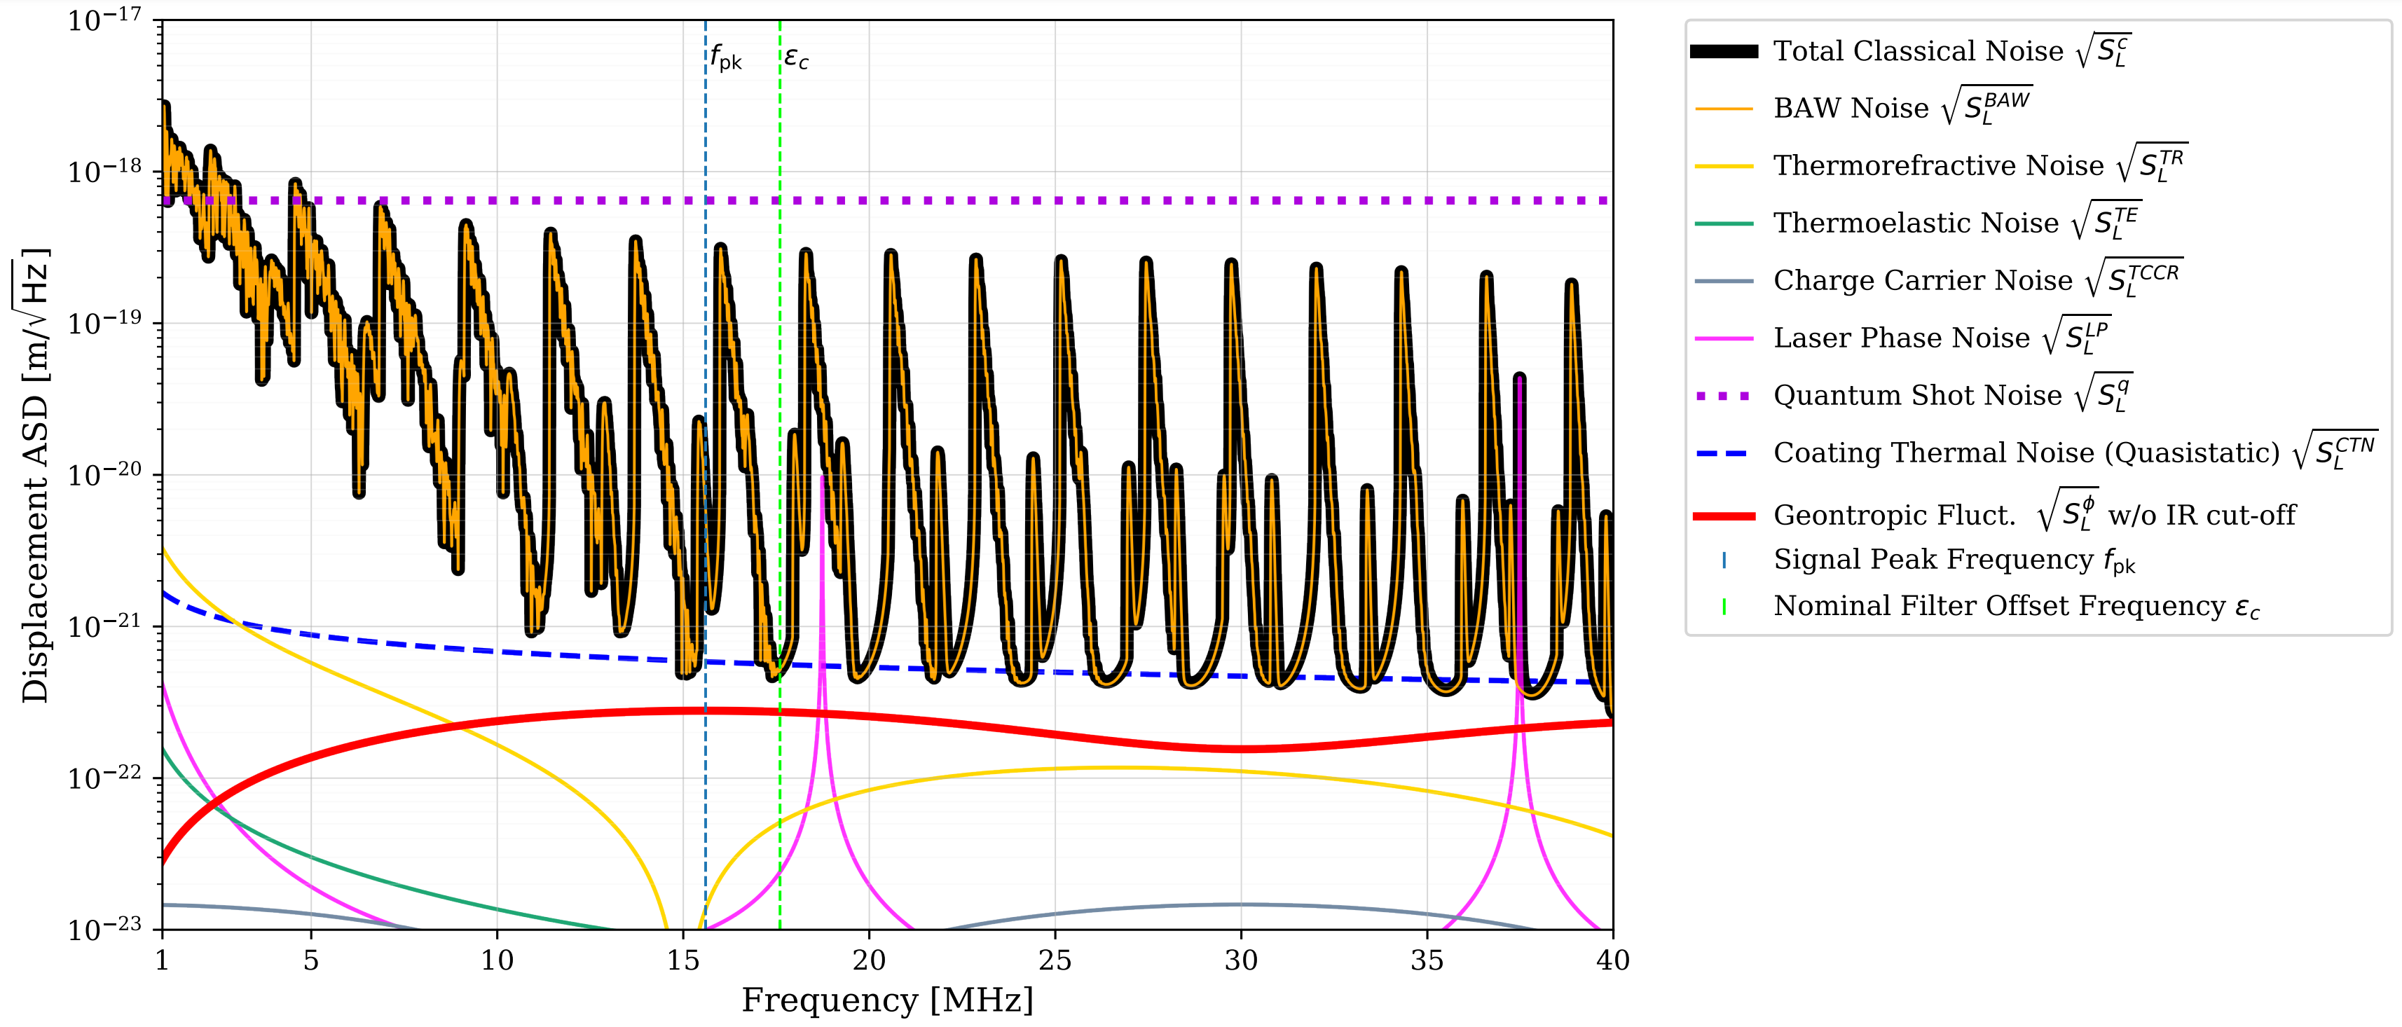
Why do we need Filter Cavities?
Most basic need for filter cavities is quantum shot noise will obscure the signal. Quantum shot noise will be orders of magnitude higher than the expected signal.
Notes:
-bullet point
-graph
-need a separate measurement scheme
-given sufficient measurement time, conventional interferometers using homodyne readout could eventually be able to detect the signal. 2months

Slide 6
Why do we need Filter Cavities?
We want to make single photon detections of the geontropic signal predicted to be on the order of ${10}^{−3}$ photons/sec (Hz) at the SNSPDs.
Current technology of interferometers predicts for GQuEST IFO parameters a leakage of photons (while locking on the dark port) on the order of 100 mW. This is 20 orders of magnitude higher in photon flux than the expected signal.
This leakage occurs due to low frequency perturbations of the IFO arms.
Solution: Filter the output of the IFO through cavities that pass the signal side band frequency and highly suppress everything else.
Notes:
-First bullet point
-If we had a perfect interferometer that locked on no fringe light, any light observed at the output would imply signal presence (assuming classical noise is low enough). Still require SNSPDs to count the single photons
-imperfections in the optics and low-frequency length perturbations of the arms

Slide 7
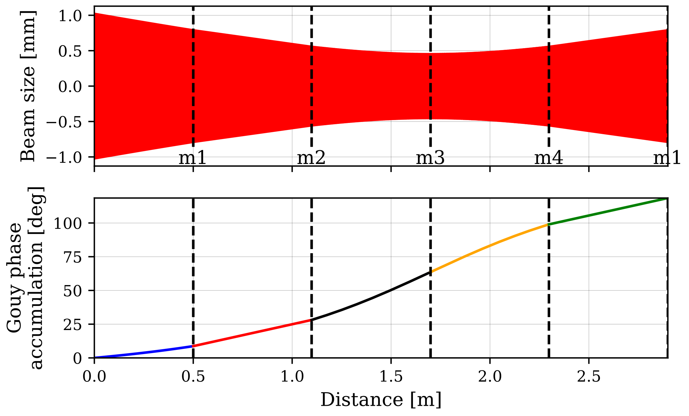
What are the GQuEST Filter Cavities?
Main mechanism used for filtering down the high power output of the IFO down to single photons.
Four mirrors forming a “bow-tie” cavity, similar to LIGO’s output mode cleaner.
Filter at ${\text{ϵ}}_{C}$ = 17.6 MHz, in a “happy valley” of the bulk acoustic wave noise curves to get best SNR possible.

Slide 8
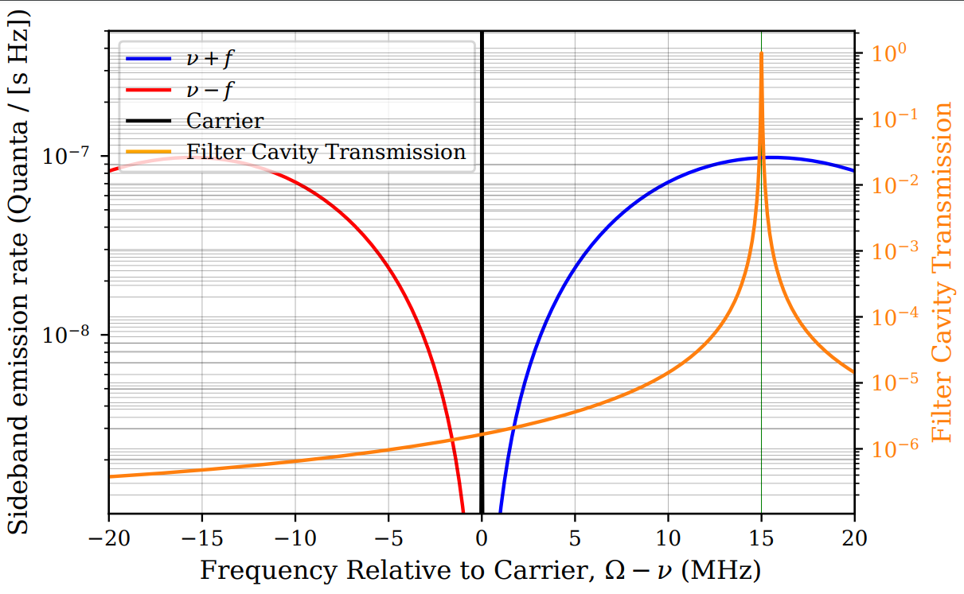
What are the GQuEST Filter Cavities?
GQuEST cavity parameters:
Optical Path Length: 2.4 m
FSR: 125 MHz
Bandwidth: ~40kHz
Finesse: ~3000
Curved M1 mirror creates a waist
58 dB suppression per cavity (four in total, ${10}^{−24}$ or 240 db)
Notes:
-go through parameters
-Here I have a diagram to demonstrate how these filter cavities provide suppression

Slide 9
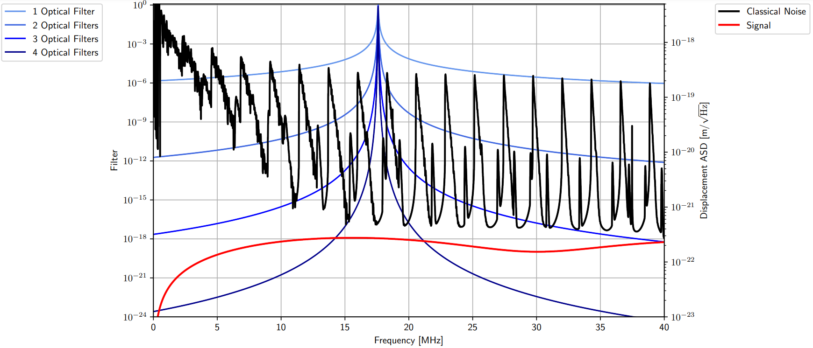
Benefits of multiple filters
Notes:
-frequency centered on a trough
-classical noise spans several orders of magnitude
-trough to signal about x2
-4 filters at carrier about 10^-24

Slide 10
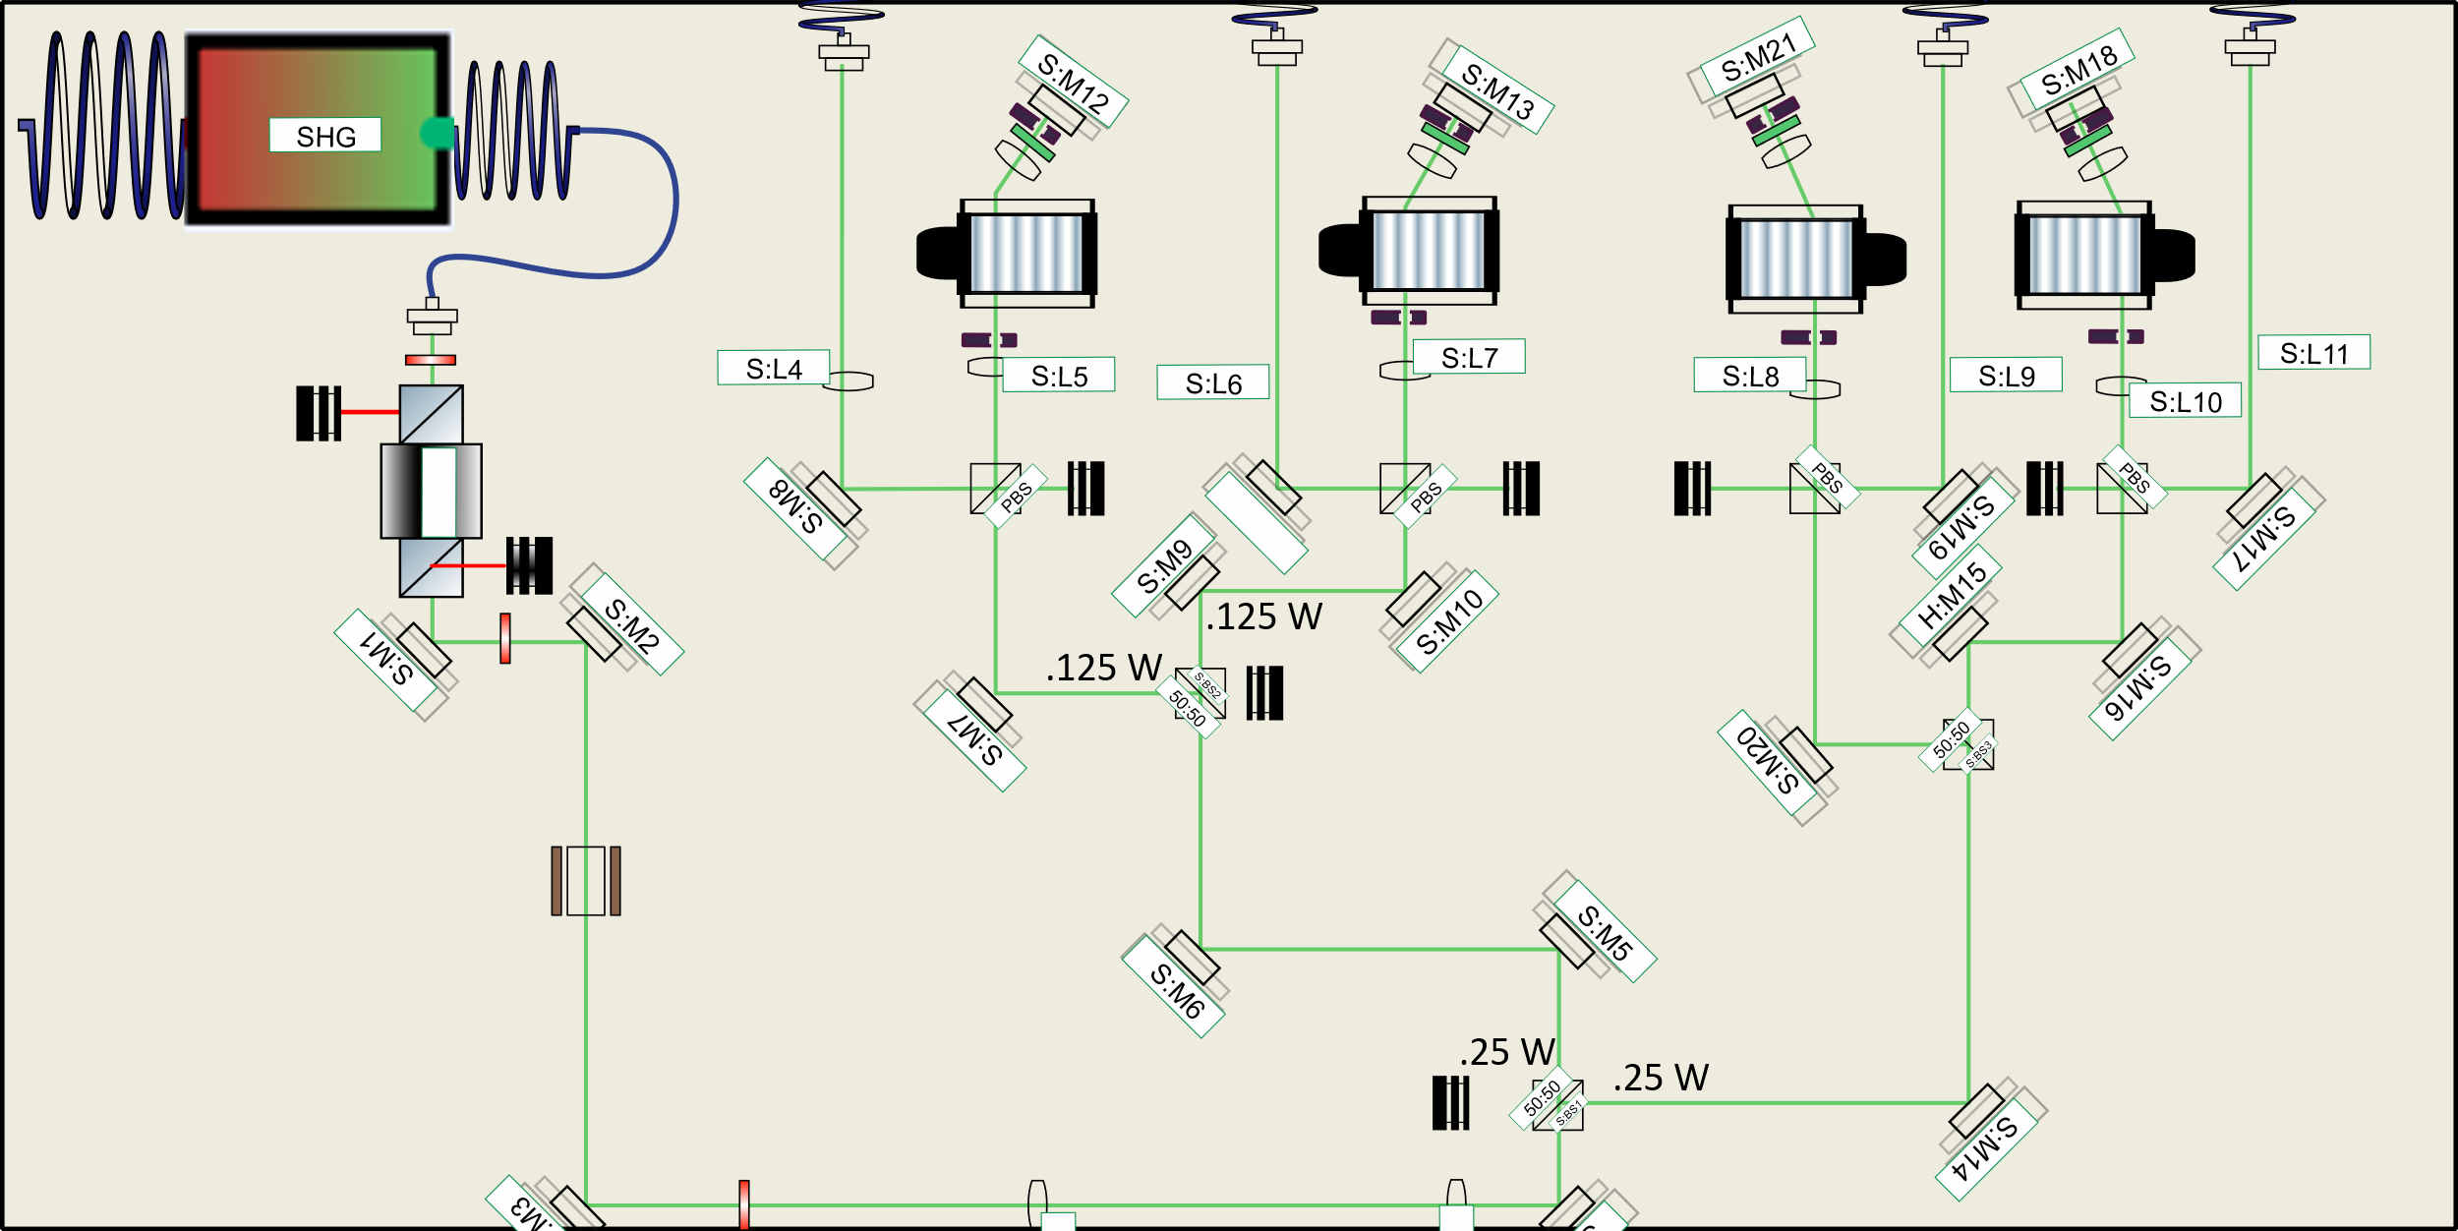
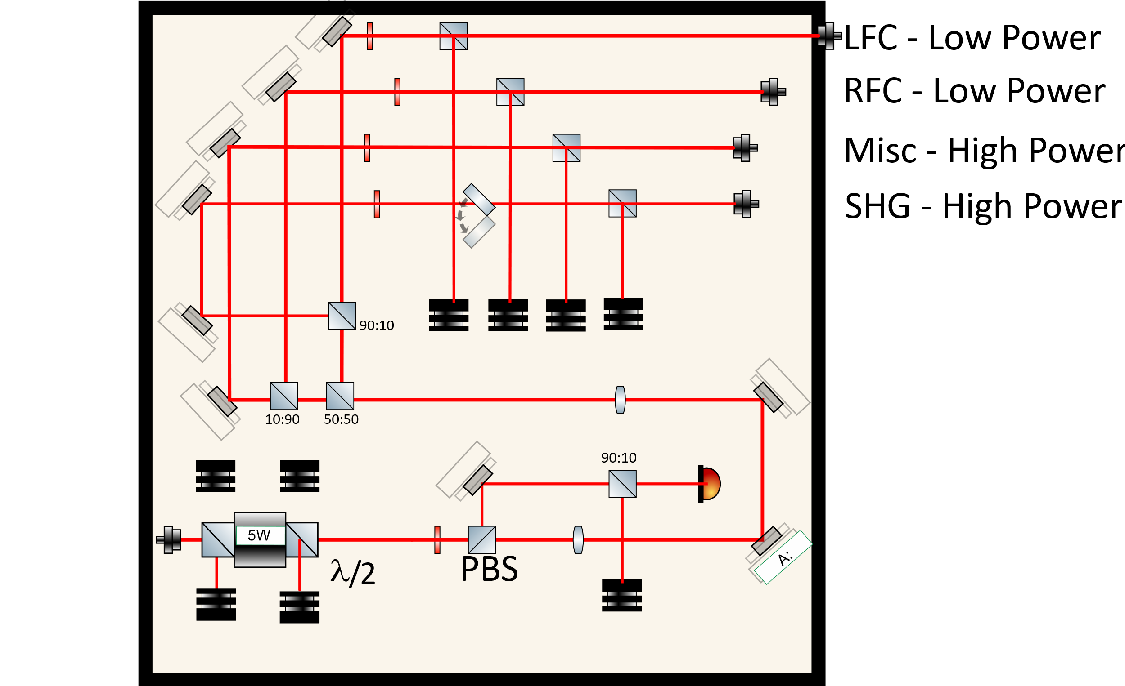
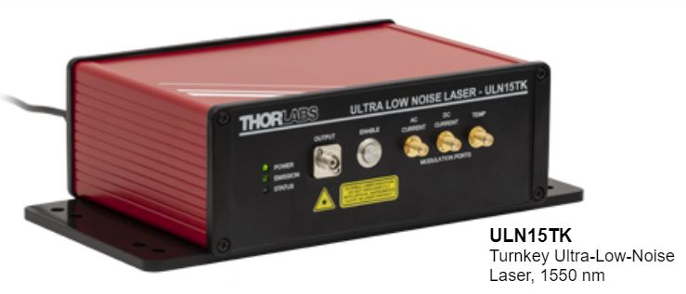
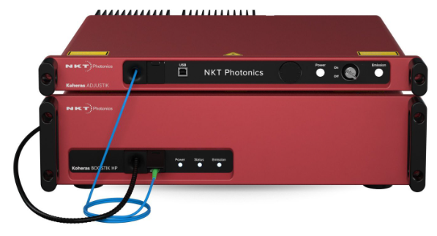
Lab Progress so far
Laser Amplifier (max order 10W)

Slide 11
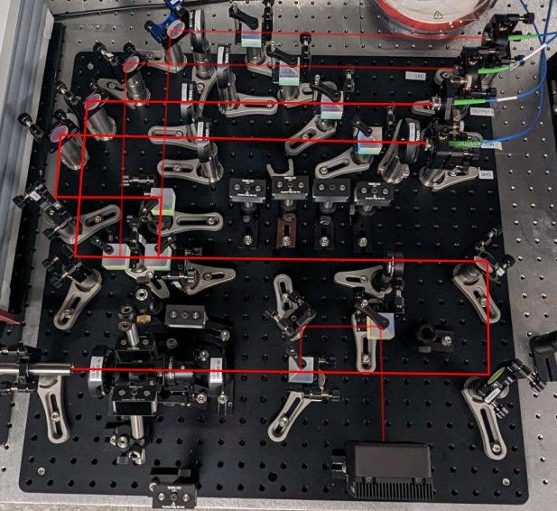
Power Distribution Center

Slide 12
First Output Filter Cavity
To future filter cavities

Slide 13
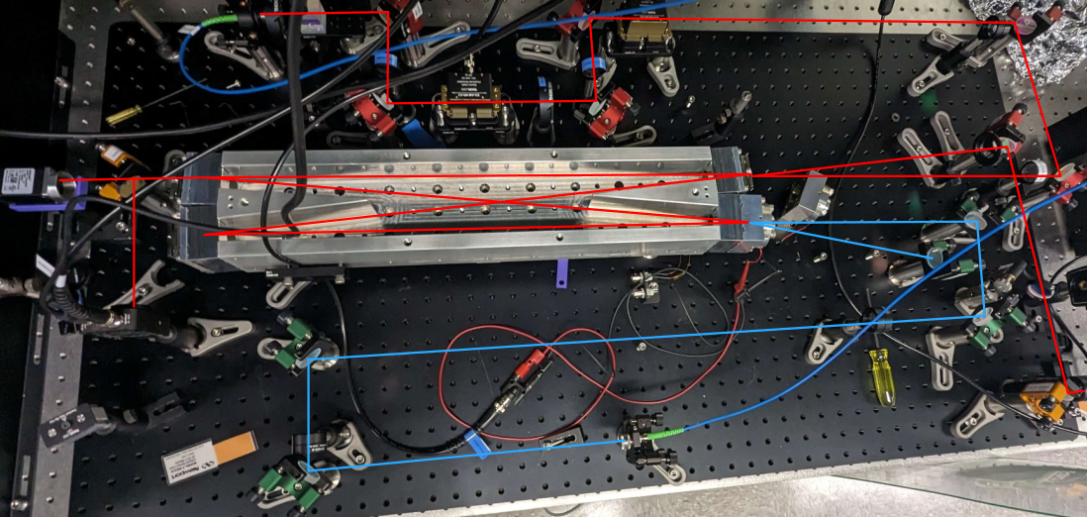
First Output Filter Cavity
Notes:
Camera, pd in transmission. Mirrors in cube. Bottom right one is a piezo mirror that controls the length of the cavity

Slide 14
SHG Farm
Second Harmonic Generation – creates 775nm light used for control of the output filter cavities (OFC).
Sled is designed such that all four fiber inputs are equidistant from the first beam splitter.
Acousto-Optic Modulators (AOMs) in each path to shift the frequency of the 775 light to match the design requirements of each OFC.

Slide 15
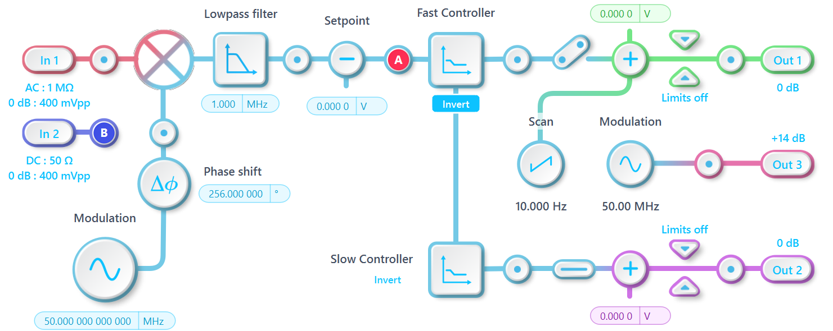
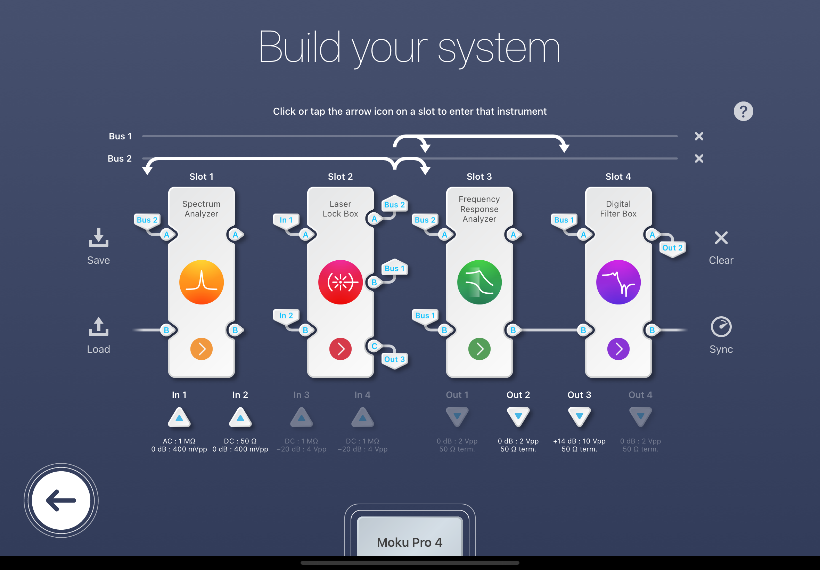
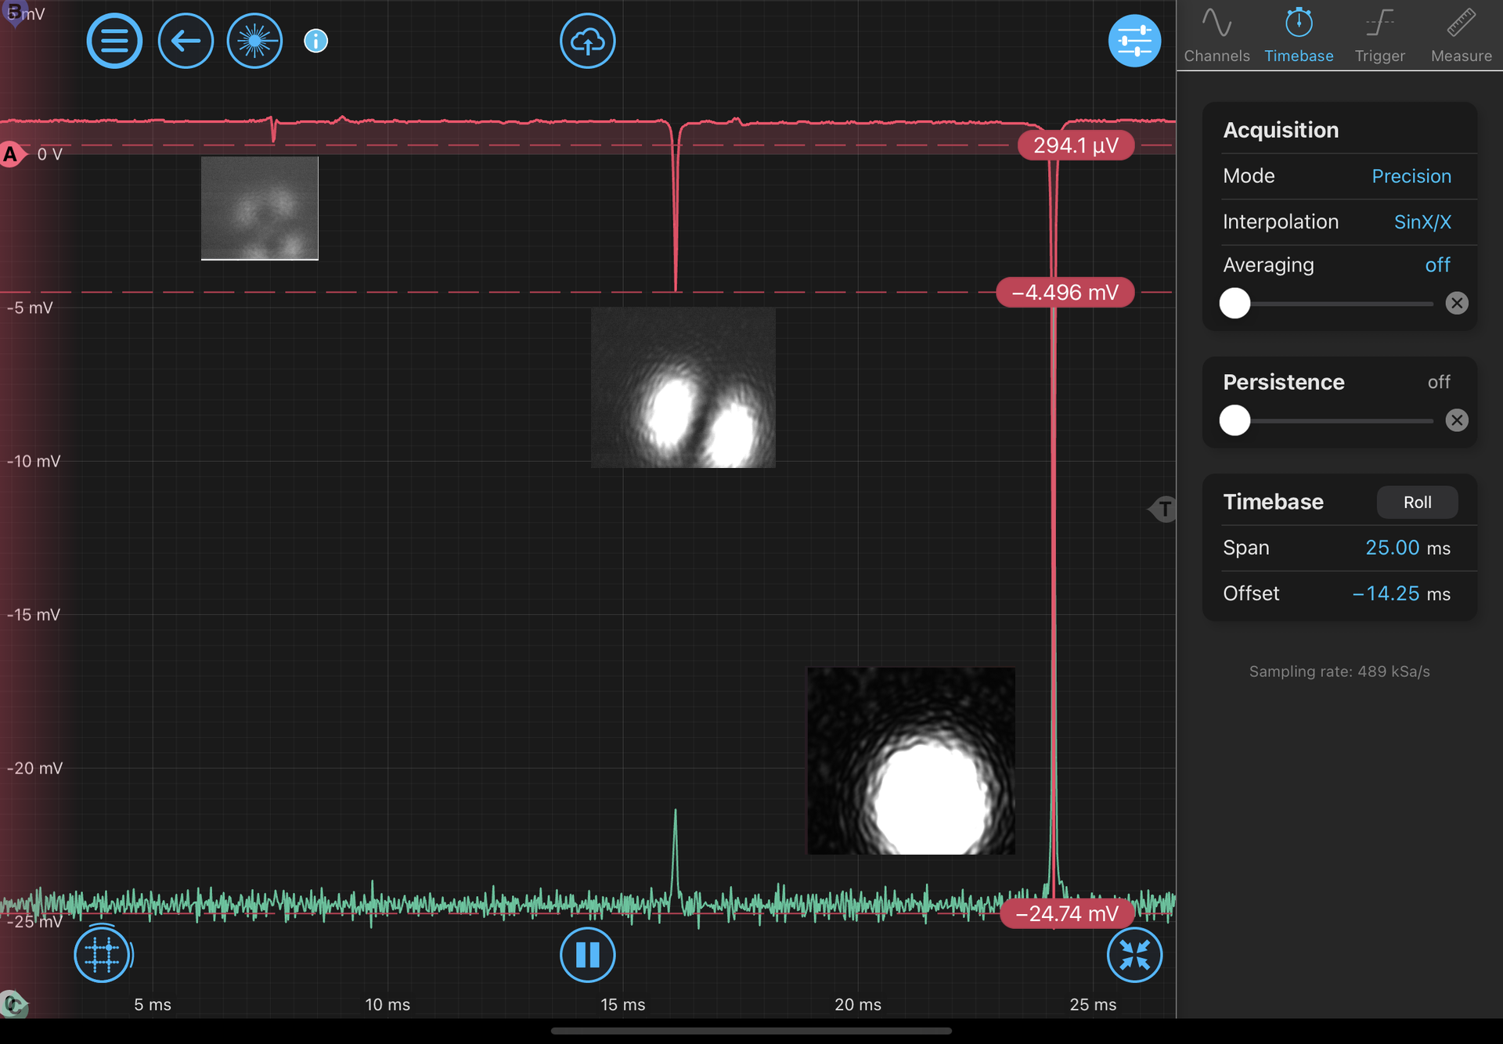
Successful first lock of the cavity!
Using laser lock box on moku to perform PDH locking.
Moku pro has multi-instrument mode to simultaneously lock, take transfer functions, record spectra, etc.
Robustness of the lock when using the cavity piezo mirror is unsatisfactory. We can achieve quality lock using frequency of the laser, but this is not a long-term solution.

Slide 16
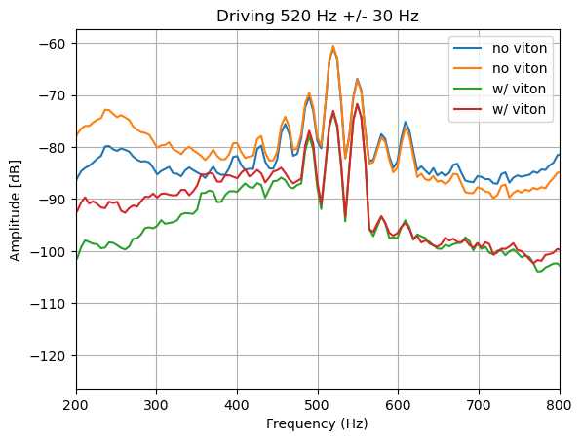
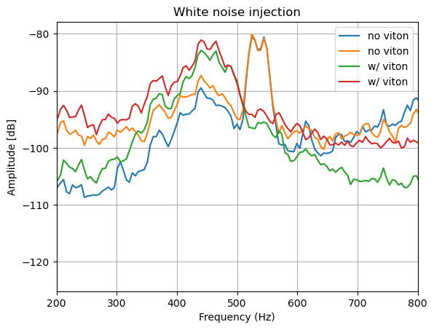
First Output Filter Cavity Challenges
Flexture mounts introducing low frequency resonances.

Slide 17
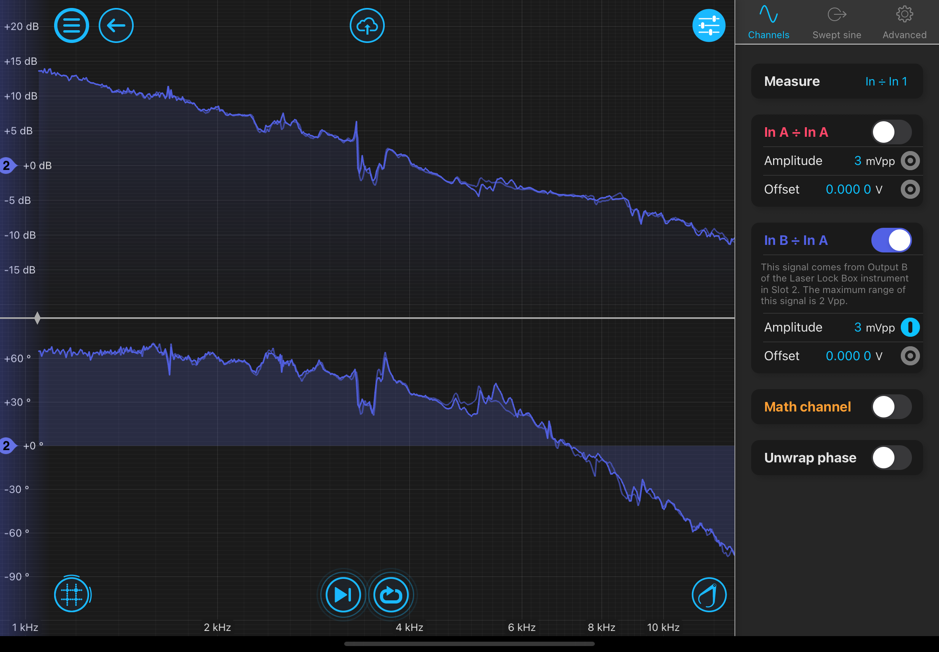
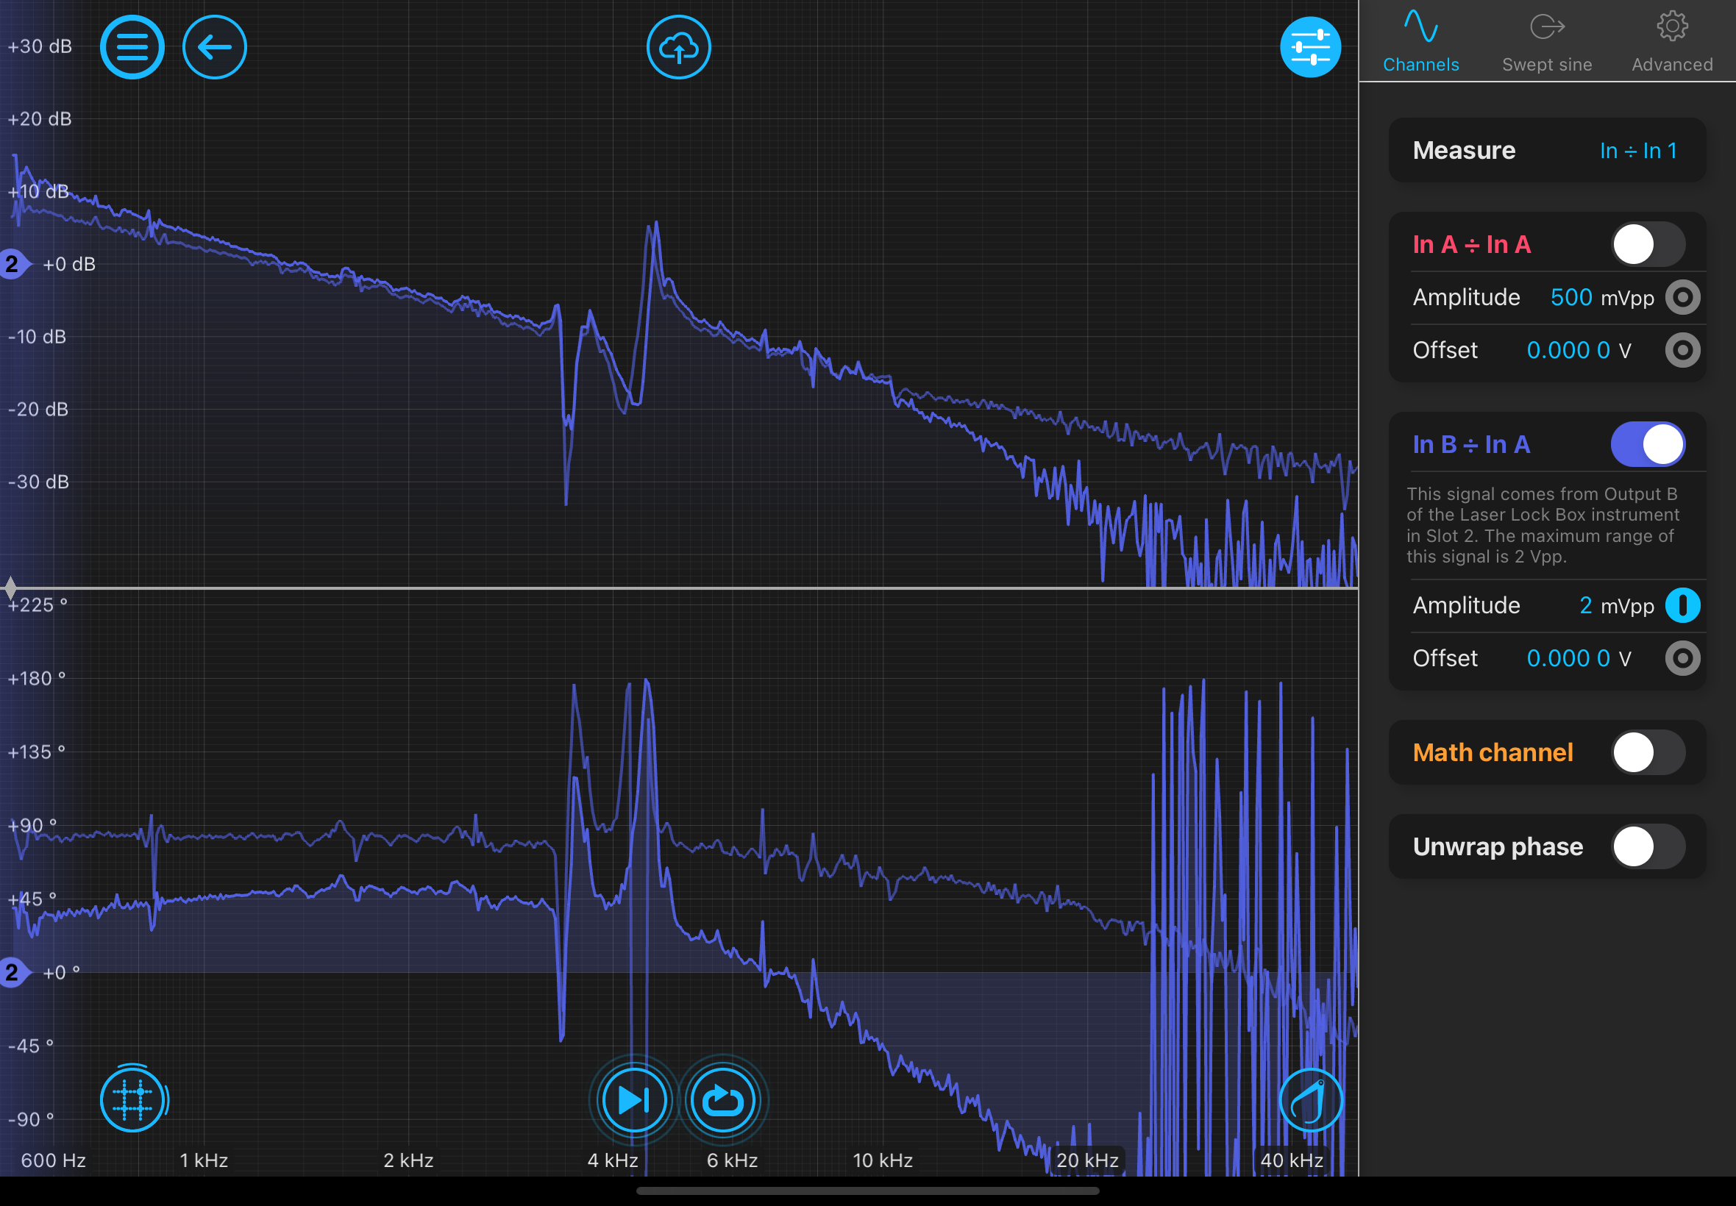
First Output Filter Cavity Challenges
Poor phase delay in the HV Amplifier.
Poor control when locking with piezo mirror.
PA44M3KW Thorlabs Piezo
With and without HV amp.

Slide 18
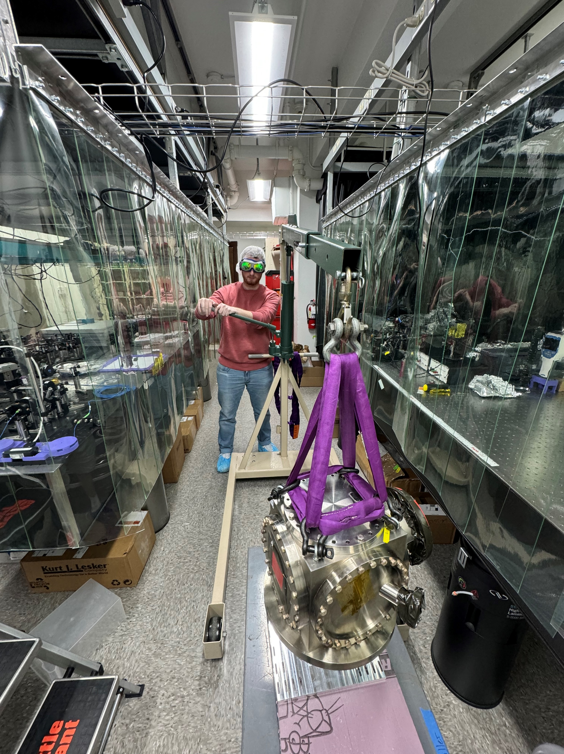
What’s next?
Finalize control over output filter cavity. Assemble additional 3 cavities.
Begun initial steps towards building the laser filter cavity (LFC).
AOMs for SHG sled should arrive soon, align and try locking filter cavities with frequency doubled light. This requires swapping out mirrors in existing filter cavities.
Put an SNSPD at the end.
Have the Technology Demonstrator, demonstrate.
End cube for LFC being hoisted onto optics table.

Slide 19
Start of extra slides

Slide 20
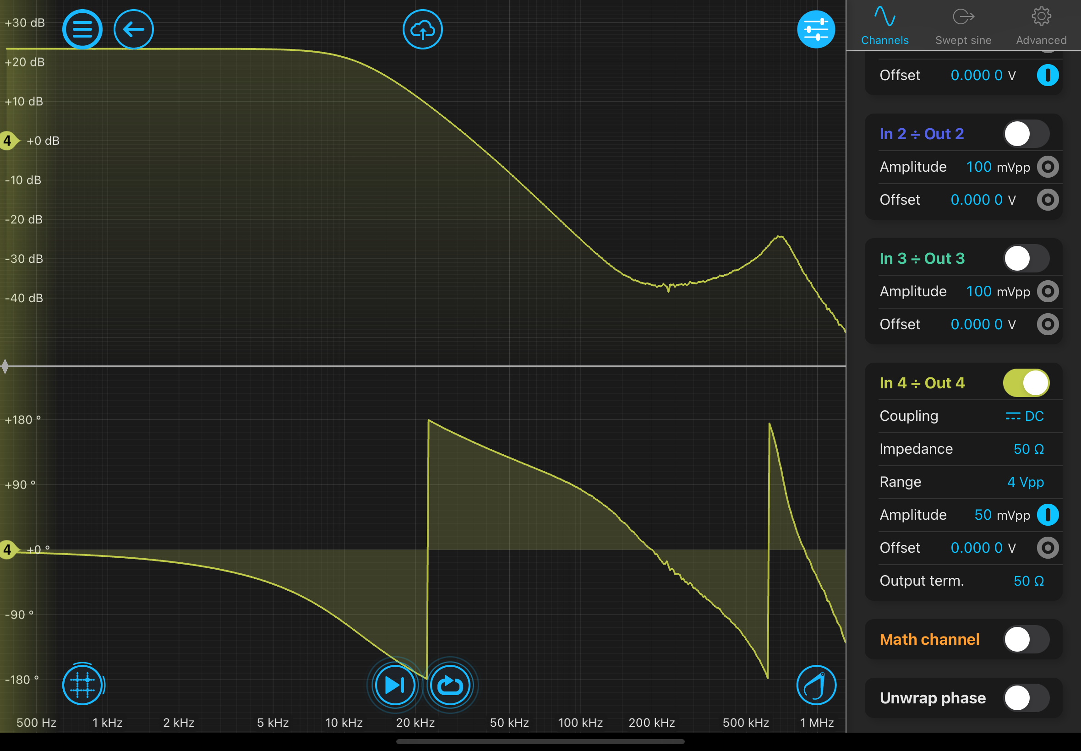
Start of extra slides

Slide 21
Extra slides

Slide 22
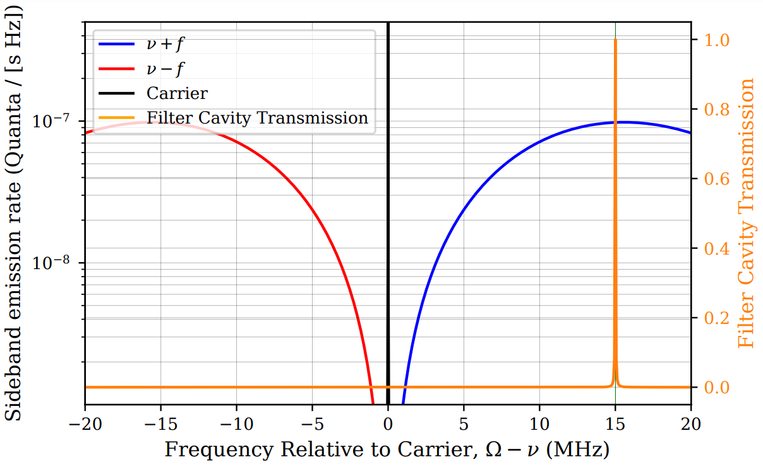

Slide 23
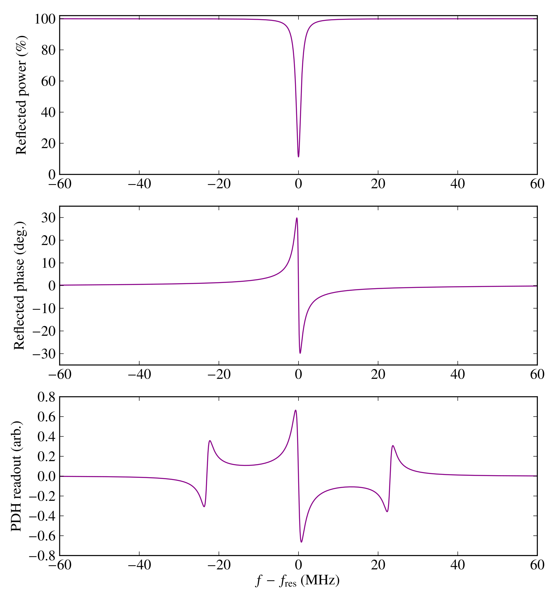
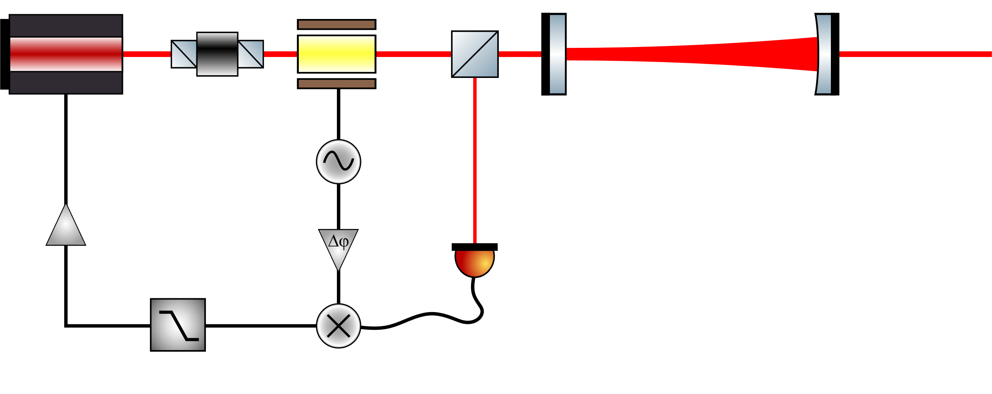
Pound-Drever-Hall (PDH) Locking
Notes:
Tera 12 -LCF- -values
Giga 9 Finesse: 350 S_Lp in photon flux: 8*10^3
Mega 6 Bandwidth: 188 kHz S_Lp in meters: 7.5*10^-17
Kilo 3 Attenuation: 10^-6
Mili -3 FSR: 66 MHz -Counts-
Micro -6 Waist: 0.8 mm No Filtering: 2*10^8 ph/s
Nano -9 With LFC/PRC: 2*10^-6 ph/s
Pico -12 -PRC- Just PRC: 2 ph/s
Fempto -15 Attenuation: 10^-8 Just LFC: 2*10^2 ph/s
IFO Gain: $G_{IFO}=\frac{kP_{BS}}{ℏc}=\frac{{\left(2π\right)}^{2}P_{BS}}{λhc}$ Bandwidth: $Δε=\frac{FSR}{Finesse}$
Photon flux PSD: $S_{photonflux}= \frac{S_{in}P_{out}λ}{hc}$ (h) Planks constant: $h=6.6 ×{10}^{−34}J/s$
Gouy phase: $φ=arctan(\frac{z}{z_{0}})$ h-bar: $ℏ=\frac{h}{2π}$
Rayleigh length: $z_{0}=\frac{πw^{2}}{λ}$ Photon Energy: $E=hv=\frac{hc}{λ}$
FSR: $FSR=\frac{c}{2L}$ Finesse: $ℱ=\frac{2π}{−ln(R_{1}R_{2})}$
G paramiters: $g_{i}=1−\frac{L}{ROC_{i}}$ Gain of Cavity: $G_{cav}=\frac{{\left(R_{1}R_{2}\right)}^{\frac{1}{4}}}{1−\sqrt{R_{1}R_{2}}}$

Slide 24
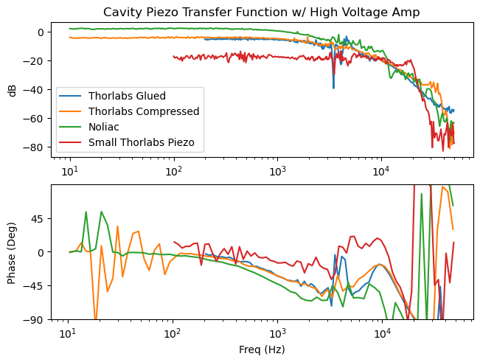
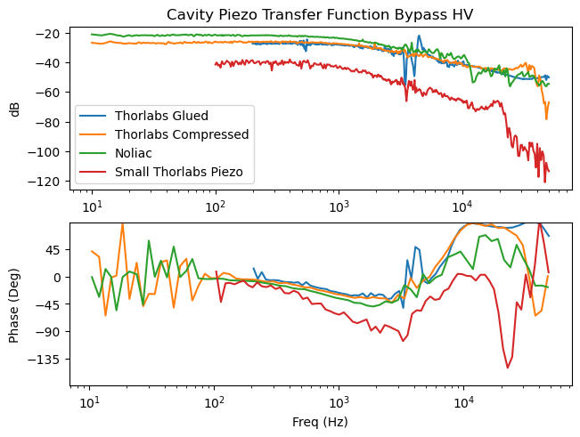
First Output Filter Cavity Problems

