Slide 1
Lab Progress Update towards GQuest Filter Cavities 5/14 – 6/13
Torrey Cullen
California Institute of Technology

Slide 2
Outline
1) Outline of rapid progress in chronological order (starting mid may)
a) Installation of cavity super optics
b) First 775 light lock (not frequency shifted)
c) Daniel steals an AOM
d) Locking with a shifted beam and coresonance
e) cavity specific measurements - finesse
f) cavity specific measurements - power suppression of the 0,0 mode
2) Update on current lab set up
a) AOM Sled
b) First filter cavity sled
3) Future works
a) 2nd and 3rd filter cavity sled
b) Future filter cavity tasks

Slide 3
Outline
1) Outline of rapid progress in chronological order (starting mid may)
a) Installation of cavity super optics
b) First 775 light lock (not frequency shifted)
c) Daniel steals an AOM
d) Locking with a shifted beam and coresonance
e) cavity specific measurements - finesse
f) cavity specific measurements - power suppression of the 0,0 mode
2) Update on current lab set up
a) AOM Sled
b) First filter cavity sled
3) Future works
a) 2nd and 3rd filter cavity sled
b) Future filter cavity tasks

Slide 4
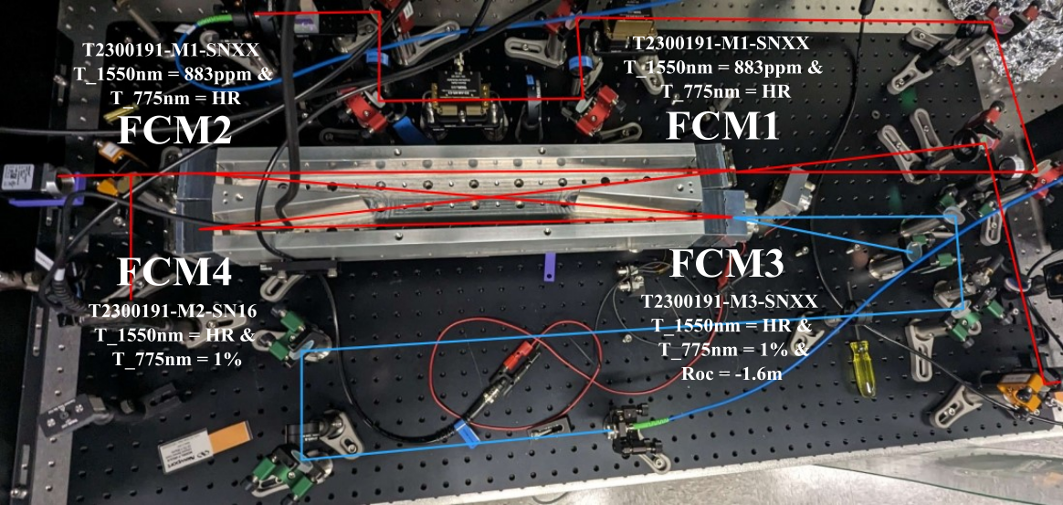
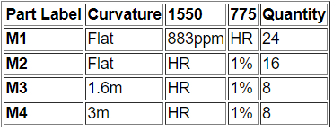
Installation of cavity super optics
i) Swapping of the mirrors into the correct positions
ii) Mode matching 775 light path into the cavity

Slide 5
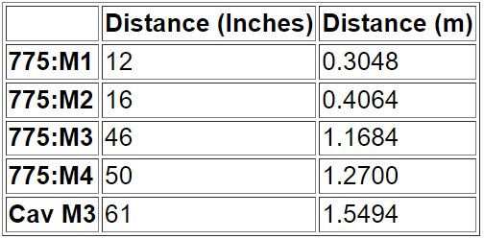
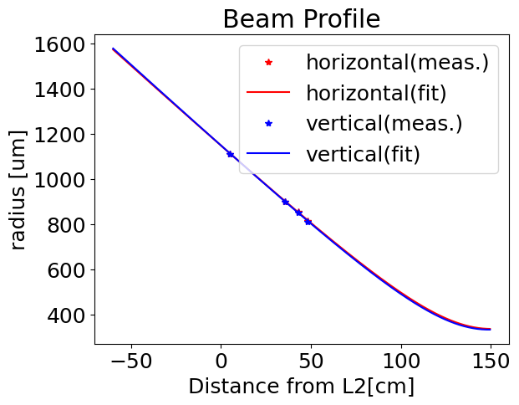
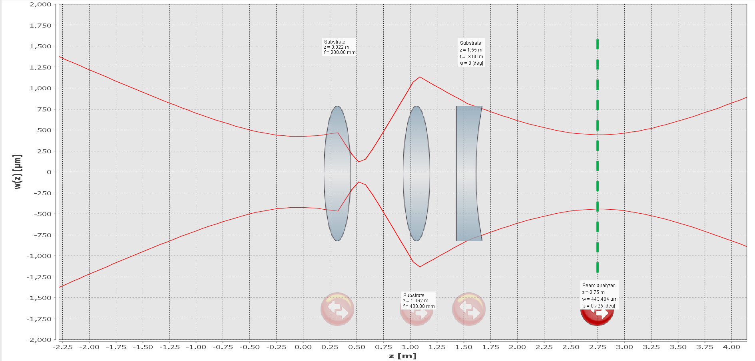
Installation of cavity super optics
i) Swapping of the mirrors into the correct positions
ii) Mode matching 775 light path into the cavity

Slide 6
Outline
1) Outline of rapid progress in chronological order (starting mid may)
a) Installation of cavity super optics
b) First 775 light lock (not frequency shifted)
c) Daniel steals an AOM
d) Locking with a shifted beam and coresonance
e) cavity specific measurements - finesse
f) cavity specific measurements - power suppression of the 0,0 mode
2) Update on current lab set up
a) AOM Sled
b) First filter cavity sled
3) Future works
a) 2nd and 3rd filter cavity sled
b) Future filter cavity tasks

Slide 7
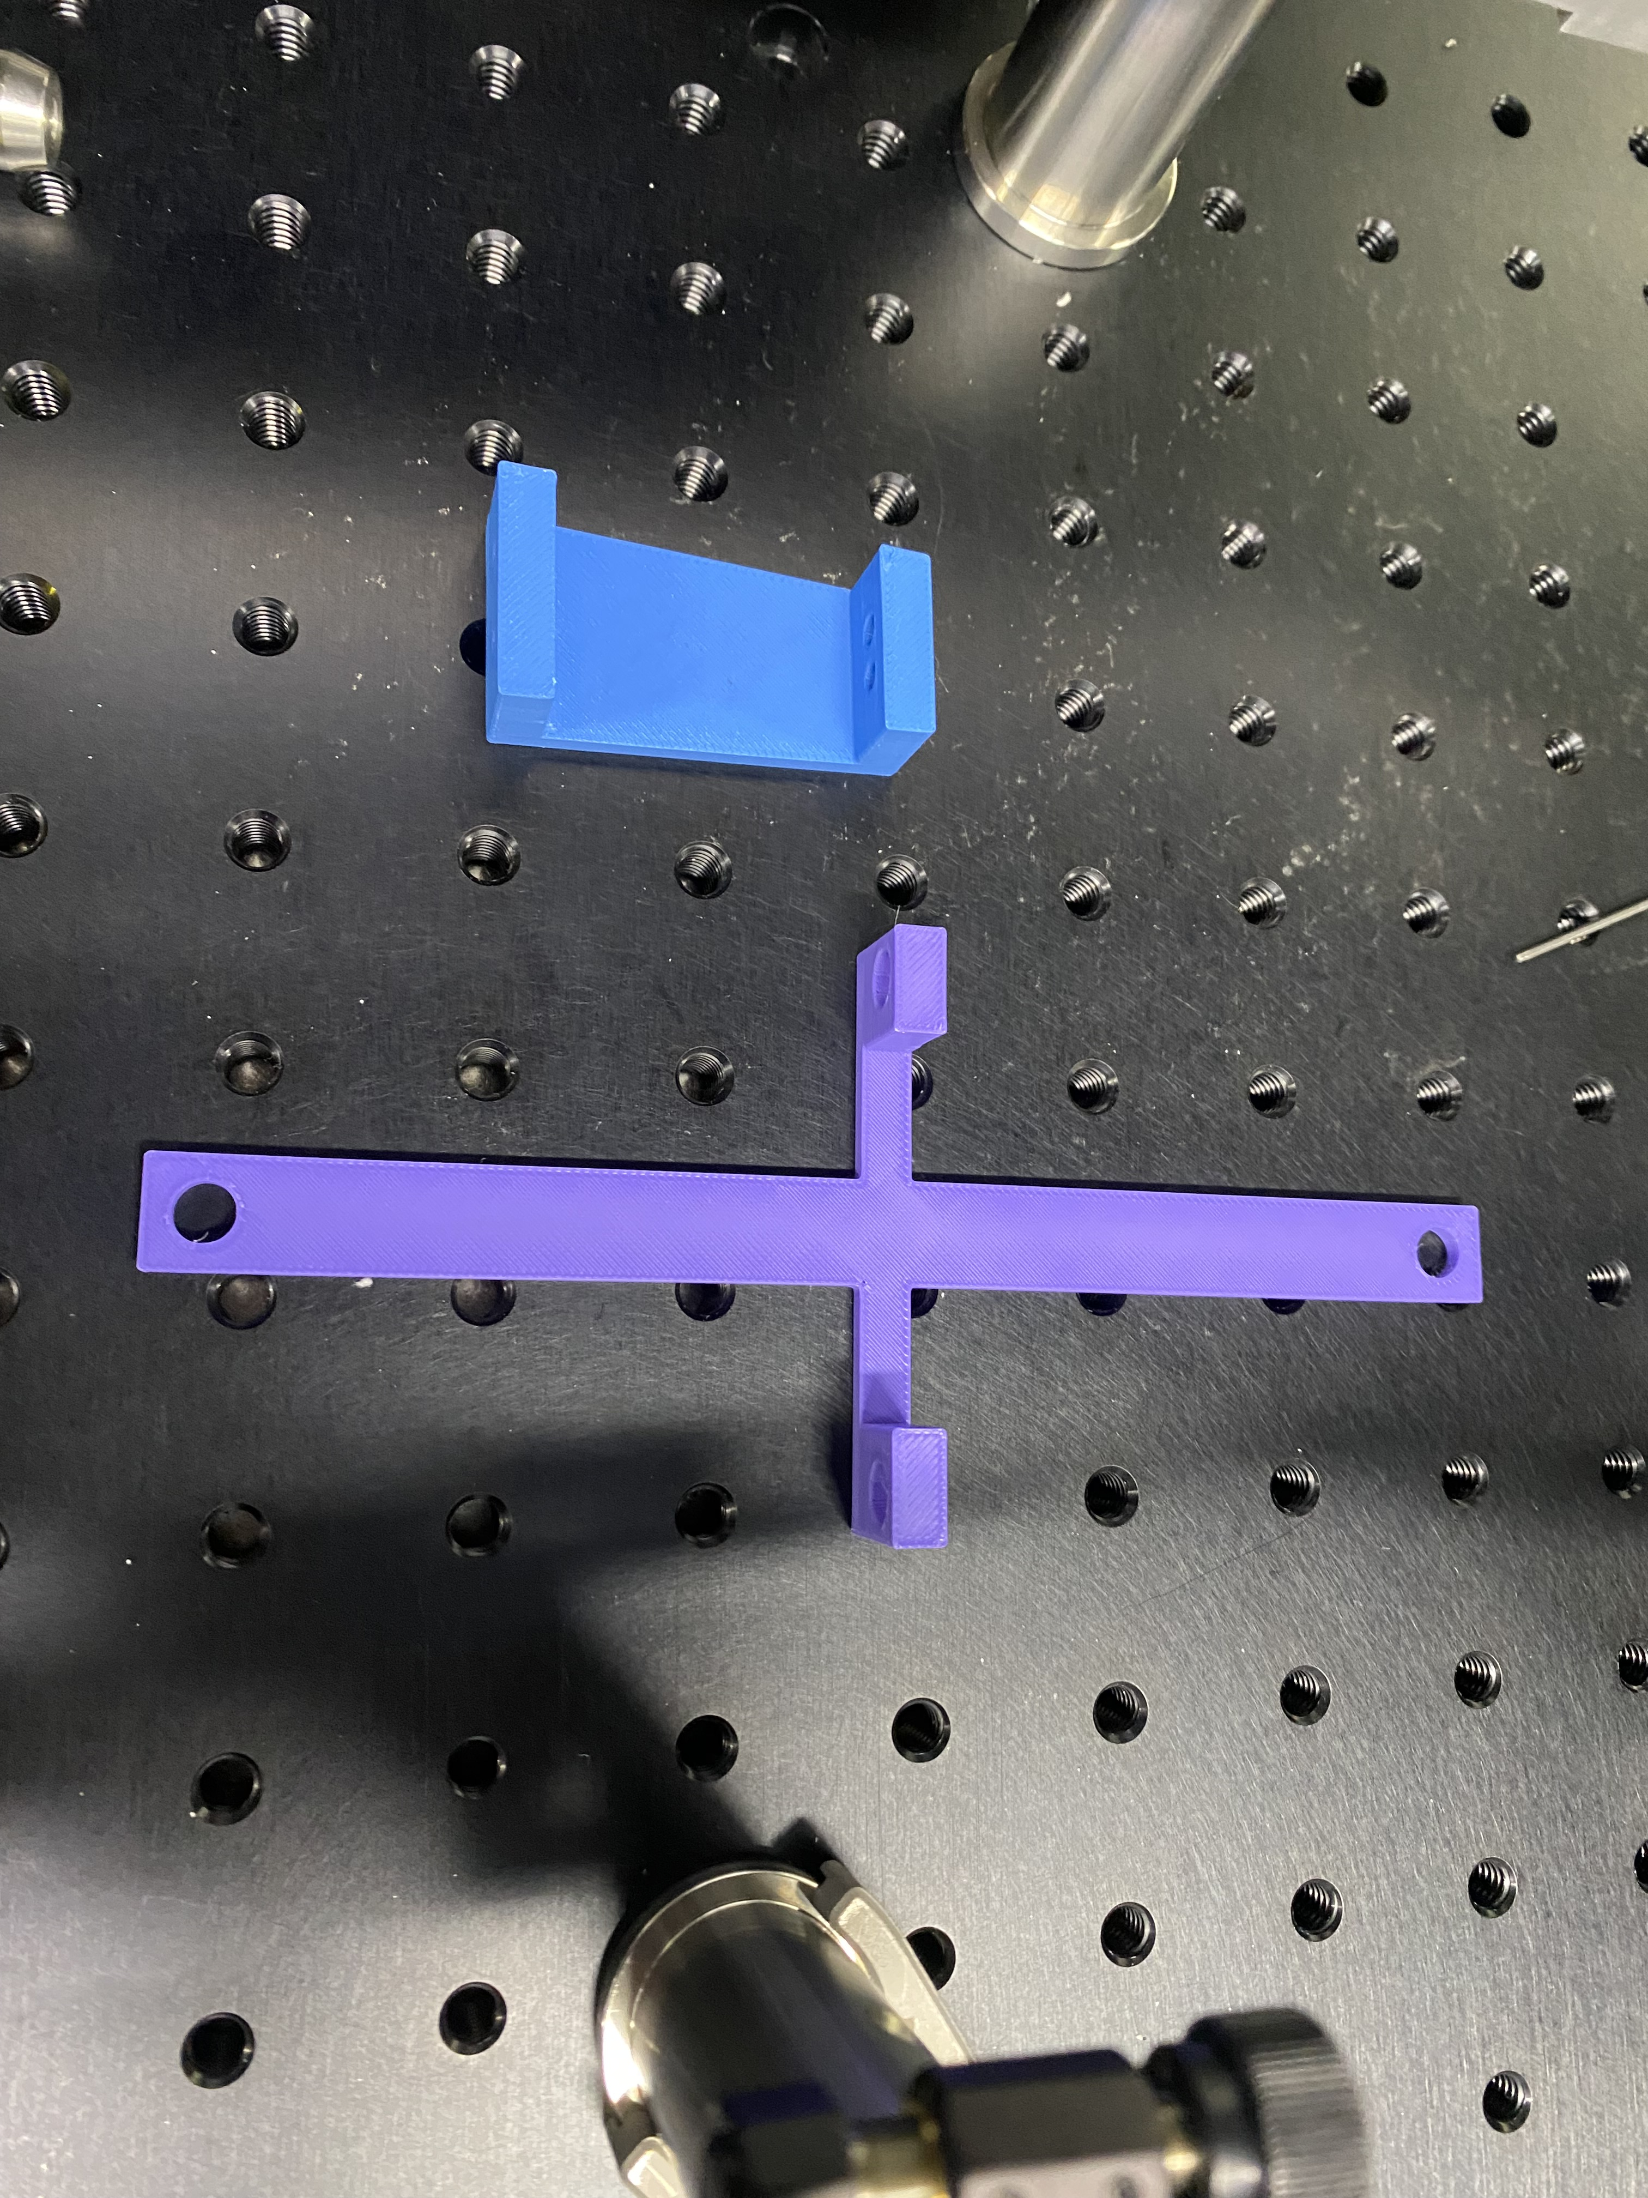
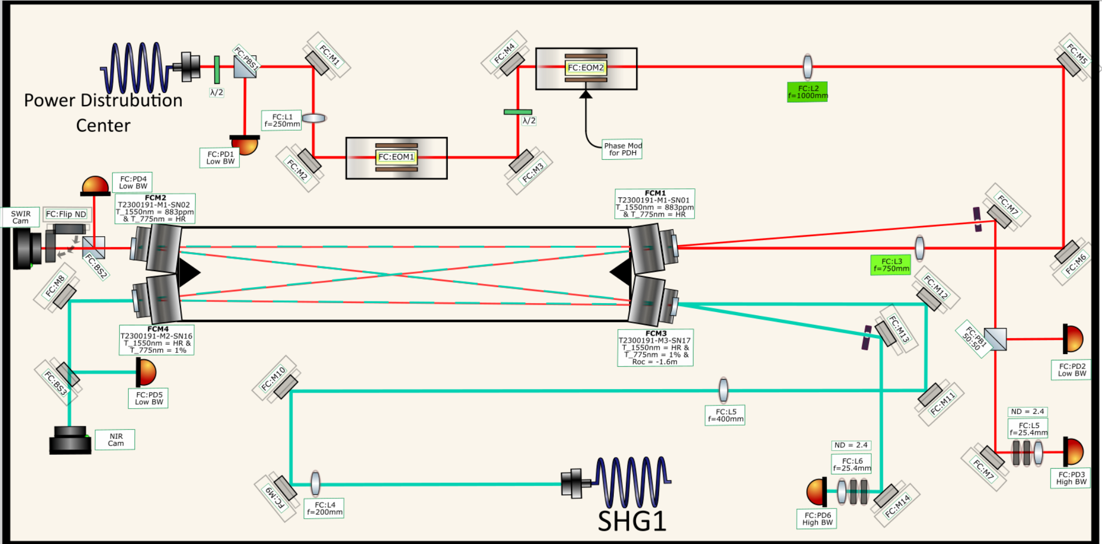
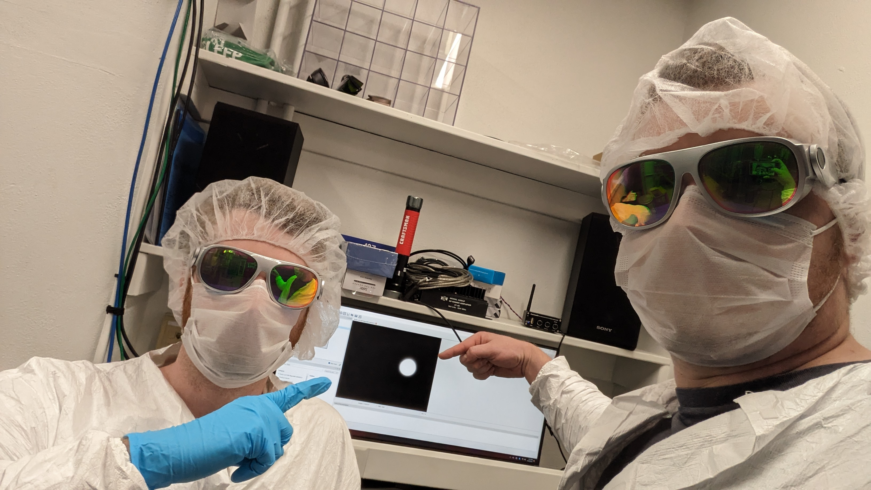
First 775 light lock (not frequency shifted)
Steps on initial alignment of a filter cavity
i) First remove input mirror.
ii) Use Daniel's 3D prints to get beam close to proper alignment and note position of round trip with iris
iii) Install the input coupler
iv) adjust input coupler to put refl beam roughly through the iris. This should allow you to start to see a second pass beam
v) Then walk the beam around by moving the 775 nm input coupling mirror (OFCM3) and the one diagonal from that (OFCM2) until we saw two beams on the camera, roughly overlapping.
vi) Turn on scan and fine tune.

Slide 8
Outline
1) Outline of rapid progress in chronological order (starting mid may)
a) Installation of cavity super optics
b) First 775 light lock (not frequency shifted)
c) Daniel steals an AOM
d) Locking with a shifted beam and coresonance
e) cavity specific measurements - finesse
f) cavity specific measurements - power suppression of the 0,0 mode
2) Update on current lab set up
a) AOM Sled
b) First filter cavity sled
3) Future works
a) 2nd and 3rd filter cavity sled
b) Future filter cavity tasks

Slide 9
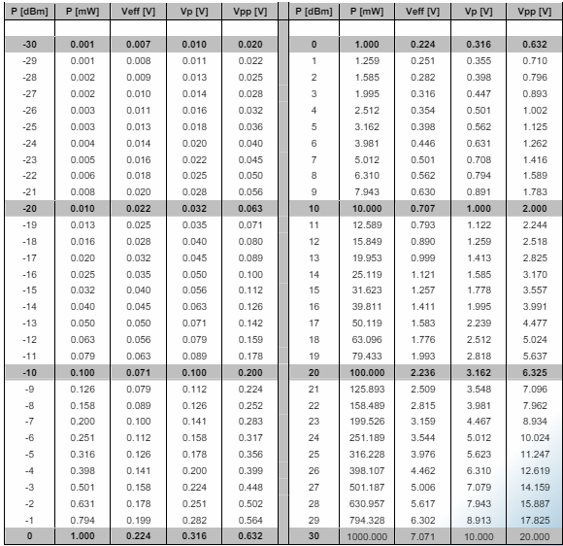
Daniel steals an AOM
i) Learning how to properly drive it
ii) mode match for it/changed fundamental design
iii) Align into the fiber (USE THE TOOL LEE BOUGHT)
Example of current drive:
-Vpp output = 2 Vpp
-Physical Attenuator – 10 dBm -> .632 Vpp
-.632 Vpp -> amplifier is roughly +30 dBm -> 1 W

Slide 10
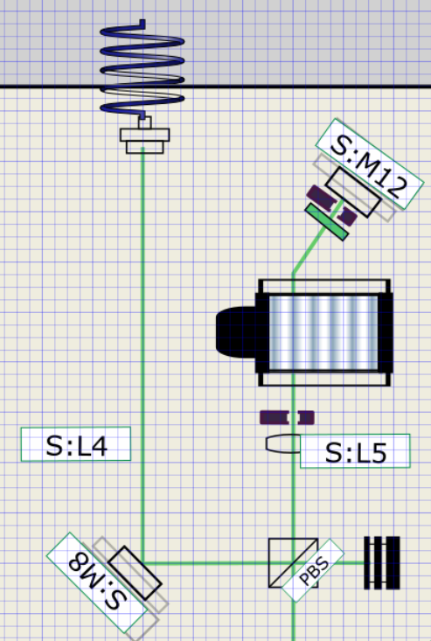
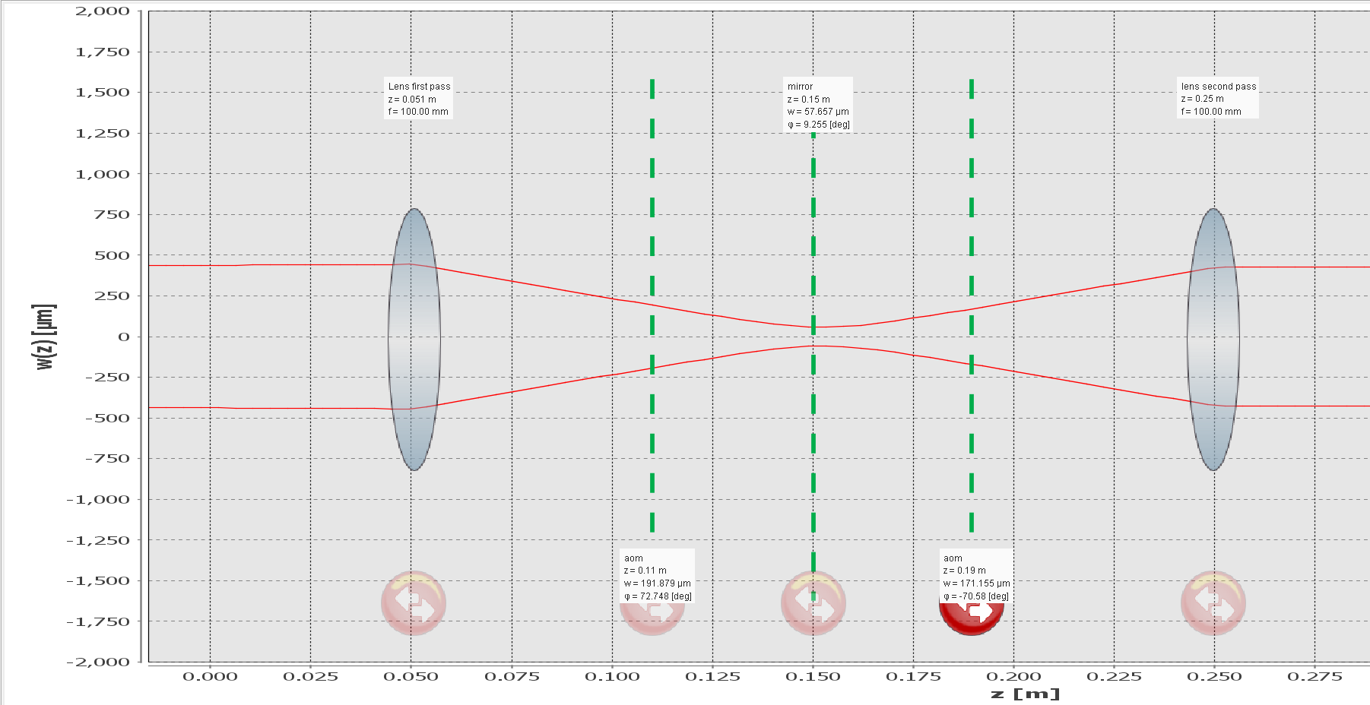
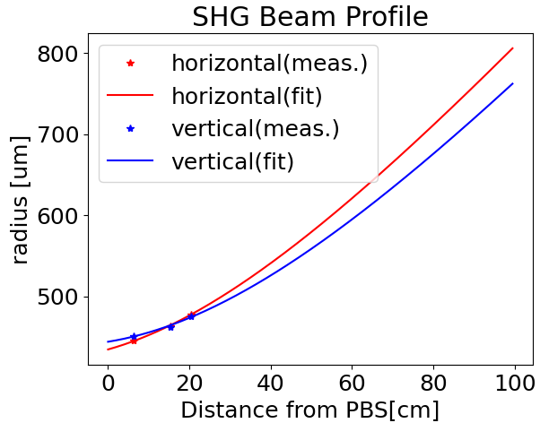
Daniel steals an AOM
i) Learning how to properly drive it
ii) Mode match for it/changed fundamental design
iii) Align into the fiber (USE THE TOOL LEE BOUGHT)

Slide 11
Daniel steals an AOM
i) Learning how to properly drive it
ii) Mode match for it/changed fundamental design
iii) Align into the fiber (USE THE TOOL LEE BOUGHT)
That’s the slide. Use the fiber aligner tool.

Slide 12
Outline
1) Outline of rapid progress in chronological order (starting mid may)
a) Installation of cavity super optics
b) First 775 light lock (not frequency shifted)
c) Daniel steals an AOM
d) Locking with a shifted beam and coresonance
e) cavity specific measurements - finesse
f) cavity specific measurements - power suppression of the 0,0 mode
2) Update on current lab set up
a) AOM Sled
b) First filter cavity sled
3) Future works
a) 2nd and 3rd filter cavity sled
b) Future filter cavity tasks

Slide 13
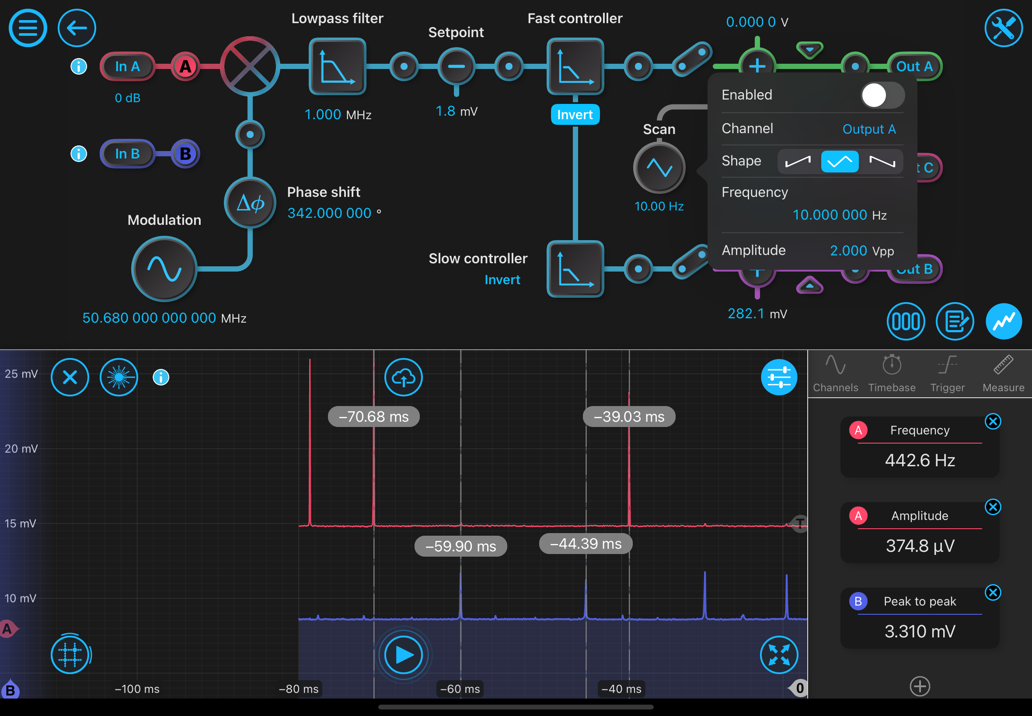
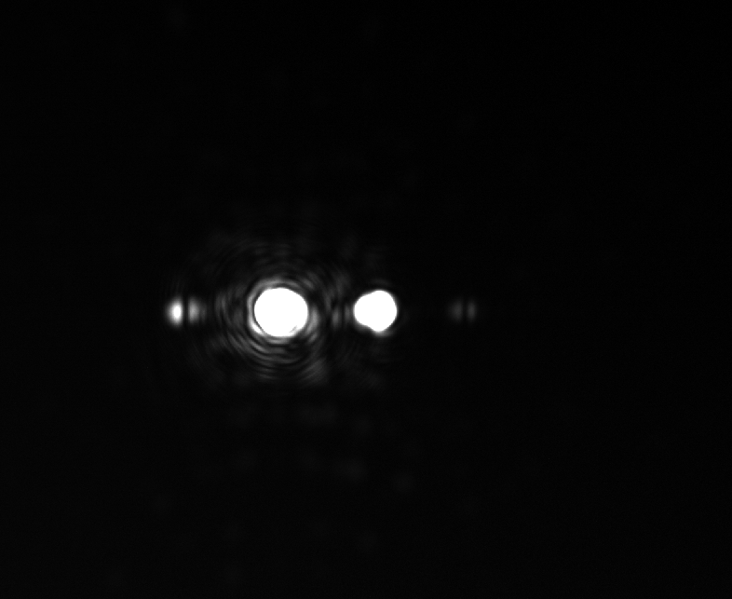
Locking with a Shifted Beam and Coresonance
i) Shifting frequency to align the trans peaks (coarse)
ii) Shifting frequency to finely align the trans peaks
iii) EOM crosstalk
Shifting multiple MHz requires alignment because the beam diverges greater than the width of the fiber input.

Slide 14
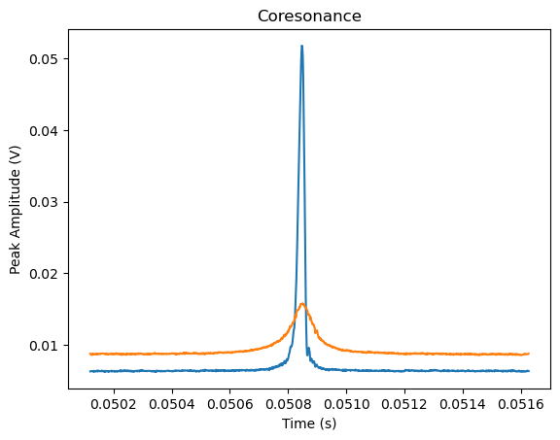
Locking with a Shifted Beam and Coresonance
i) Shifting frequency to align the trans peaks (coarse)
ii) Shifting frequency to finely align the trans peaks
iii) EOM crosstalk
-Total shift currently is ~104.30 MHz
-Fine shifting occurs on the order of +/- .01 MHz

Slide 15
Locking with a Shifted Beam and Coresonance
i) Shifting frequency to align the trans peaks (coarse)
ii) Shifting frequency to finely align the trans peaks
iii) EOM crosstalk
-We have a 11 Hz sinewave on the error signals.
-This seems to be caused from cross talk on the EOM drives.
-We replaced the BNC cables that are providing the EOM signal with the homemade ultra shield BNC cable. This did not make a noticeable difference.
-We then wrapped the separate inductors making up the tank circuits on the EOM in multiple layers of aluminum foil in case the RF was emanating from there. Still little difference.
-Daniel tuned the EOM drive by different orders of magnitude. Possible to get the drift to order mHz but it is still there.
-Also note the inductors on the EOMs need to be tuned to match the 1/sqrt(LC) resonance condition for them to increase your error amplitude properly.

Slide 16
Outline
1) Outline of rapid progress in chronological order (starting mid may)
a) Installation of cavity super optics
b) First 775 light lock (not frequency shifted)
c) Daniel steals an AOM
d) Locking with a shifted beam and coresonance
e) cavity specific measurements - finesse
f) cavity specific measurements - power suppression of the 0,0 mode
2) Update on current lab set up
a) AOM Sled
b) First filter cavity sled
3) Future works
a) 2nd and 3rd filter cavity sled
b) Future filter cavity tasks

Slide 17
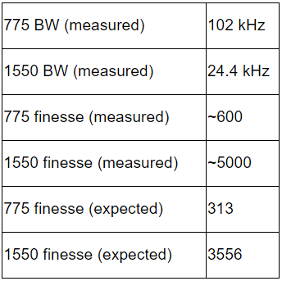
Cavity Specific Measurements - Finesse
i) by way of FSR/FWHM TRANS peaks
ii) by way of cavity ringdown measurement
Two ways:
Calibrate using the laser specs to put it in frequency and use FSR in Hz. OR…
Directly measuring using it both measurements (FSR and BW) in time from previous measurement.

Slide 18
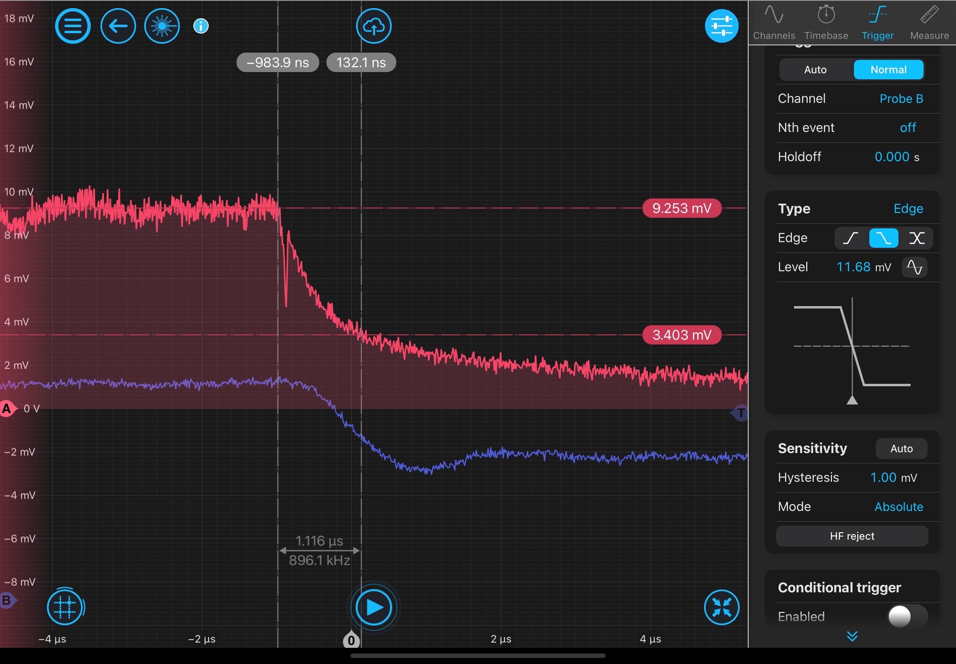
Cavity Specific Measurements - Finesse
i) by way of FSR/FWHM TRANS peaks
ii) by way of cavity ringdown measurement
Process:
Changed the measurement PD to the 1811 REFL PD to DC coupling and adjust error signal set point and PID controller so that you can lock the cavity with the much higher bandwidth PD on DC coupling (DC coupling the PD reduces the error amplitude).
Lock the cavity with the 775 light using this method and then change the trigger mode on the moku to decaying edge and set the threshold underneath the lock point.
Use the AOM as a "fast shutter" of the light going to the cavity simply by turning off the amplified RF drive going to the AOM. This should be a sufficiently fast "blocking" of the light going to the filter cavity.

Slide 19
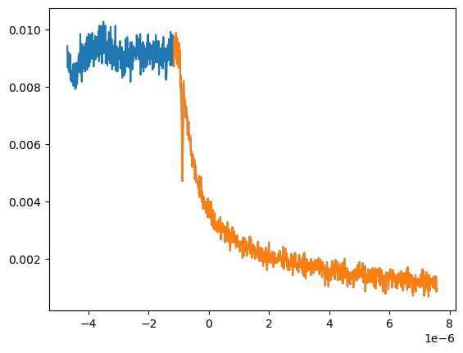
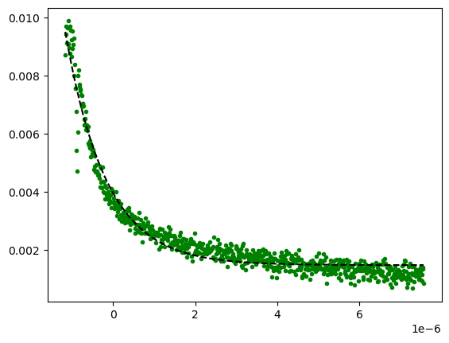
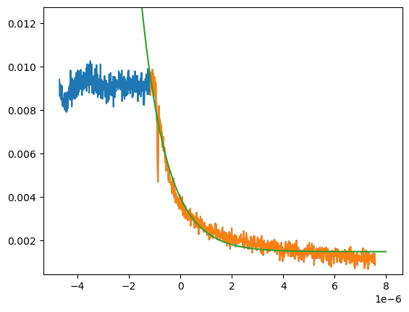
Cavity Specific Measurements - Finesse
i) by way of FSR/FWHM TRANS peaks
ii) by way of cavity ringdown measurement - analysis
Yields finesse = 389

Slide 20
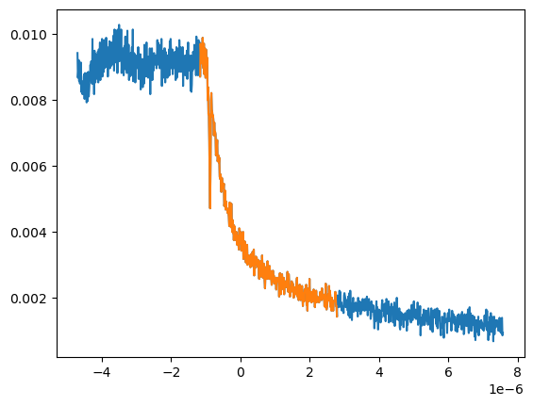
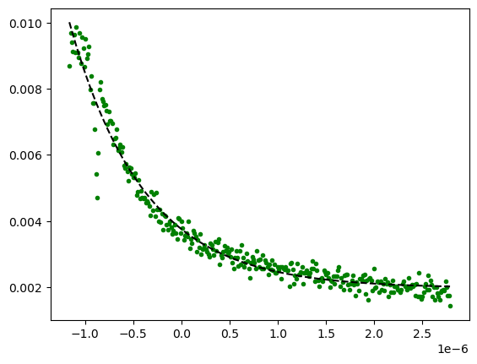
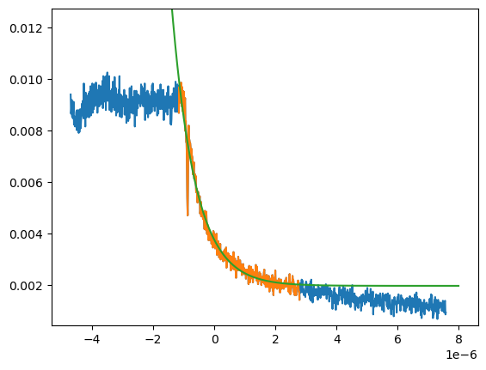
Cavity Specific Measurements - Finesse
i) by way of FSR/FWHM TRANS peaks
ii) by way of cavity ringdown measurement - analysis
Yields finesse = 303

Slide 21
Outline
1) Outline of rapid progress in chronological order (starting mid may)
a) Installation of cavity super optics
b) First 775 light lock (not frequency shifted)
c) Daniel steals an AOM
d) Locking with a shifted beam and coresonance
e) cavity specific measurements - finesse
f) cavity specific measurements - power suppression of the 0,0 mode
2) Update on current lab set up
a) AOM Sled
b) First filter cavity sled
3) Future works
a) 2nd and 3rd filter cavity sled
b) Future filter cavity tasks

Slide 22
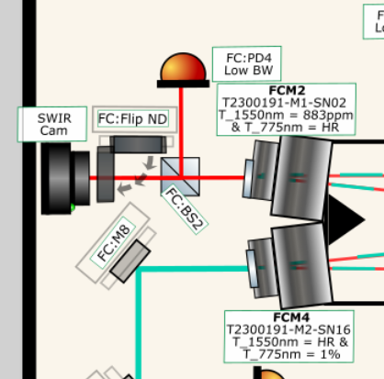
Cavity Specific Measurements - Power Suppression of the 0,0 mode
i) by way of brute force with power meter
ii) by way of summing the pixel values on a basler camera
-substep of modifying code to allow for saturated beam
1550 nm
input - 2.18 mW
measured output .67 mW (this is after a 5050 BS)
Inferred output ~1.4 mW (.67 *2 + ~5% losses on the BS)
reflection is .5 mW
This implies a 13% loss. What does this say about the cavity coupling?
.9 nW When the two modes are minimally coresonant. (blocking the 1550 beam reduces the reading down to the background level)
7 nW Background.
This yields 1 * 10^6 suppression of the carrier on one cavity.
Would like to retry this method higher total power so the background level isn’t as higher compared to low power measurement, seems very uncertain.

Slide 23
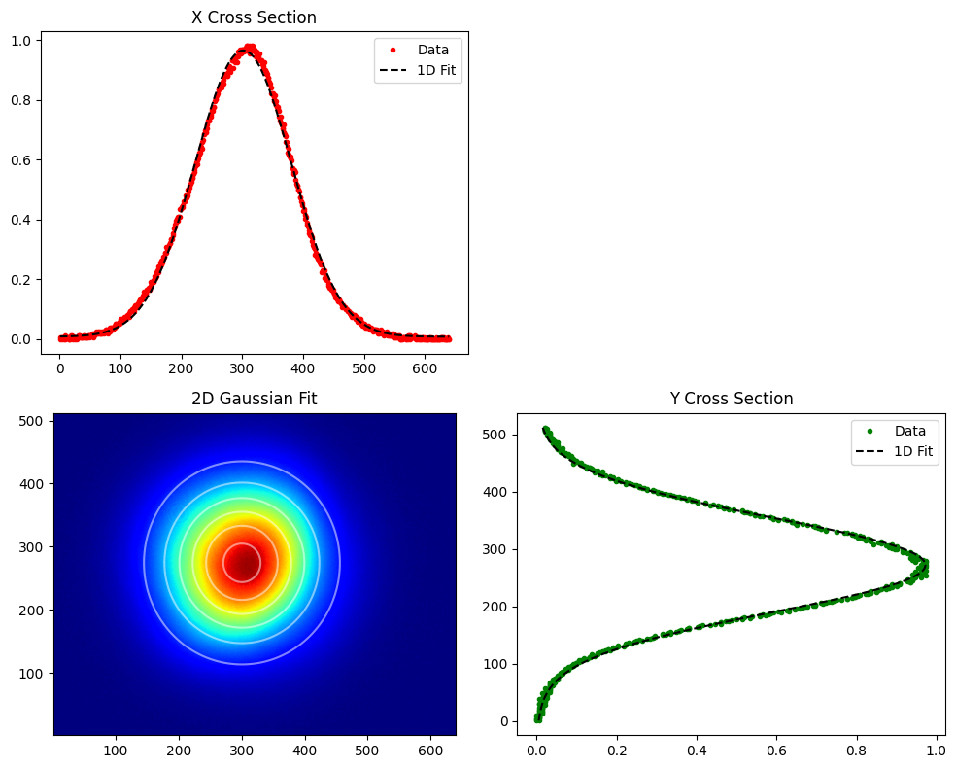
Cavity Specific Measurements - Power Suppression of the 0,0 mode
i) by way of brute force with power meter
ii) by way of summing the pixel values on a basler camera
-substep of modifying code to allow for saturated beam
-Code fits beam picture to gaussian.
-Idea is to sum the value at each pixel, accounting for exposure time, therefore getting rid of the need for an absolute calibration.

Slide 24
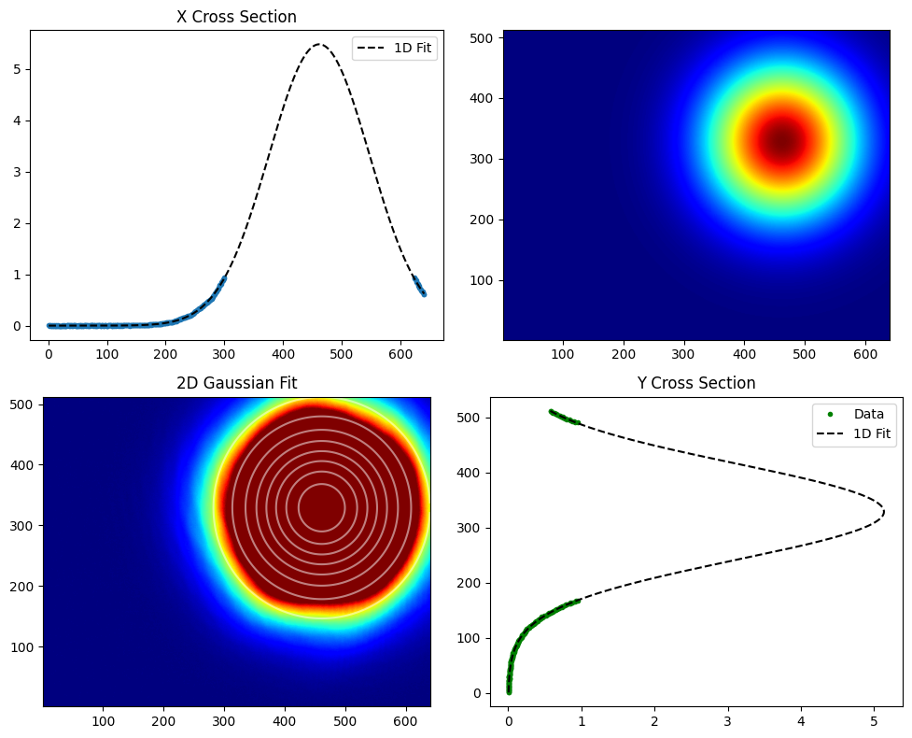
Cavity Specific Measurements - Power Suppression of the 0,0 mode
i) by way of brute force with power meter
ii) by way of summing the pixel values on a basler camera
-substep of modifying code to allow for saturated beam
-Problem is best case scenario were trying to span 6 orders of magnitude.
-Rewrote code to estimate gaussian on a saturated beam.
-Doing this yields 1.9 * 10^5 suppression.

Slide 25
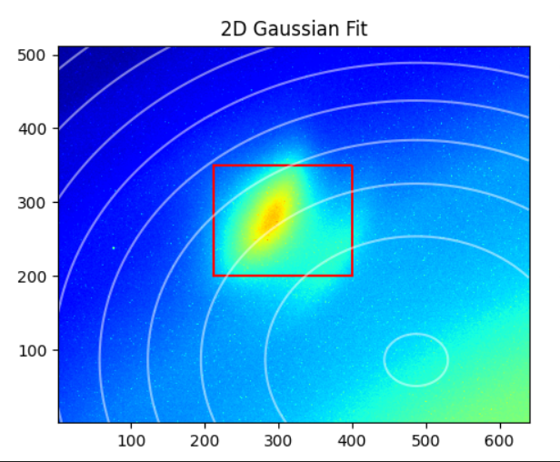
Cavity Specific Measurements - Power Suppression of the 0,0 mode
i) by way of brute force with power meter
ii) by way of summing the pixel values on a basler camera
-substep of modifying code to allow for saturated beam
-There are order nanowatts leaking through the 775 HR mirrors (1550 input coupler mirrors).
-Need to up total power in 1550 path or figure out a way to subtract beam in red square (I upped the power)
-Did try subtracting the 1550 input beam blocked image from the low power measurement and got 2.7 * 10^5, which is consistent with other methods, but the subtraction region is fairly arbitrary.
Cavity locked with 775, looking at swir camera, with 1550 input beam blocked.

Slide 26
Cavity Specific Measurements - Power Suppression of the 0,0 mode
i) by way of brute force with power meter
ii) by way of summing the pixel values on a basler camera
-substep of modifying code to allow for saturated beam
Summary:
-Comparing the saturation fit vs just putting and ND filter in the way there is a <3% difference between the two methods
-Using either method we get a suppression factor of 1.9 * 10^5.

Slide 27
Outline
1) Outline of rapid progress in chronological order (starting mid may)
a) Installation of cavity super optics
b) First 775 light lock (not frequency shifted)
c) Daniel steals an AOM
d) Locking with a shifted beam and coresonance
e) cavity specific measurements - finesse
f) cavity specific measurements - power suppression of the 0,0 mode
2) Update on current lab set up
a) AOM Sled
b) First filter cavity sled
3) Future works
a) 2nd and 3rd filter cavity sled
b) Future filter cavity tasks

Slide 28
Outline
1) Outline of rapid progress in chronological order (starting mid may)
a) Installation of cavity super optics
b) First 775 light lock (not frequency shifted)
c) Daniel steals an AOM
d) Locking with a shifted beam and coresonance
e) cavity specific measurements - finesse
f) cavity specific measurements - power suppression of the 0,0 mode
2) Update on current lab set up
a) AOM Sled
b) First filter cavity sled
3) Future works
a) 2nd and 3rd filter cavity sled
b) Future filter cavity tasks - https://openproject.mccullerlab.com/projects/gquest/work_packages

Slide 29
Full outline with leelogs
Outline:
1) Outline of rapid progress in chronological order (starting mid may)
a) Installation of cavity super optics
i) Swapping of the mirrors into the correct positions - https://mccullerlab.com/logs/lab/index.php?callRep=11575
ii) Mode matching 775 light path into the cavity - https://mccullerlab.com/logs/lab/index.php?callRep=11574
b) First 775 light lock (not frequency shifted) - https://mccullerlab.com/logs/lab/index.php?callRep=11595
i) First remove input mirror.
ii) Use Daniel's 3D prints to get beam close to proper alignment and note position of round trip with iris
iii) Install the input coupler
iv) adjust input coupler to put refl beam roughly through the iris. This should allow you to start to see a second pass beam
v) Then walk the beam around by moving the 775 nm input coupling mirror (OFCM3) and the one diagonal from that (OFCM2) until we saw two beams on the camera, roughly overlapping.
vi) Turn on scan and fine tune.
c) Daniel steals an AOM
i) Learning how to properly drive it - https://qtwork.tudelft.nl/~schouten/linkload/dbm-conv.pdf
ii) mode match for it/changed fundamental design - https://mccullerlab.com/logs/lab/index.php?callRep=11602
iii) Align into the fiber (USE THE TOOL LEE BOUGHT)
d) Locking with a shifted beam and coresonance
i) Shifting frequency to align the trans peaks (coarse) - https://mccullerlab.com/logs/lab/index.php?callRep=11631
ii) Shifting frequency to finely align the trans peaks - https://mccullerlab.com/logs/lab/index.php?callRep=11632
iii) EOM crosstalk - https://mccullerlab.com/logs/lab/index.php?callRep=11638
e) cavity specific measurements - finesse
i) by way of FSR/FWHM TRANS peaks - https://mccullerlab.com/logs/lab/index.php?callRep=11633
ii) by way of cavity ringdown measurement - https://mccullerlab.com/logs/lab/index.php?callRep=11650
f) cavity specific measurements - power suppression of the 0,0 mode
i) by way of brute force with power meter - https://mccullerlab.com/logs/lab/index.php?callRep=11642
ii) by way of summing the pixel values on a basler camera - https://mccullerlab.com/logs/lab/index.php?callRep=11645
-substep of modifying code to allow for saturated beam - https://mccullerlab.com/logs/lab/index.php?callRep=11644
2) Update on current lab set up
a) AOM Sled
b) First filter cavity sled
3) Future works
a) 2nd and 3rd filter cavity sled
b) Future filter cavity tasks

