Slide 1
Real Cavity Design Basics
Daniel Grass

Slide 2
GQuEST Review
Michelson Interferometer to detect (tiny) quantum spacetime fluctuations
Novel “Photon Counting Readout” requires filtering out “carrier” and passing signal with ~18 MHz sideband
Using 4 Optical Cavities to do this filtering

Slide 3
Optical Cavity Review
Electric Field incident on system of mirrors that circulates light
Get field buildup inside cavity that depends on the spacing, mirror reflectivity, and loss

Slide 4
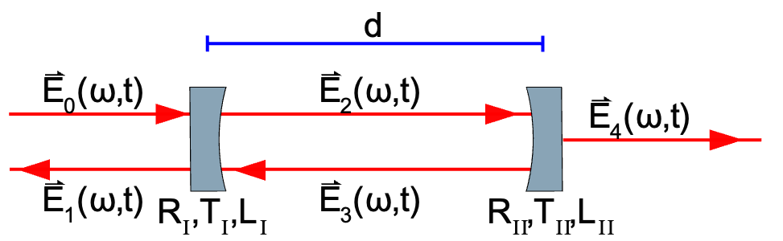
Optical Cavity Review
Electric Field incident on system of mirrors that circulates light
Get field buildup inside cavity that depends on the spacing, mirror reflectivity, and loss

Slide 5
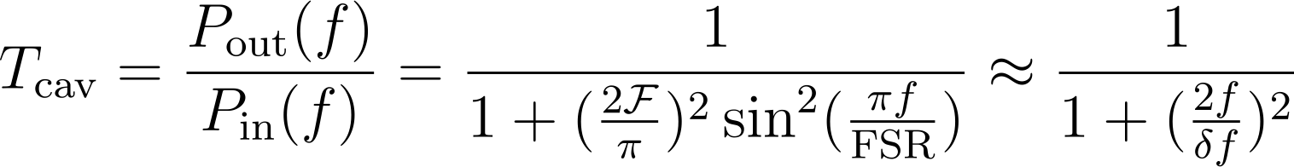
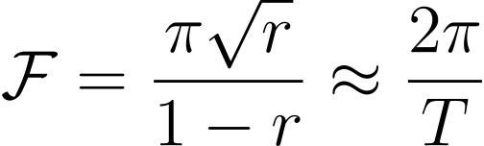
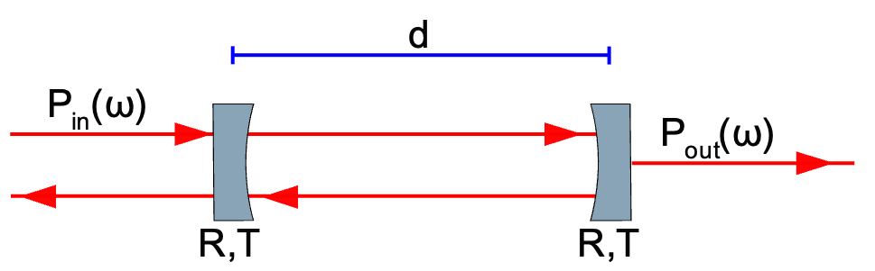
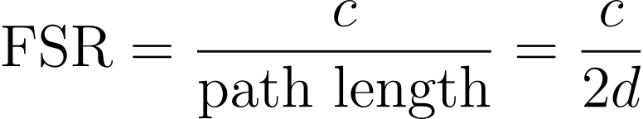
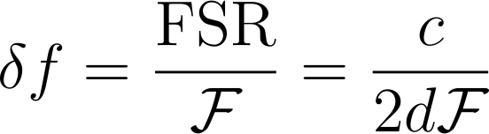
Optical Cavity Math
Assume 2 mirror cavity with lossless mirrors and equal reflectivities

Slide 6
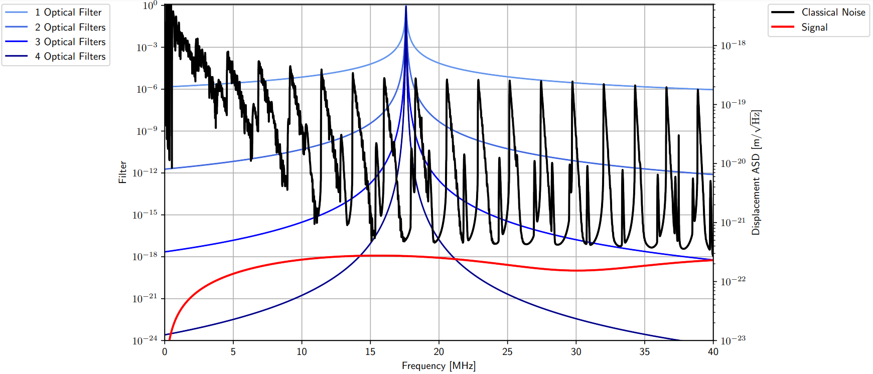
How GQuEST uses Cavities
Use the frequency selectivity of optical cavities to pass signal and filter out carrier
Have to filter carrier power by 22 orders of magnitude and still pass a meaningful amount of signal
Use multiple cavities: passband width minimally reduced while carrier filtered by more

Slide 7

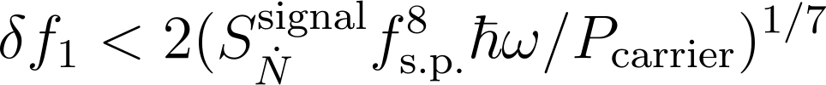
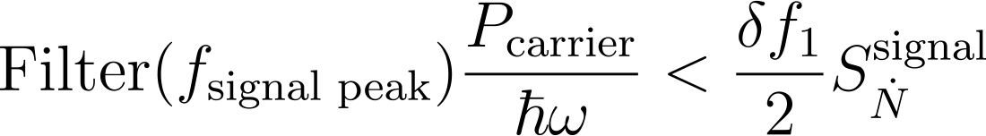
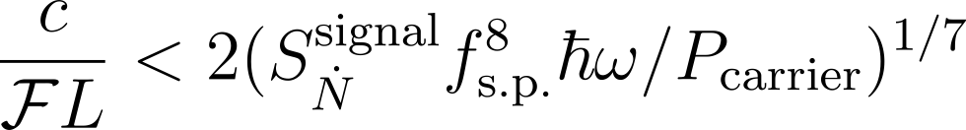
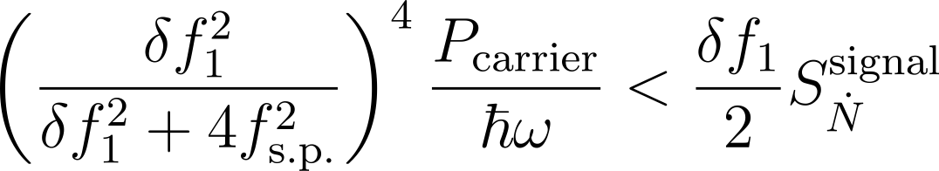
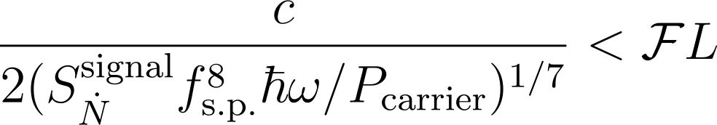
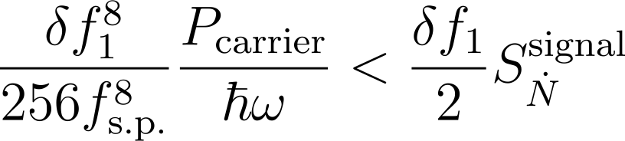

Finesse and Length Choice
4000 m <

Slide 8
Finesse and Length Choice pt 2.
To suppress the carrier below signal => 4000 m <
Finesse chosen to be large (3000), but it becomes infeasible to keep the cavity at the operating point with too high a Finesse
Requiring high mode spacing means the FSR cannot be too small
Thus, length cannot be too large
Additional practical concern with too long a length

Slide 9

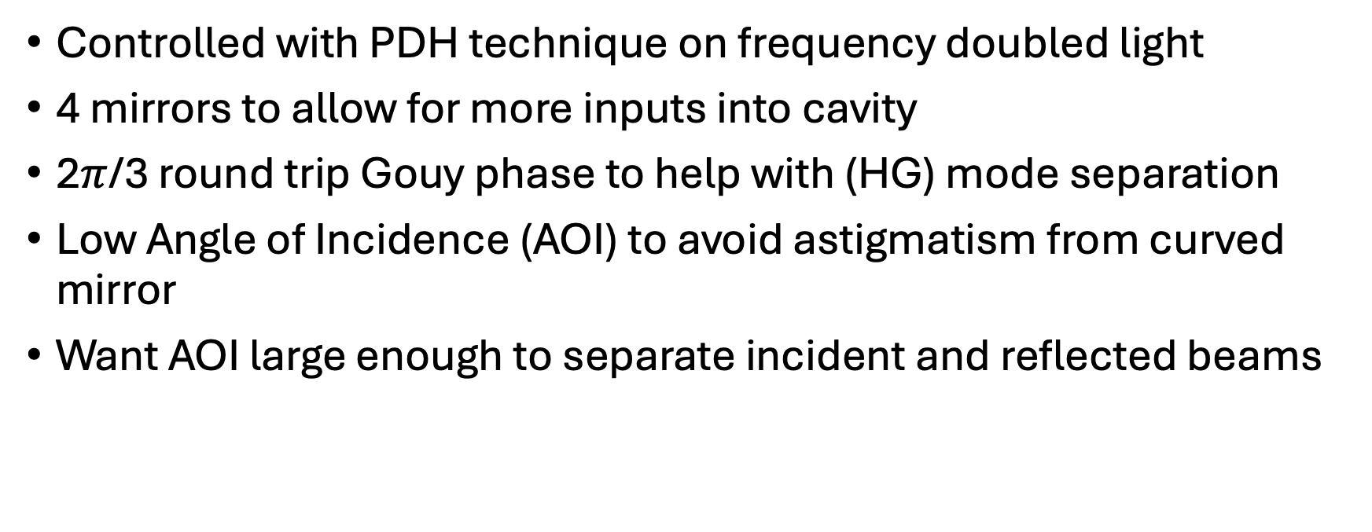
More high-level design choices
Controlled with PDH technique on frequency doubled light
4 mirrors to allow for more inputs into cavity
2$π$/3 round trip Gouy phase to help with (HG) mode separation
Low Angle of Incidence (AOI) to avoid astigmatism from curved mirror
Want AOI large enough to separate incident and reflected beams

Slide 10
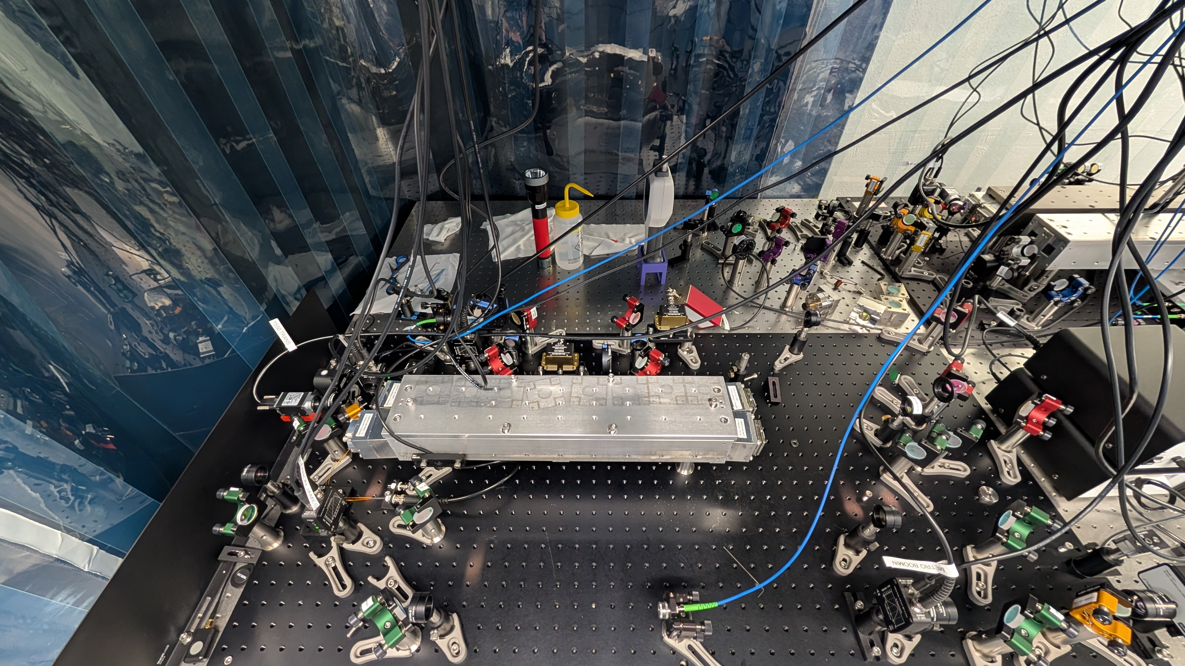
Practical Design Choices
Solid body to accurately set cavity length and reduce vibration noise
“Flexure mounts” to align mirrors
Enclosed body and black coating (not shown) to reduce stray and scattered light
Controlled with a piezoelectric chip (cannot use laser)
Novel design to avoid gluing ($1,000) mirrors to piezo

