Slide 1
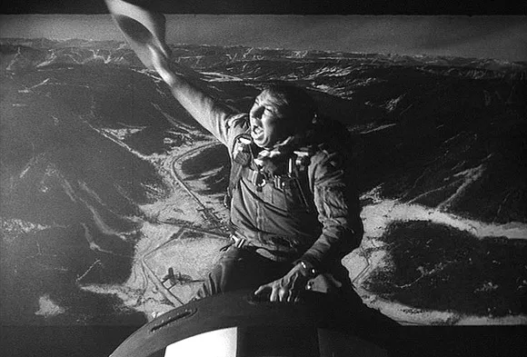
Dr. RbQ Or: How I Learned to Stop Worrying and Love Atoms

Slide 2
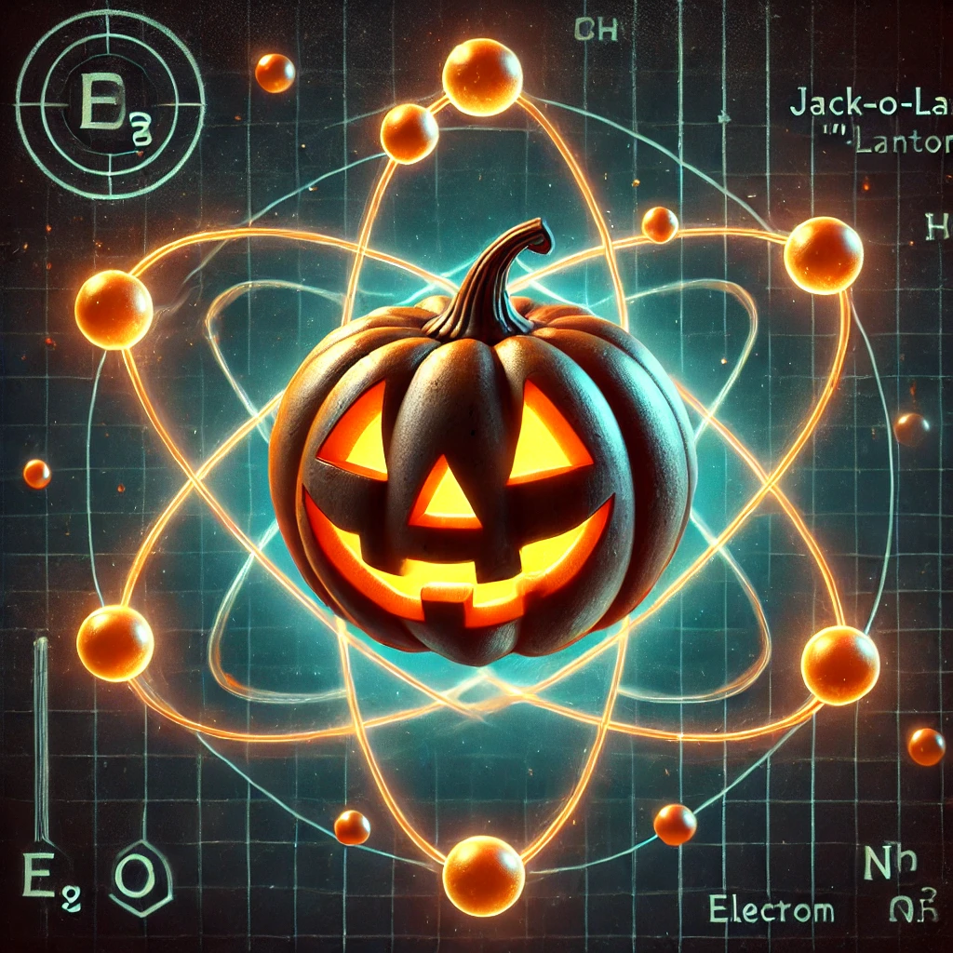
What can atoms do for us
What can atoms do for us?
?
State Injection
State Injection
Quantum Memory
Quantum Memory
Multiplexing Lorentzian Filtering and easier measurement
Multiplexing Lorentzian Filtering and easier measurement
Better Filtering
Better Filtering

Slide 3
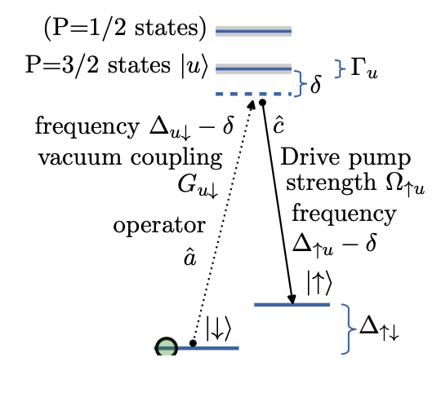
How?
Raman Transitions

Slide 4
Why cavities?
More interactions with interferometer output
Higher pump power
Can make standing waves

Slide 5
The final plan

Slide 6
Intermediate Steps
Demonstrate 3D MOT
Demonstrate Dipole Trap Conveyer

Slide 7
What we’re working on now
Cavity Design
Vacuum Chamber Procurement
Building the Demonstrator

Slide 8
Atomic Cooling Basics
Dipole Trap
Basic idea: oscillating field induces as oscillating dipole in the atom, which interacts with the oscillating field
Use red-detuned light to focus our atoms towards the intensity maximum
Cannot cool atoms
Magneto-Optical Trap (MOT)
Use (circularly polarized) red-detuned light to cool atoms
Magnetic Field Gradient provides Zeeman shift to favor trapping at the location of no magnetic field

